Slide 1
IMEC in Navolchi
Progress meeting, Dec. 2011

Slide 2
WP4 - Work
Initial focus of work:
Overall design (Weiqiang Xie)
Electrical injection: investigation of suitable layers (Pieter Geiregat)
Improvement of related processes (QDOT embedding, local deposition, ebeam process …)(Katarzyna Komorowska)
Stack of semiconducting oxide with QDot
Top-electrode
(forming plasmon waveguide)
Bottom Electrode
p-Si
H
Current flow

Slide 3
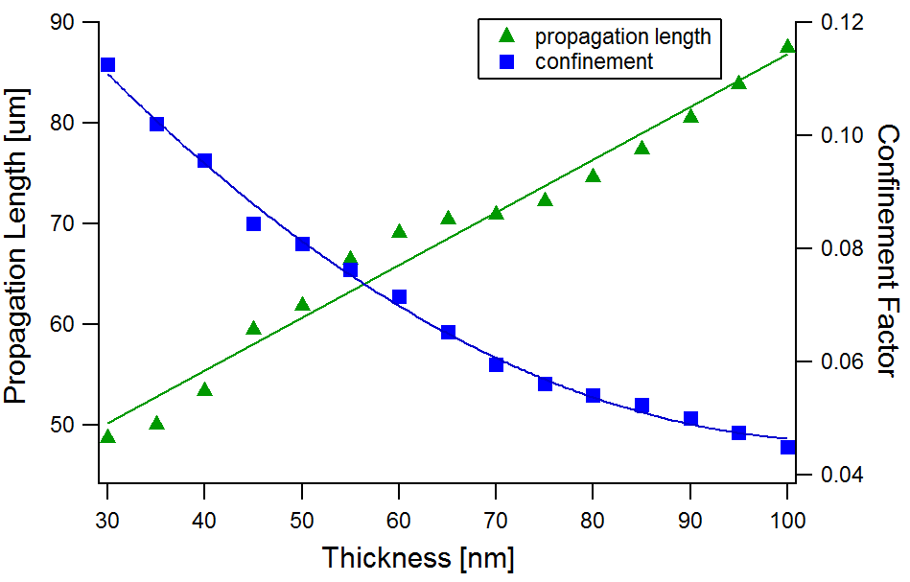
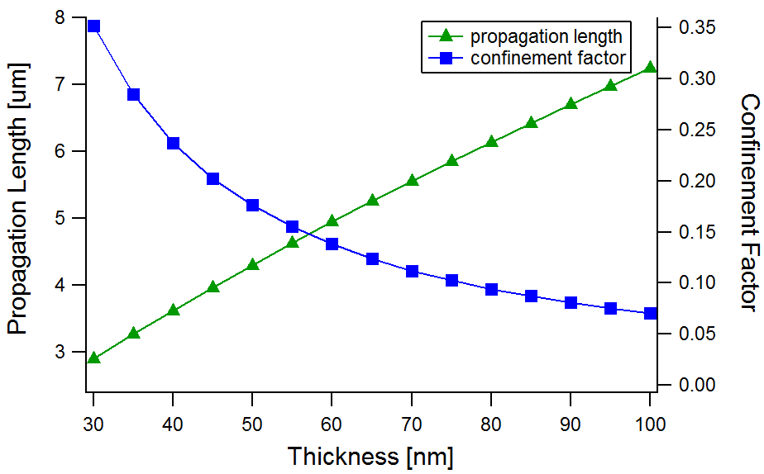
WP4 – Overall design
Silver: n = 0.14 + 11.36i
t
Oxide layers: n=2
Si: n = 3.445
Silica
Silicon
‘Hybrid metal-dielectric waveguide’
‘Strong TM character’

Slide 4
WP4 – Overall design
$$F_{p}=\frac{3}{4π}\frac{c/n}{v_{g}}\frac{(λ_{0}/n)²}{A_{eff}}$$
Purcell factor in 2D:
Cathode | Silver | Silver | a:Si
Anode | Gold | c-Si | c-Si
Fp | 33.9 | 7.12 | 5.8
FOM () | 0,23 | 0,36 | 31
Silver-Gold structure: High purcell effect due to large mode confinement, but large loss
a:Si-Si: Low purcell effect due to smaller mode confinement, but low loss
How to compare ? Figure of merit (FOM) = $\frac{F_{P}Γ}{α_{m}}$

Slide 5
WP4 – electrical injection
Created new samples with different n and p-type materials
IV-curves look promising
EL-measurements to be started

Slide 6
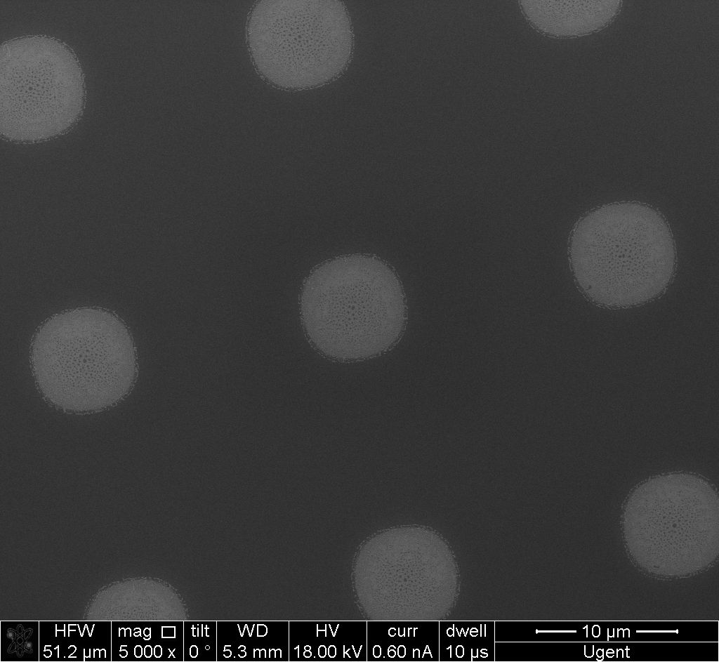
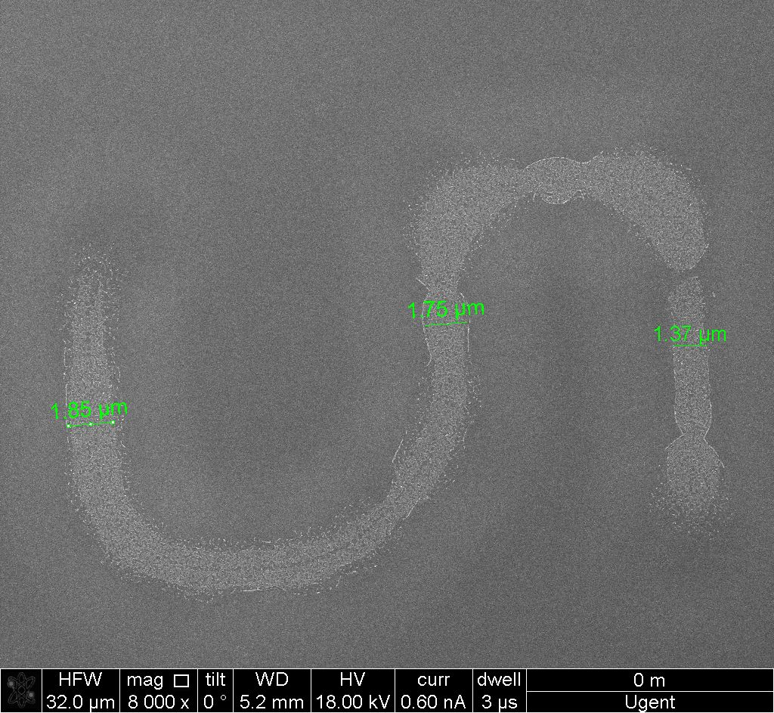
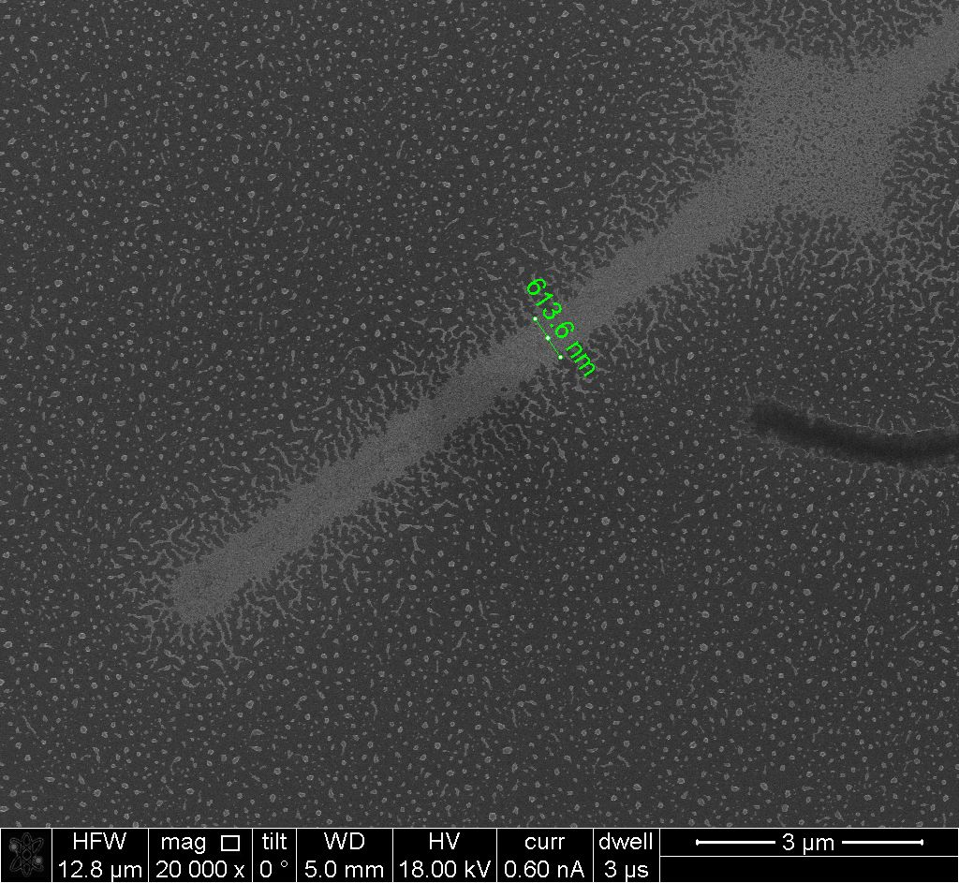
WP4 – Supporting processes
Different processes for local deposition of quantum dots
Negative photoresist + lift off (optical lithography)
Pretreatment of surface with anti-adhesion layer

Slide 7
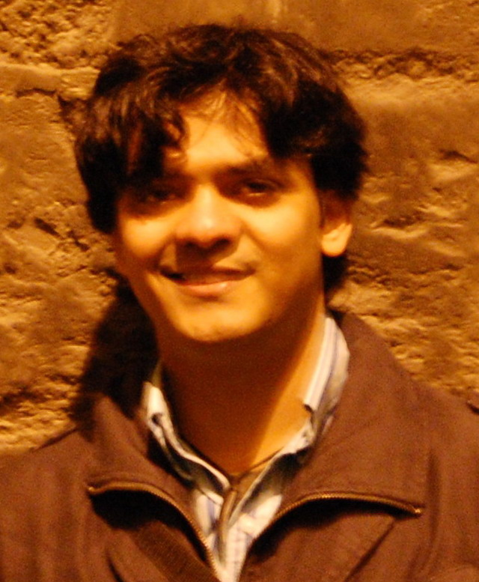
WP5 - work
Passive filter:
1st gen: 3nm bandwidth, 10dB suppression, 30nm FSR
options: ring resonator, AWG, PCG …
Beam steerer:
1st gen: 5dB loss, 100um distance
2nd gen: 3dB loss, 1mm distance, 10nm bandwidth
“Challenging”
Time line:
1st gen: Design (month 12, M5.3)→ Fabrication (month 18, M5.7) → characterisation (month 21, D5.3)
2nd gen: Design (month 24, M5.9) → Fabrication (month 30, M5.11) → Characterisation (month 33, D5.7)
NOT STARTED YET
Sukumar Rudra

Slide 8
UGent collaboraton
(Zeger Hens)

Slide 9
WP4 - work
Gain measurements on different materials planned for January
Synthesis of PbS/CdS dot in rod particles in progress

