Slide 1

Work on (planar) Plasmonic waveguides
Structure of the samples tested up to now
(a) (b) (c)
Different QDs filling factors: 0-10⁻³
Cladding provides amplification medium
Symmetric structure c would lead to longer plasmon-polariton propagation lengths due to refractive index matching of cladding layers.
PL and pump beam light can be coupled even from the top (due to roughness scattering at the Au layer?)

Slide 2

Work on (planar) Plasmonic waveguides
Experimental set-up with a tapered fiber to couple probe beam
PL and probe are superposed, but there is not light amplification at the availble laser pumping power and QDs.
Probe
PL

Slide 3
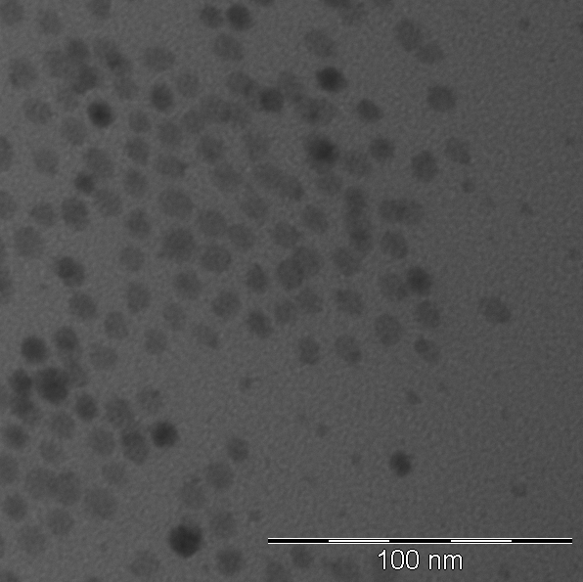
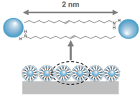
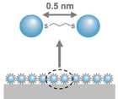
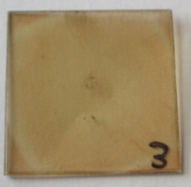


Work on synthesis of QDs for infrared PDs
1. Improvement of the synthesis of PbS to increase QY and stability.
2. Synthesis of PbS with absorption at around 1550 nm.
TEM
d = 10 ± 2 nm
3. Fabrication of multilayers of PbS QDs using LBL technique
Ligand Exchange
Spincoating
LbL
Oleyamin-capped
PbS QDs
QD monolayer
Ethanedithiol
HS-CH₂-CH₂-SH
QD monolayer
QD multilayer

Slide 4
Next planned work
New experiments
IV-VI QDs and core-shell nanorods as active medium in waveguides
Fabrication of stripe- plasmonic waveguides
Fabrication of infrared photodetectors using LbL method
We have a supercontinuun source in the range 600 – 1600 nm (and the pumping laser is a 20 μJ pulsed at 1064 nm that can be used independently for pumping QDs / nanorods.

