Slide 1
IMS R&D – Support Technologies Group
Optoelectronics, Photonics and
Si-technology Integration Group

Slide 2
Organization
Group VP, IMS R&D
General Manager
S. Coffa
Support Technologies
Group Manager
S. Leonardi
Group Assistant
V. Formica
Health & Energy
Integration
R. Giuffrida
Opto, Photonics and
Si-Tech Integration
E. Castagna
Smart Materials
M. Salanitri
(ST Group Deputy)
Energy Generation
and Harvesting
S. Leonardi (Acting)
Optical Architecture
Design
A. Piro (Consultant)
A. Lazzara
G. Catania
R. Zito
R. Giuffrida
A. Muscarà
S. Calamia
D. Panebianco

Slide 3
Group Organization and Mission
Optoelectronics, Photonics and Si-Technologies Integration
Design, integration, characterization and testing of optoelectronics and photonics technologies, components and architectures related with IMS R&D programs such as Healthcare and Energy Generation.
Start-up and upgrade of new electro-optical equipments.
Maintenance of the development of Si and Poly-Si technologies and devices.
E. Castagna
Techno Dev TL
SECT MGR
A. Muscarà
Techn Dev
SR ENG I
G. Catania
Techn Dev
JR ENG I

Slide 4
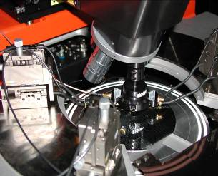
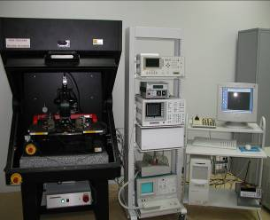
Optoelectronics Lab
Equipment overview
Probe station (1)
Probe station for temperature mesaurements (2)
Spreading Resistance Profile (3)
(1), (2) used for electro-optic characterization of devices and prototypes at room temperature and other various temperatures
(3) Used for doping profiles analysis

Slide 5
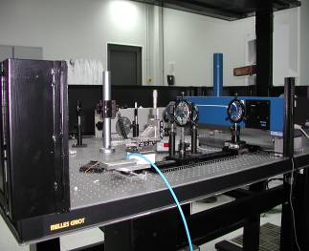
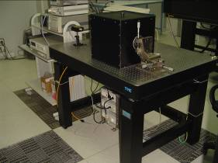
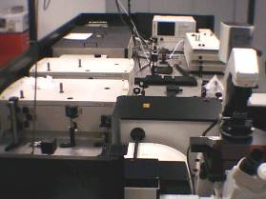
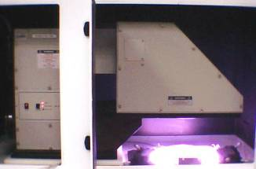
Photonics Lab
Equipment overview
Photoluminescence bench
Tsunami bench: Femto Laser
Solar Simulator
Waveguides characterization bench
“SiPM” characterization bench
Spectralight for illumination chatacterization

Slide 6
Main activities - Competences
Silicon based LEDs and LASERs
Integrated photodetectors on Silicon technology
Erbium doped planar waveguide amplifiers (EDWAs)
Integrated Silicon optical interconnect
Electro-optical devices characterization
Advanced equipments for devices fabrication, i.e. e-beam.

Slide 7
Possible contributions to NAVOLCHI
Support to all the partners for designing, manufacturing, testing and characterizing plasmonic devices
Willing to visit partners sites and labs
Willing to guest partners in ST Catania site
Realization and characterization of a demonstrator oriented to SiP applications
Benchmarking of plasmonics based solution versus alternative solutions

