Slide 1

Progress meeting
Victor Calzadilla
Meint Smit
Andrea Fiore
12/03/2012

Slide 2
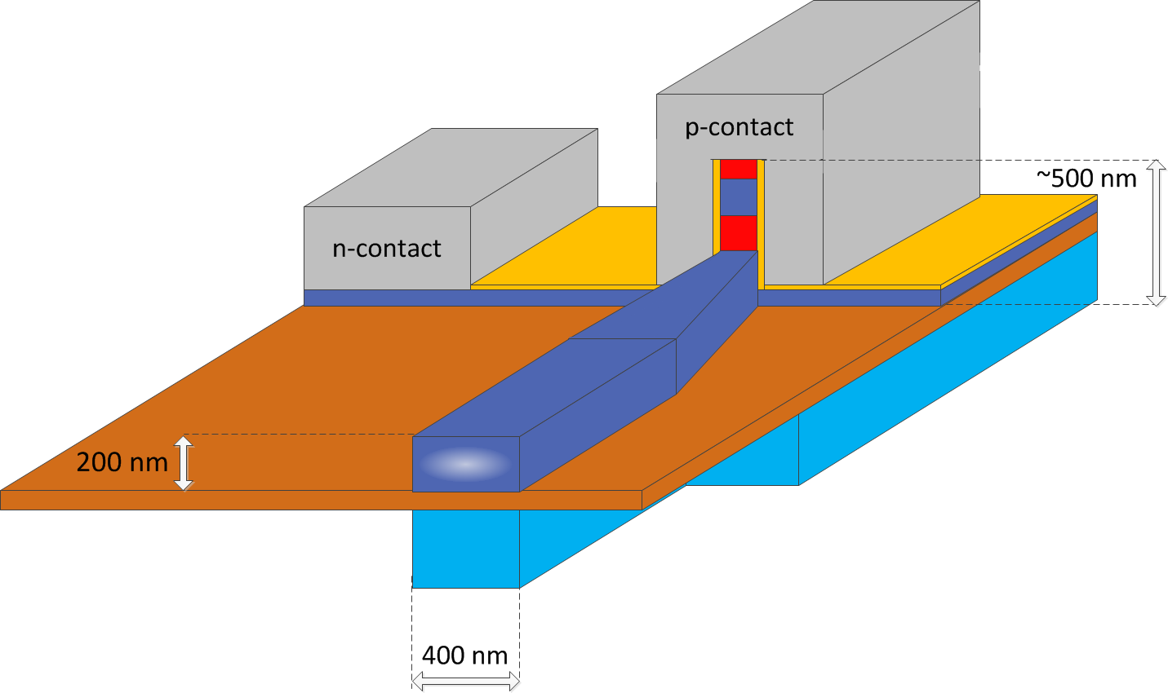


Current design
Desirable characteristics:
  Side emitting structure
  IMOS compatible
  Outcoupling to a Si-waveguide from an InP-waveguide
InGaAs
InP
Si
Ag
SiN
BCB

Slide 3
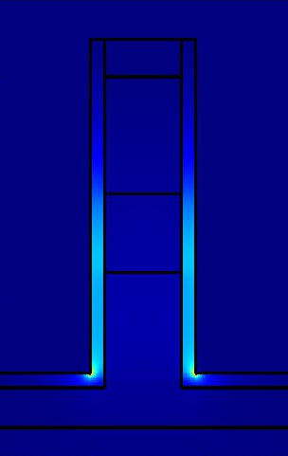
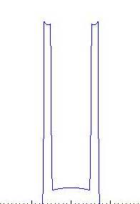
Optical mode properties
Intensity
Intensity cross-section
along core (horizontally)
Our interest focuses on a laser width of around 100 nm, which shows losses of 460 cm⁻¹
Investigations of the achievable gain in the nanometric active medium due to high current density are required.

Slide 4
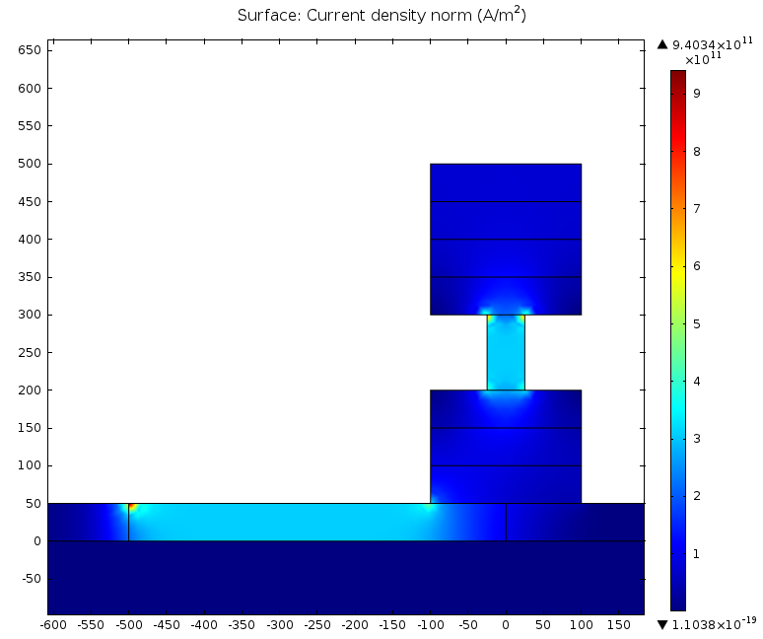
Currently: Electrical simulations
Simulations to calculate the current density and then estimate the InGaAs material gain are being carrier out. This model is based only in the conductivities of the layers with different doping.
p-contact
Voltage = 10 V
Next activities: properly estimate the material gain and then the final design of the structure.
n-contact

