Slide 1
NAVOLCHI TeleConf. 02.04.2012
Institute of Photonics and Quantum Electronics (IPQ), Karlsruhe, Germany
Institute of Microstructural Technology, Karlsruhe, Germany

Slide 2
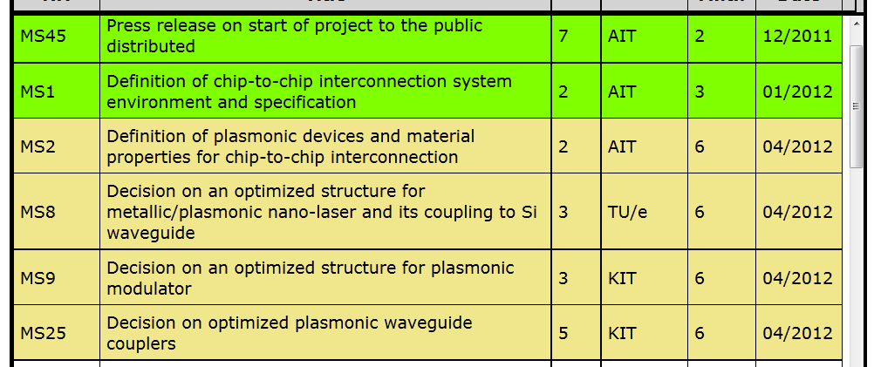
Upcoming Milestones

Slide 3
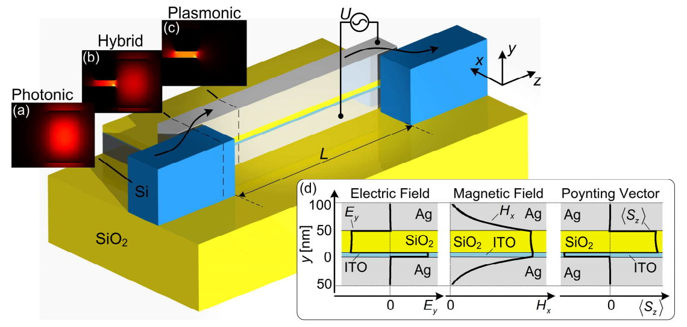
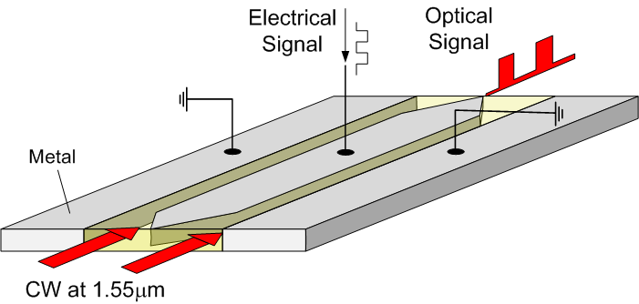
Absorption Modulator vs Phase Modulator
Surface Plasmon Polariton Absorption Modulator
Surface Plasmon Polariton Phase Modulator

Slide 4
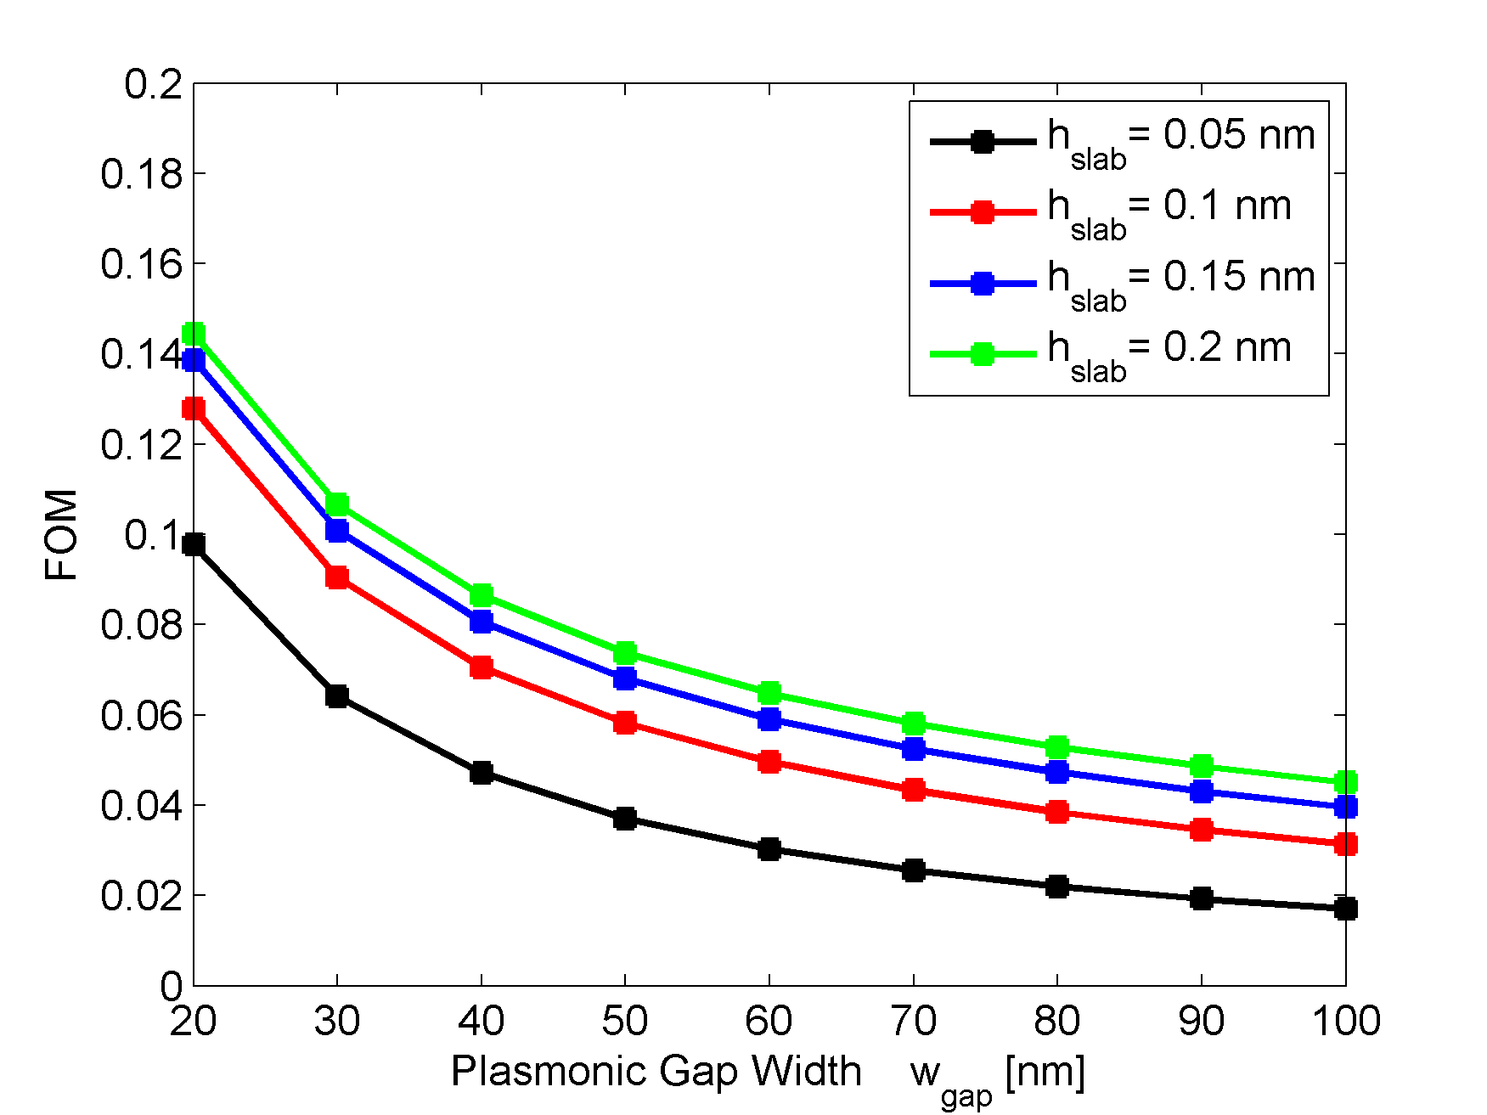
Absorption Modulator vs Phase Modulator
Surface Plasmon Polariton Absorption Modulator
Surface Plasmon Polariton Phase Modulator

Slide 5
Optimized Couplers
Tapered Coupling

Slide 6
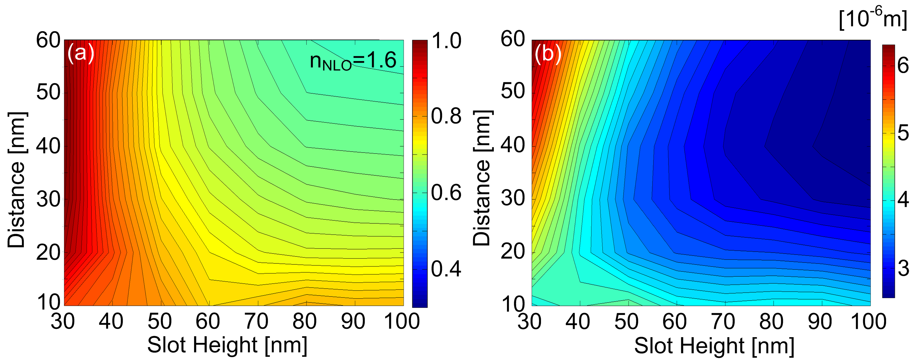
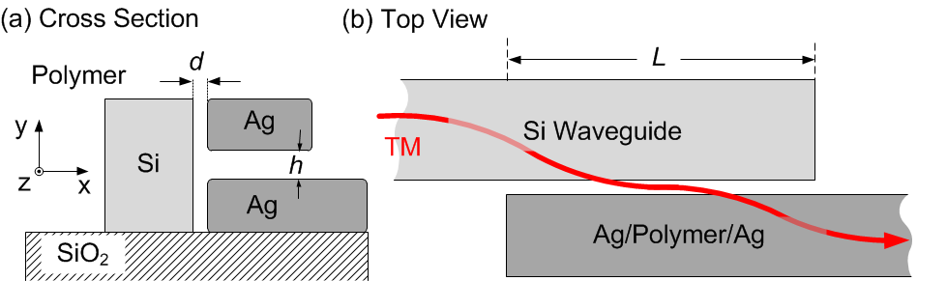
Optimized Couplers
Coupling efficiency
Coupling Length
Side Coupling

