Slide 1

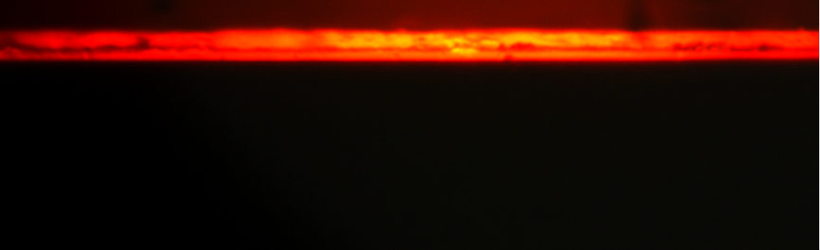
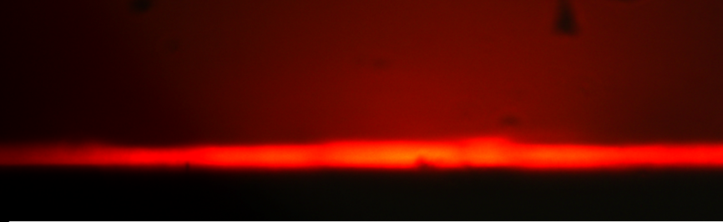
CdSe-PMMA waveguides
Dielectric and plasmonic CdSe-PMMA waveguides
Maximum gain obtained of to 20 cm⁻¹, but losses around 30 cm⁻¹
Close to amplification but it needs more powerful laser or more efficient nanostructures
Similar spectra with and without gold

Slide 2
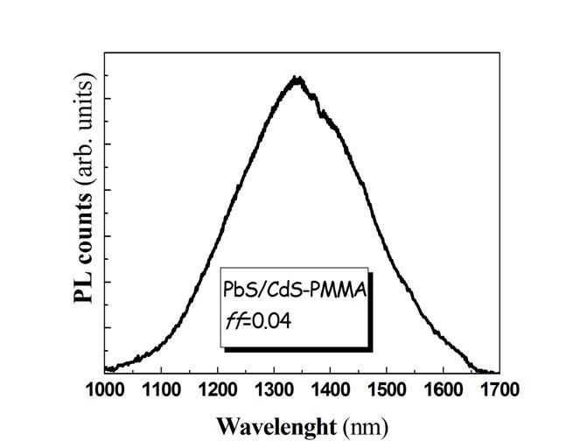
PbS/CdS-PMMA waveguides
PbS-CdS quantum rods developped by UGENT
Broad band with emission between 1100 and 1600 nm
High stokes-shift
Good efficiency

Slide 3
PbS/CdS-PMMA waveguides
Quantum rods-PMMA nanocomposites
filling factor | 404 nm | 633 nm | 1060 nm | waveguided PL
8·10⁻⁴ | yes | yes | yes | no
8·10⁻³ | no | yes | yes | yes
4·10⁻² | no | no | no | yes

Slide 4
PbS/CdS-PMMA waveguides
Pumping power dependence
Low concentration shows saturation due to the filling of quantum dots states, but a higher concentration is close to amplify!!

Slide 5
PbS/CdS-PMMA waveguides
Gain and losses characterization
Gain
Losses
Increase of gain/losses with ff due to QD emission/reabsorption and scattering

Slide 6
New approaches
to get amplification
Increase QR concentration (with the expenses of optical losses)
Pumping with a high power Nd:Yag laser (1060 nm)
Plasmonic waveguide
Deposite nanocomposite on a gold film
Stripe to improve confinement

Slide 7
Papers and conferences
Poster presentation at ECIO conference (17-20 april)
ICTON paper submitted (in collaboration with AIT)
Emmanouil Panagiotis (AIT) will visit our labs nest week

