Slide 1
Navolchi Telco – 7 May 2012 Part 1 : Beam Steering
Sukumar Rudra, Dries Van Thourhout, Kasia Komorowska

Slide 2
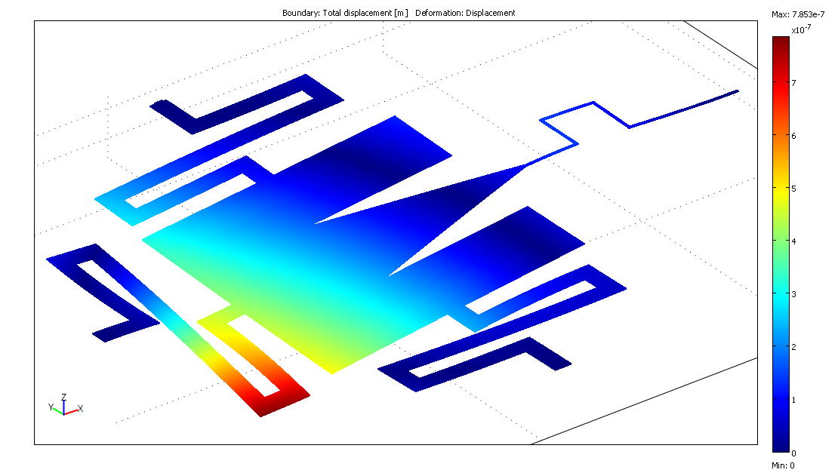
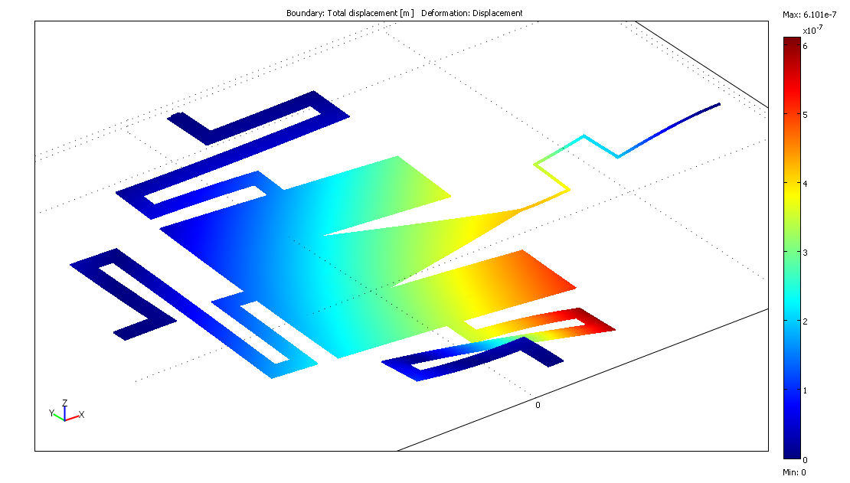
Beam steering
Proposed structure: grating coupler on movable MEMS platform
3 electrodes allow applying force in 3 directions
Comsol simulation
Back pad actuation
Side pad actuation

Slide 3
Beam steering
Processing:
Underetching initially not controllable – currently OK
Fiber Characterisation:
Change in power + central wavelength measured when applying voltage
Device dependent (sometimes increase, sometimes decrease)
Change not in line with predictions
Back pad
Side pad

Slide 4
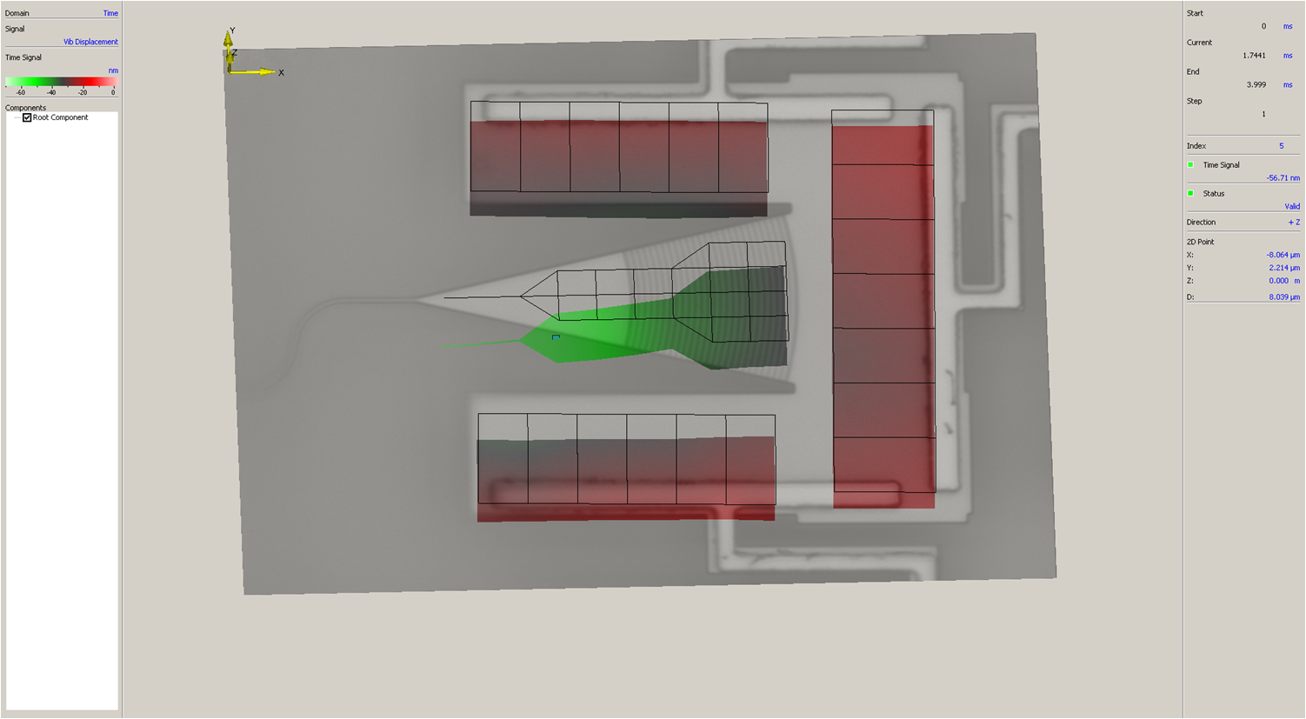
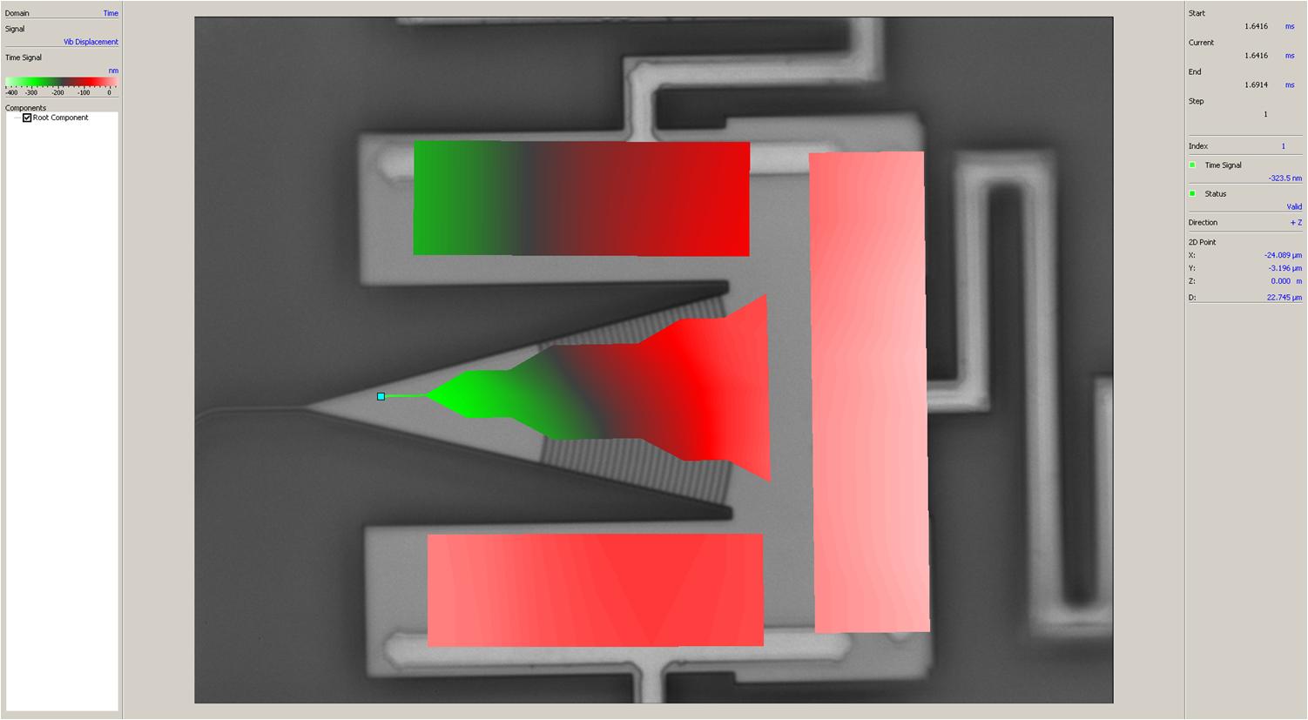
Beam steering
Measurements using Laser Doppler Vibrometry
Gives image of displacement
No difference seen between side and back pad actuation
Always tilt to front – Discrepancy with fiber based measurements
Back pad
Side pad
Green = low -- Red = High
Next step
Reprocessing current samples
Designed new version with simpler structure

Slide 5
Navolchi Telco – 7 May 2012 Part 2 : Amplifier: current injection
Physics and Chemistry of Nanostructures Group
Floris Tailleu, Kasia Komorowska, Pieter Geiregat, Zeger Hens, Dries Van Thourhout

Slide 6
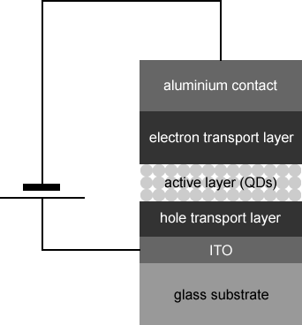
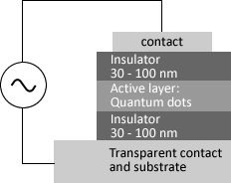
Two ways of inducing e-h recombination in the QDs
Direct charge injection
Field-driven ionization (“isoLED”)
1
2
AC voltage
up to 100 V
peak to peak
DC voltage
up to 10 V
Alumina
ALD

Slide 7
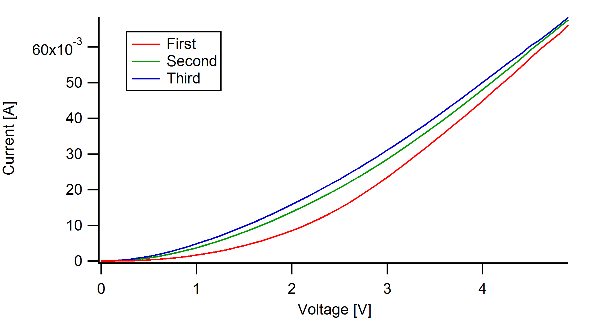
Current-voltage characteristic by direct charge injection
1
Multiple reasons for unsuccessful measurements and irreproducibility
High concentration of free carriers
Quenching of the electroluminescence by non-radiative processes (especially Auger)
Could be solved by adding an insulating layer between the quantum dots and the electron transport layer (ETL)
Charging of the quantum dot layers
Imbalance of number of injected electrons and holes
Could be solved by adding an insulating layer in the ETL:
Wide band gap material induces additional energy barrier for the electrons
Repeated IV-measurements on same sample
No successful light emission have been measured

Slide 8
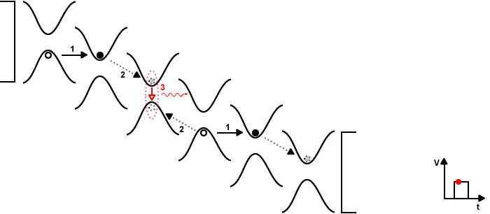
Field-driven ionization: theoretical approach
2
Influence of
external electric field
Influence of
remaining internal field

Slide 9
IsoLED electroluminescence results
2
Applied block pulse (20 kHz) at V_{pp} = 100 V and corresponding EL intensity
Resulting EL spectrum
Good correspondence
with PL spectrum
Persistent light emission, clearly visible by eye

