Slide 1

Progress meeting
Victor Calzadilla
Meint Smit
Andrea Fiore
07/05/2012

Slide 2
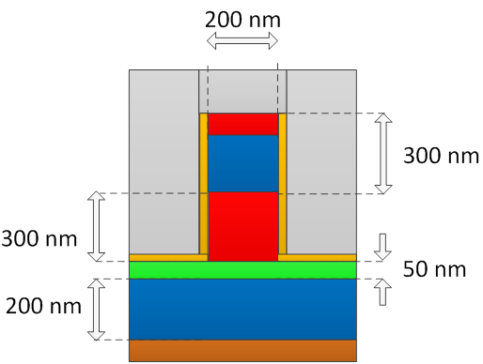
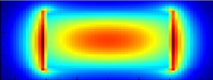

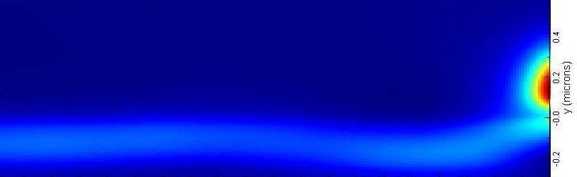

Coupling by an open facet
Reflection and outcoupling coefficients
|E|
Longitudinal cross-section:
|E|
At 1.5 um:
  Reflection ~ 60%
  Coupling ~ 20%
  Radiation loss ~ 30%

Slide 3
Butt coupling
Reflection and outcoupling coefficients
Longitudinal cross-section:
For < 1.4 um:
  Reflection ~ 5%
  Coupling ~ 90%
  Radiation loss ~5%

Slide 4
Specifications and final comments
Expected specifications (at cryogenic temperatures)
  Driving voltage > 1.5 V
  Current > 1mA (above 3 mA at room temperature)
  Device length > 10 um
  Output power = 100 uW ± 90uW
Milestone 3.1: Decision on an optimized structure for metallic/plasmonic nano-laser and its coupling to a Si-waveguide
  It has been postponed 1 month (to be reached next TelCo)
  Currently investigating different coupling schemes
  The best coupling scheme will determine the final structure and layer stack

