Slide 1
Navolchi Telco – 4 June 2012
(including input UGent

Slide 2
Summary
1) Characterisation of interaction QDOTS with silicon waveguide
2) Build proposed amplifier with different top contacts
3) Preparing new QDOTS for Valencia
4) New QDOT-gain characterization planned (collaboration with TUDelft)

Slide 3
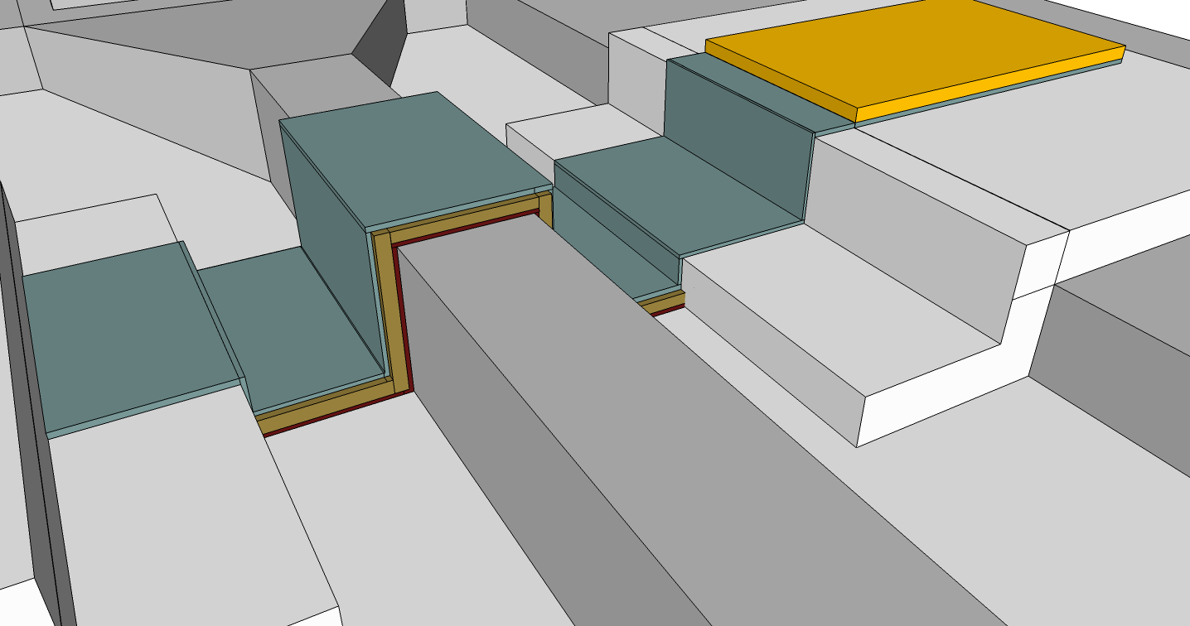
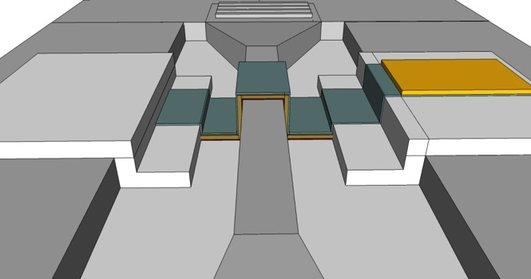
Gold Contact Pad
Top electrode
Al2O3
Quantum Dots
SiO2
Silicon waveguide
Total stack thickness is approximately 90nm

Slide 4
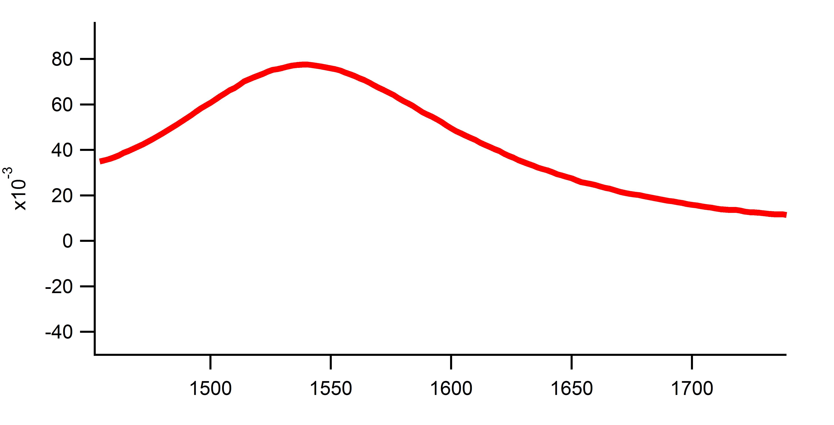
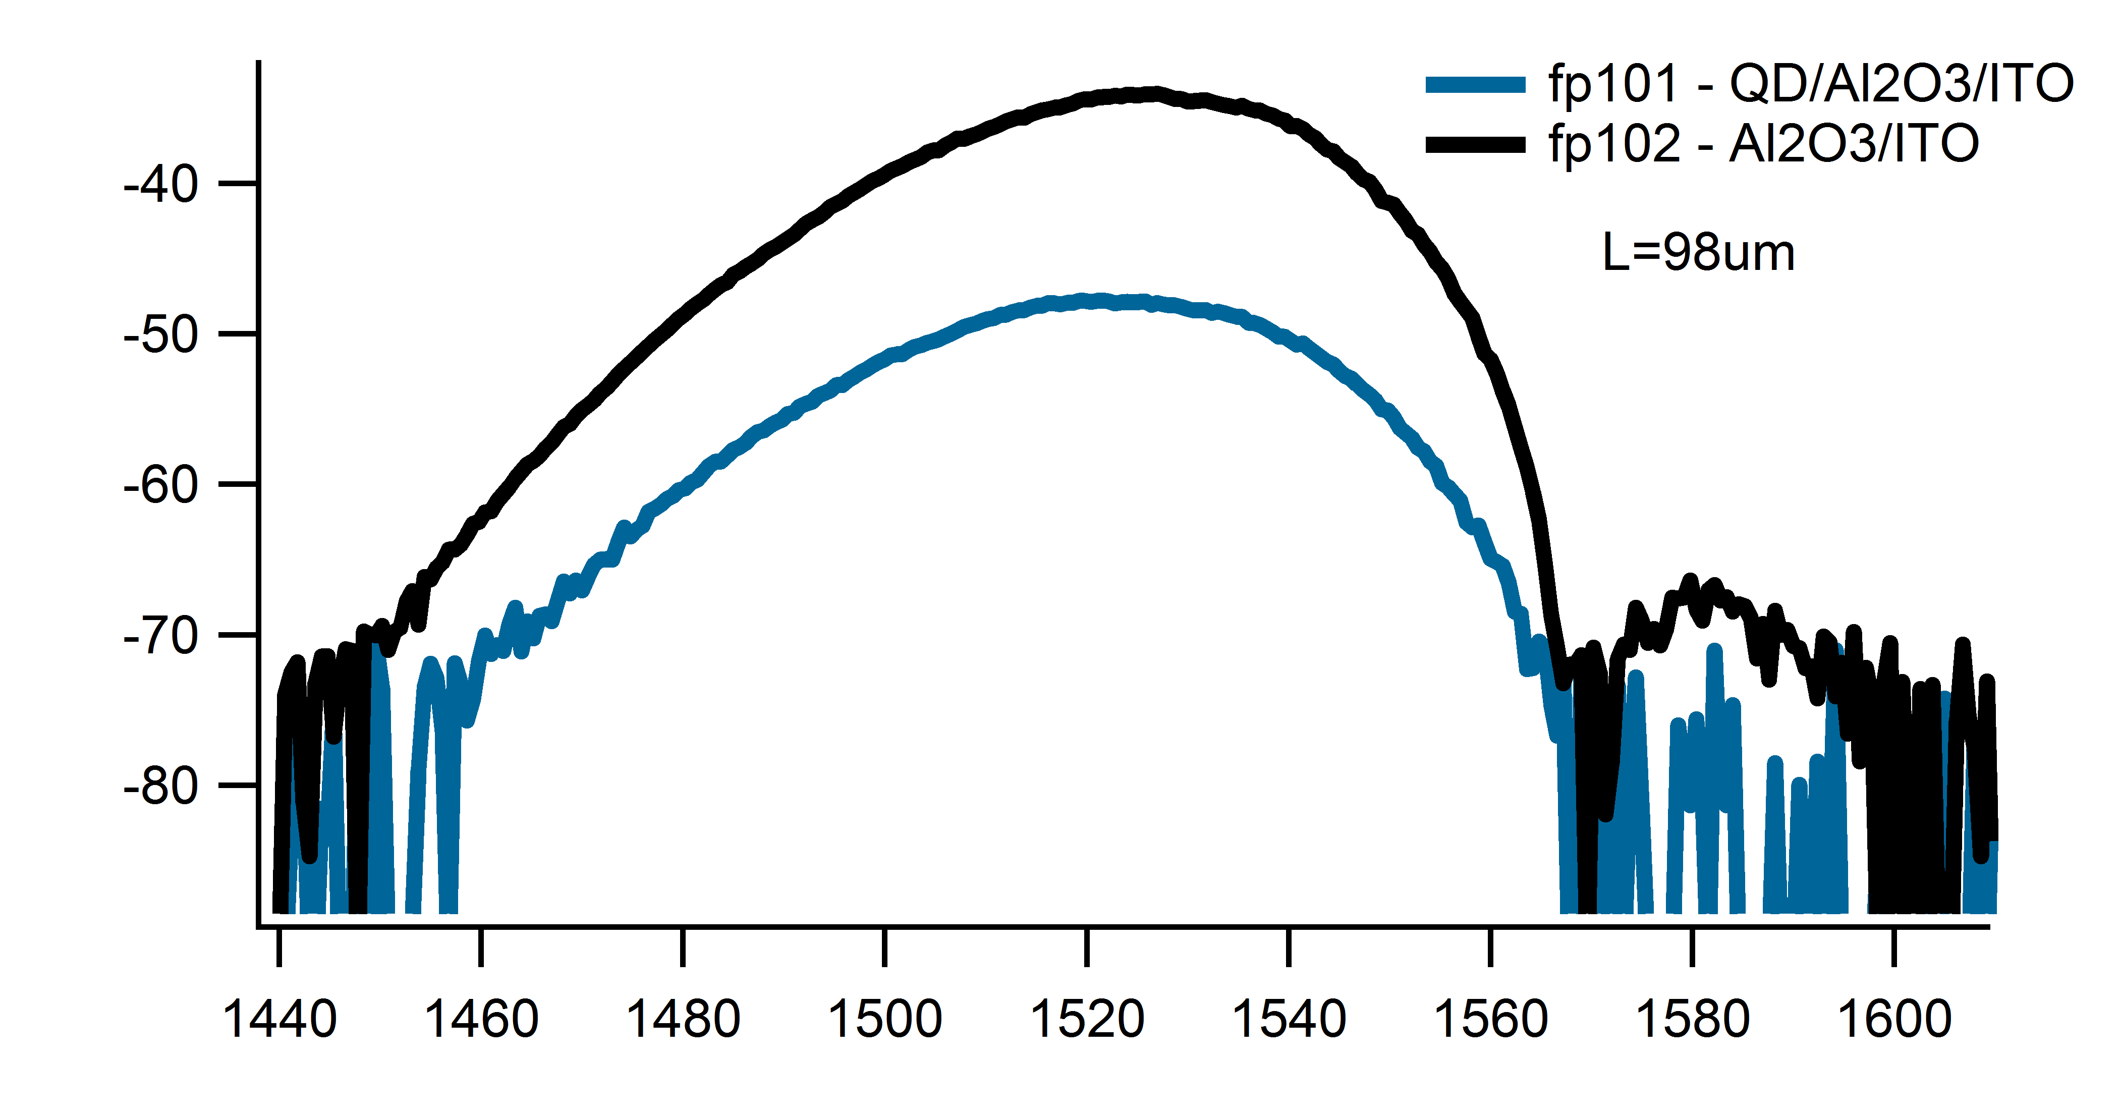
Using ITO top-contact
Absorption of PbS in solution
Qd/al2o3/ito – al2o3/ito

Slide 5
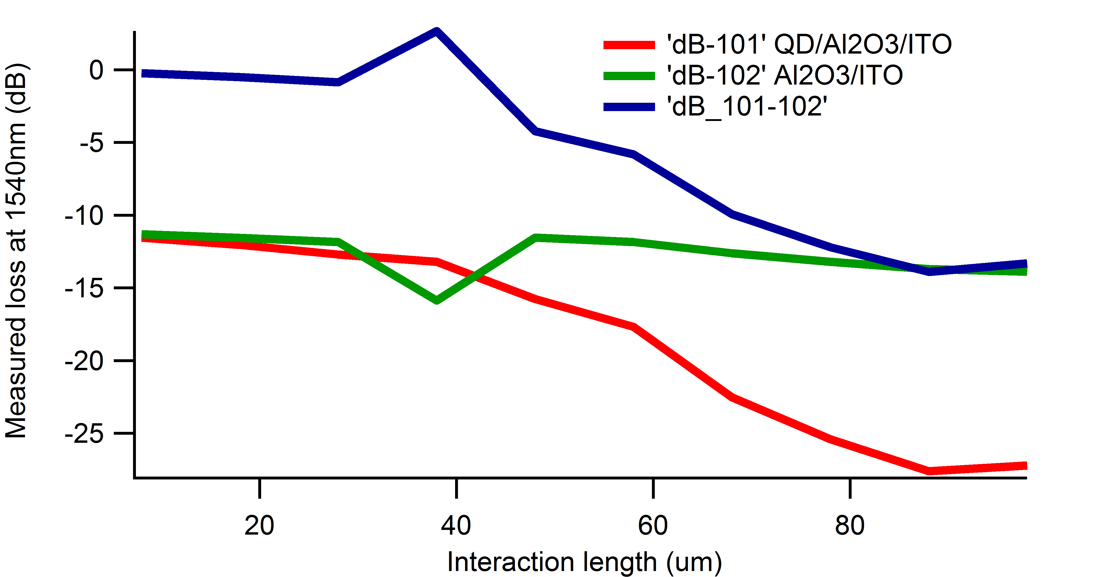
Using ITO as top contact
Difference
ITO only
ITO + QDOTS
Clear effect of QDOTS, absorption ± 200/cm

