Slide 1

Milestone 3.1:
Optimized structure for metallic/plasmonic nano-laser and its outcoupling
Victor Calzadilla
Meint Smit
Andrea Fiore

Slide 2
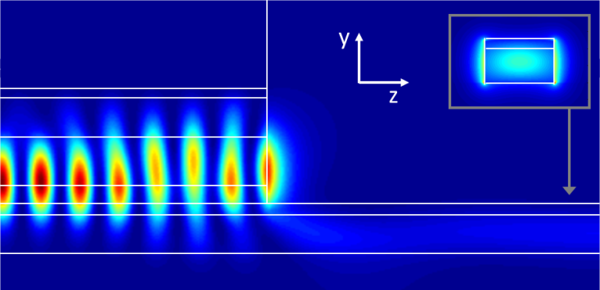
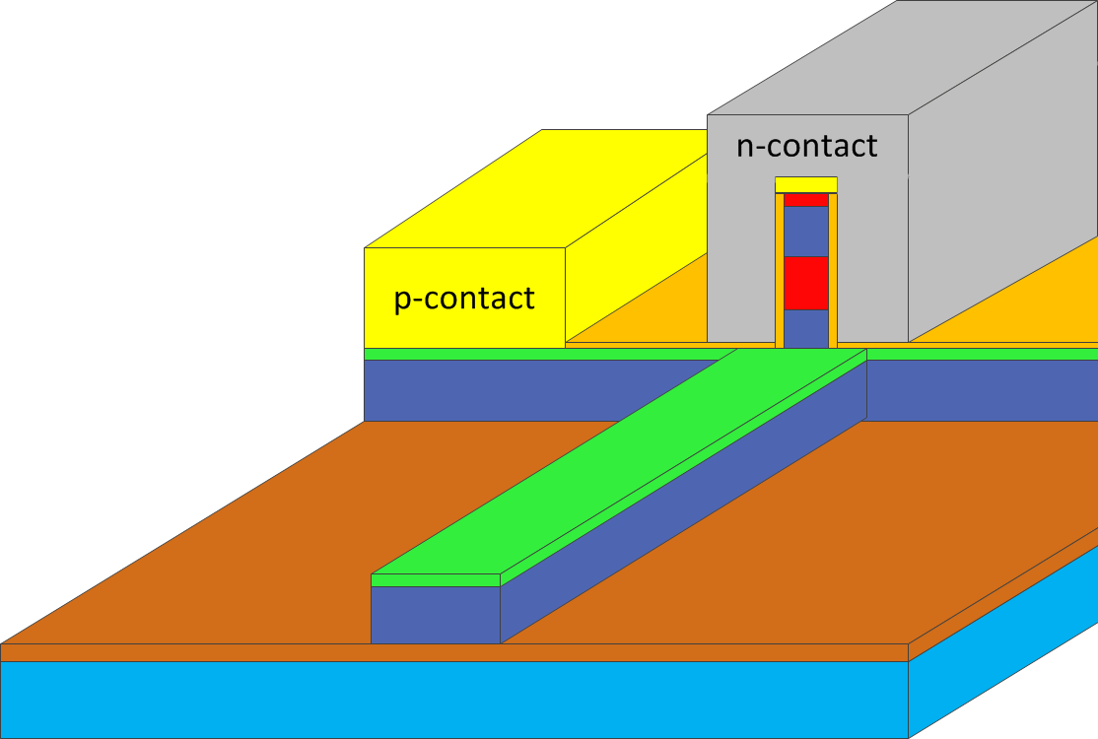
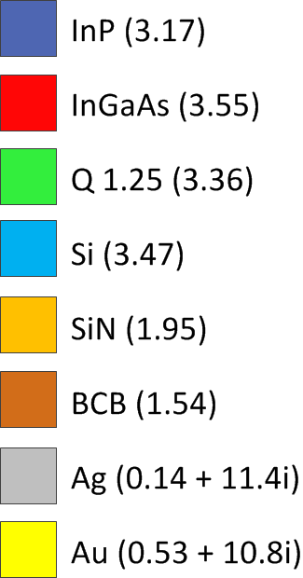


Coupled laser structure
The structure allows for outcoupling through an open facet
The IMOS waveguide can be tapered horizontally to push down the mode to the Si-waveguide afterwards
$${\left|E\right|}^{2}$$

Slide 3
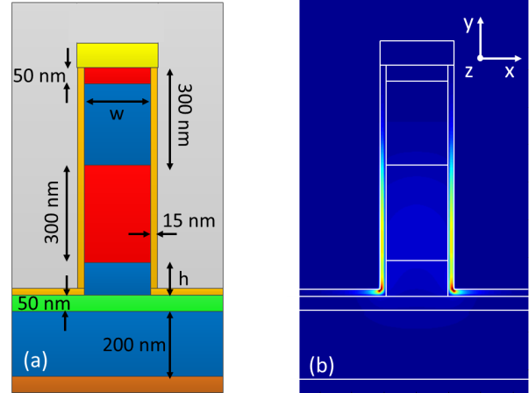

Modal distribution
$${\left|E\right|}^{2}$$
The width w has an influence on the confinement and propagation loss
The post height h determines the facet reflectivity and outcoupling
Decreasing the thickness of the insulation layer leads to a better confinement, however the propagation loss is also increased

Slide 4
Influence of width and post height
When the post height increases, both the confinement and propagation loss decrease, due to the presence of BCB (low refractive index)

Slide 5
Reflectivity and outcoupling
Reflectivity increases for a higher post height, however it is limited to the reflectivity given by the interface InGaAs-air
A full metal termination provides R ~ 0.98
The outcoupling decreases for a higher post height, since the vertical distance between the plasmonic mode and the dielectric waveguide is increased

Slide 6
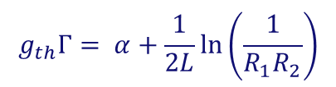

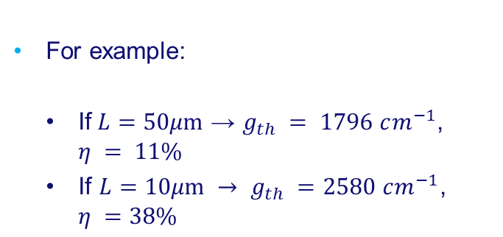
Threshold gain and internal efficiency
Considering $w=200 nm$, $h =100 nm$, then $α=0.16 dB/μm$, $Γ=0.23$, $R_{1}= 0.65$, $R_{2}=0.98$, what leads to:
$$g_{th}Γ= α+\frac{1}{2L}\ln\left(\frac{1}{R_{1}R_{2}}\right)$$
$$η=\frac{mirror loss}{total cavity loss}$$
For example:
  If$L=50μm$ → $g_{th} = 1796 cm^{−1}$, $η = 11\%$
  If $L=10μm → g_{th} =2580 cm^{−1}$, $η =38\%$

Slide 7
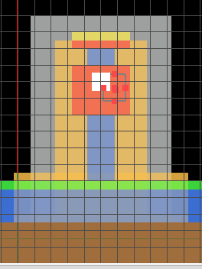
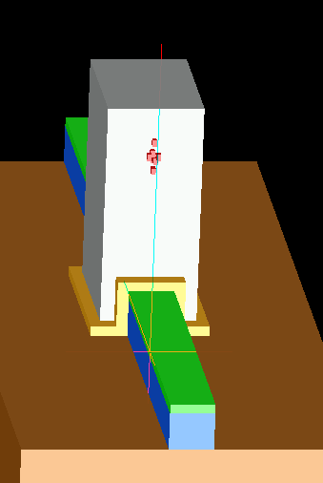
Alternative structure
A better performance can be obtained by increasing the width of the waveguide-like cavity
However, for a width ~ 350 nm dielectric modes start to exist, which have better characteristics in terms of confinement factor and metal loss. Therefore we plan to investigate alternatively wider cavities but much shorter. Such cavities would couple the light out by evanescent field through the bottom interface:

