Slide 1



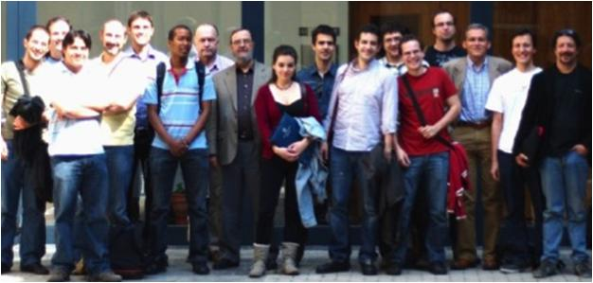
Unit of Materials and Optoelectronic Devices
University of Valencia
www.uv.es/umdo

Slide 2
Role in the project
Plasmonic amplifiers by using polymers doped with QDs
(Task 4.1, 4.3, 4.4, 5.1)
Design of plasmonic amplifiers
Light coupling to metal waveguides and plasmon propagation / amplification
Demonstration of amplification in polymer thin films / stripes
Fabrication of metal nanostructures based on patternable metal-polymer nanocomposites
Plasmon/Photon-Plasmon Photodetectors based on QDs and metal nanostructures
(Task 4.2, 4.5)
Stacks of QDs (layer-by-layer method) for photoconductors/photodetectors
Patternable conductive polymers with added plasmonic capabilities
2/14

Slide 3
Plasmonic Amplifiers
Previous work
Planar plasmonic (and dielectric) waveguides using a QD-PMMA nanocomposite as active layer
Asymmetric structure
Symmetric structure
t=30 nm
d=1-2 µm
CdSe QDs from Valencia λ=600 nm
PbS-CdS QRs from UGENT λ=1300 nm
3/14

Slide 4
Plasmonic Amplifiers
Previous work
Design of the plasmonic amplifiers in colaboration of AIT (task 4.1)
Light coupled to the waveguide using a fiber tip or pumping the QDs (task 4.4)
Gain/losses characterization using the variable stripe length method (VSL)
(tasks 4.3-4.4)
4/14

Slide 5
Plasmonic Amplifiers
Objective
Plasmonic gain at 1400-1500 nm
New approaches
Model to fit the data
Dielectric and plasmonic waveguides using QRs from U-GENT
New plasmonic waveguide designs
5/14

Slide 6
Plasmonic Amplifiers
Model
PL measured as a function of the pumping length (VSL method)
I_{SS}=Spontaneous emission intensity
g= gain
α= losses
I(x)=light intensity
g,I_{SS}≠f(x)
It can fit the gain, but it doesn’t take in account saturation observed experimentally
6/14

Slide 7
Plasmonic Amplifiers
Model
PL measured as a function of the pumping length (VSL method)
I_{SS}=Spontaneous emission intensity
g= gain
α= losses
I(x)=light intensity
L=Auger time·Speed of light
Saturation due to Auger effect (APL, 86,073102,2005)
Gain and spontaneous emission proportional to the shape of the laser
7/14

Slide 8
Plasmonic Amplifiers
New QRs from UGENT
Nanostructures mixind in PMMA with filling factors between 0.01 and 0.08
PbS-CdS partially exchanged rods PER
PbS-CdSe dots in rod
Absorption: UV-800 nm
PL: 800-1400 nm
Absorption: UV-1400 nm
PL: 1000-1600 nm
8/14

Slide 9
Plasmonic Amplifiers
PbS-CdS PER from UGENT
Dependence on pumping power
Small narrowing and saturation with high pumping powers
Dependence on stripe length
New model fits well the experimental data with high at x=0, but it decreases exponentially (L=100-150 µm)
9/14

Slide 10
Plasmonic Amplifiers
PbS-CdSe QRs from UGENT
Dependence on pumping power
Narrowing at short wavelengths and saturation with high pumping powers
Dependence on stripe length
High at x=0, but also higher losses sue to the short Stokes-shift
Report will be sent to GENT
10/14

Slide 11
Plasmonic Amplifiers
New designs
Cladding layer to isolate plasmonic and photonic modes.
Thicker cladding layers don’t change the gain but decrease the losses (CdSe-PMMA)
11/14

Slide 12
Role in the project
Plasmonic amplifiers by using polymers doped with QDs
(Task 4.1, 4.3, 4.4, 5.1)
Design of plasmonic amplifiers
Light coupling to metal waveguides and plasmon propagation / amplification
Demonstration of amplification in polymer thin films / stripes
Fabrication of metal nanostructures based on patternable metal-polymer nanocomposites
Plasmon/Photon-Plasmon Photodetectors based on QDs and metal nanostructures
(Task 4.2, 4.5)
Stacks of QDs (layer-by-layer method) for photoconductors/photodetectors
Patternable conductive polymers with added plasmonic capabilities
12/14

Slide 13
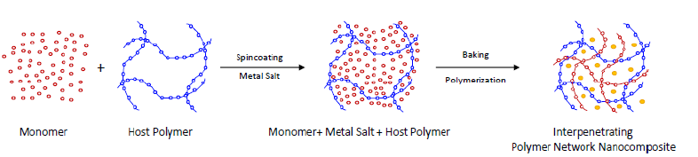
Plasmonic PCPs for photodetection
In-situ synthesis of PCP and Au NPs based on PMMA and Novolak showing plasmonic properties.
 | Conductivity (S/cm) |  | Gain due to PC
exposure time (min) | No laser | Laser at 533 nm
0 | 6,43518599 | 6,47054798 | 0.54951 %
10 | 1,23971956 | 1,23971956 | 0.00000 %
30 | 0,03181512 | 0,03241319 | 1.87983 %
120 | 1,45812591 | 1,45812764 | 0.00012 %
1200 | 2,91537706 | 2,91537706 | 0.00000 %
x 3.5
Dedoping (reduction) by exposing the film Au/3T/PMMA to hydrazine vapor
13/14

Slide 14
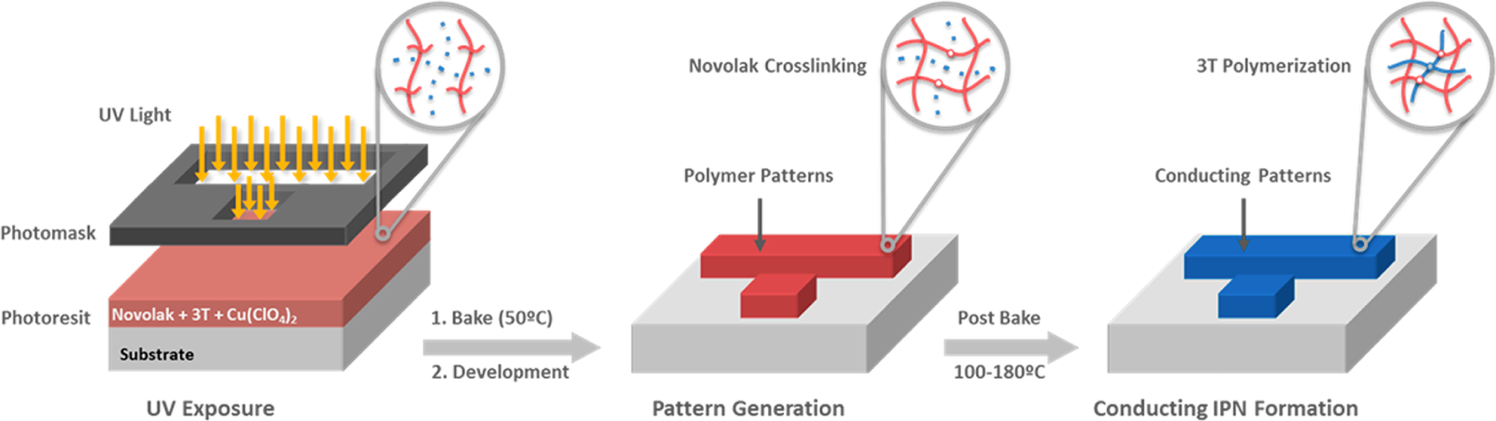
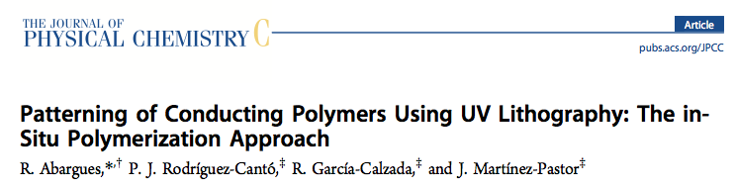
PCPs for photodetection
Development of Patternable Conductive Polymers –Recent Publication
Phys. Chem. C 2012, 116, 17547−17553.
Development of QDs-Solid for Photodetectors
Along with the PbS-based layer stacks, we just started working on the synthesis of CdSe/ZnS CS
colloidal nanostructures and fabrication layer stacks by using a LbL approach.
14/14

