Slide 1
Progress meeting
Victor Calzadilla
Meint Smit
Andrea Fiore
03/09/2012

Slide 2
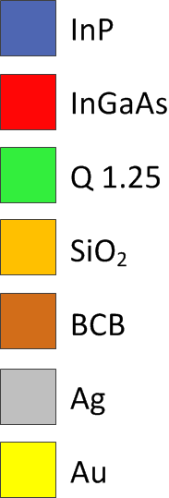
Metallo-dielectric nanolaser

Slide 3
Layer stack of first wafer
Laser
Waveguide

Slide 4
Approach 1
EBL 1: Ridge
EBL 2: Laser and waveguide definition
Self-aligned structure!

Slide 5
Approach 2
EBL 1: Laser
EBL 2: Waveguide
Better performance!

Slide 6
Plans
Determination of dosis for bilayer resist (HPR + HSQ)
Measurement of roughness of SiO2 to check out whether it can be used or not
Experiments: etching of the pillar
Experiments with the wet etching to achieve undercut

