Slide 1



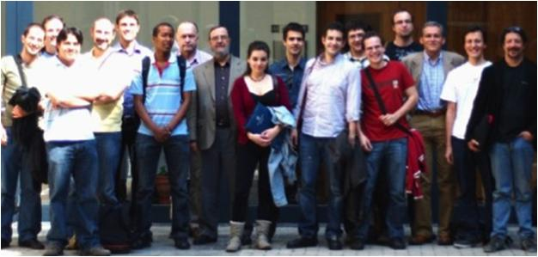
Unit of Materials and Optoelectronic Devices
University of Valencia
www.uv.es/umdo

Slide 2
Role in the project
Plasmonic amplifiers by using polymers doped with QDs
(Task 4.1, 4.3, 4.4, 5.1)
Design of plasmonic amplifiers
Light coupling to metal waveguides and plasmon propagation / amplification
Demonstration of amplification in polymer thin films / stripes
Fabrication of metal nanostructures based on patternable metal-polymer nanocomposites
Plasmon/Photon-Plasmon Photodetectors based on QDs and metal nanostructures
(Task 4.2, 4.5)
Stacks of QDs (layer-by-layer method) for photoconductors/photodetectors
Patternable conductive polymers with added plasmonic capabilities
2/11

Slide 3
Plasmonic Amplifiers
CdSe QDs (600 nm)
Model applied to previous measurements
d=1-2 µm
t=30 nm
I_{SS}=Spontaneous emission intensity
g= gain
α= losses
g₀ increases with ff, but also losses due to reabsorption
3/11

Slide 4
Plasmonic Amplifiers
QRs from UGENT (IR)
Three types of nanostructures
  PbS/CdS QRs
  PbS/CdS PER QRs
  PbS/CdSe QRs
New characterization and modelling of dielectric and plasmonic waveguides as function of the filling factor
Report sent to UGENT and IMEC for discussion
4/11

Slide 5
Plasmonic Amplifiers
PbS/CdS QRs (IR)
ff=0.04
PL: 1000-1700 nm
absorption edge: 600 nm
g₀: ~350 cm⁻¹
α: 60 cm⁻¹
5/11

Slide 6
Plasmonic Amplifiers
PbS/CdS PER QRs (IR)
ff=0.06
PL: 900-1600 nm
absorption edge: 500 nm
g₀: 300-400 cm⁻¹
α: 50-60 cm⁻¹
6/11

Slide 7
Plasmonic Amplifiers
PbS/CdSe QRs (IR)
ff=0.06
PL: 1000-1600 nm
absorption edge: 1000 nm
g₀: ~300 cm⁻¹
α: ~100 cm⁻¹
7/11

Slide 8
Role in the project
Plasmonic amplifiers by using polymers doped with QDs
(Task 4.1, 4.3, 4.4, 5.1)
Design of plasmonic amplifiers
Light coupling to metal waveguides and plasmon propagation / amplification
Demonstration of amplification in polymer thin films / stripes
Fabrication of metal nanostructures based on patternable metal-polymer nanocomposites
Plasmon/Photon-Plasmon Photodetectors based on QDs and metal nanostructures
(Task 4.2, 4.5)
Stacks of QDs (layer-by-layer method) for photoconductors/photodetectors
Patternable conductive polymers with added plasmonic capabilities
8/11

Slide 9
Development of plasmonic metal layers by chemical growing of metal NPs: Towards prepatterned plasmonic nanostructures
Invention disclosure report accepted -> Patent application is being prepared!!!
Based on Metal-Polymer Nanocomposite Resist and a growing solution
Possibility of prepatterning by using UV, Ebeam, inkjet printing, NIL…
A step towards in-situ nanopatterns metallization
9/11

Slide 10
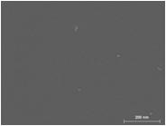
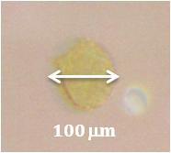
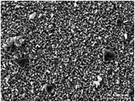
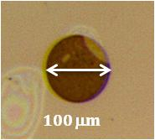
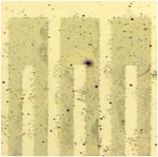
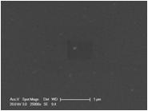
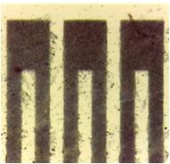
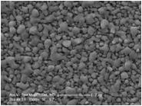
Development of plasmonic metal layers by chemical growing of metal NPs: Towards prepatterned plasmonic nanostructures
Ag/PVA nanocomposite
initial
initial
Not conductive
68 H
68 H
E-beam Lithography
Conductive
Au/Novolac nanocomposite
initial
initial
Not conductive
UV Lithography
68 H
68 H
Conductive
Increase of LSPR with growth time: Increase of size + density of Nanoparticles
10/11

Slide 11
Conclusions
Dissemination
Talk at CEN conference Sevilla (Spain): 1-4 October
Two posters at CEN conference Sevilla (Spain):1-4 October - Talk at Micro and Nano12 (leaded by AIT )
Two abstracts submitted to the SPIE conference Advanced Lithography San Jose: 24-28 February 2013
Contact with other Navolchi-groups
AIT: modelling
UGENT and IMEC: IR QRs
New approaches
Choose “the best” QRs
Dielectric and gold stripes
11/11

