Slide 1



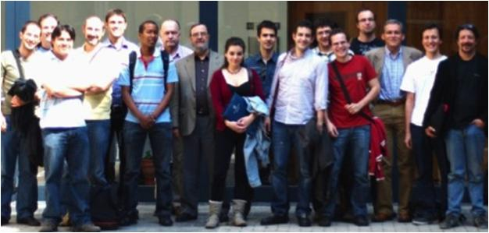
Unit of Materials and Optoelectronic Devices
University of Valencia
www.uv.es/umdo

Slide 2
Telco 5 Nov
Gain comparison between the best QR-PMMA and QD-PMMA waveguides
Summary of MS16
2/5

Slide 3
Plasmonic Amplifiers
Gain measurements
PbS QDs with small Stokes-shift to compare gain with QR
Pietr Geiregat (UGENT) visited UVEG
New characterization with pulse-Ti:sapphire is planned
3/5

Slide 4
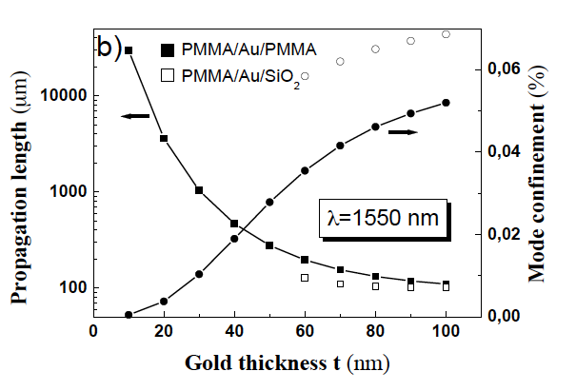
MS16: optimum design
Modelling (in collaboration with AIT)
Optimum design is for Symmetric structure
t = 30 nm and d₁ = d₂ ≈ 3 µm (1550 nm)
4/5

Slide 5
MS16: optimum design
Further optimized structure
QD-PMMA thin enough to neglect the overlap of the active material with high order TM modes and emitted light mainly contributing to compensate losses along the LR-SPP propagation.
Optimum d1 = 1.4 µm at 1550 nm (FWHM of TM mode) and d₂ = 10 µm to separate high order TM modes.
1D plasmonic waveguide design
5/5

