Slide 1
Work Package 4 Presentation
Juan P. Martínez Pastor
University of Valencia (UVEG), Spain

Slide 2
WP4: Outline
WP Position in Project.
WP Objectives.
Milestones and Deliverables.
Status of Work: Achievements.
Resources: Budget and Manpower.
Summary and Outlook.

Slide 3

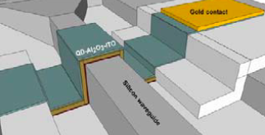
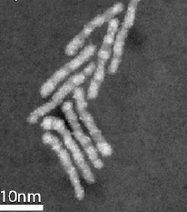
WP4 presentation
1. WP Position in Project.
DEVICES
Au
Au
QD-solid
photodetector
MATERIALS

Slide 4
WP4 presentation
2. WP Objectives
Plasmonic Amplifier (PA):
Modelling (SPP physics and loss compensation)
IR Quantum Dots (wavelength tunable, high QY)
PA by using polymers doped with QDs (optical injection)
Si based PA platform (electrical injection)
Photodetectors using QDs and metal NS
- Photoconductors based on QD solids
- Patternable conductive polymers + metal NS (+ QDs)
UGENT: base materials
AIT: PA Simulation
IMEC: PA with Electrical Injection
Au
Au
QD-solid
photodetector
UVEG: hybrid materials for PA and PD

Slide 5
3. Milestones and Deliverables
WP4 presentation

Slide 6
WP4 presentation
3. Milestones and Deliverables

Slide 7
4. Status of Work: Achievements.
WP4 presentation
Task 4.1 Design and modeling of plasmonic pre-amplifier
Real part of the effective refractive index (symbols) in a symmetric PA structure as a function of the thickness (d=d₁=d₂ and t = 30 nm).
Above 3 μm appear higher order TM modes.
Interplay between LR-SPP mode confinement and propagation length
LR-SPP mode distribution extends ≈ 5 μm

Slide 8
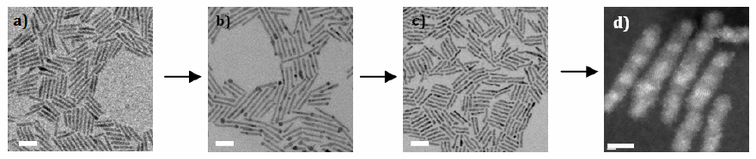
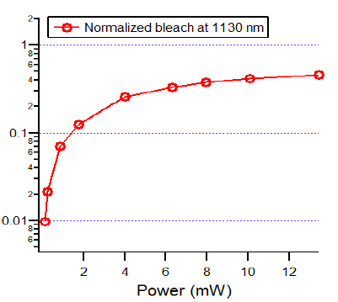
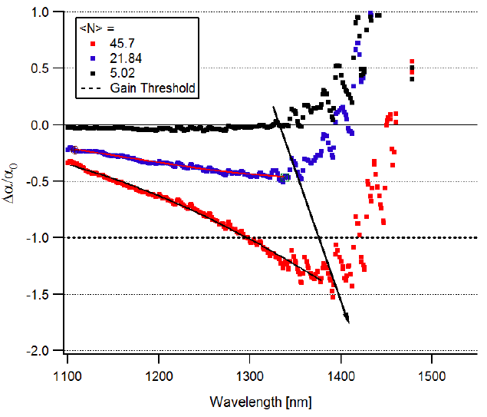
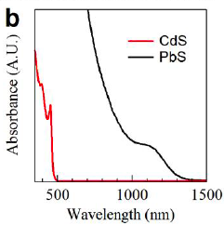
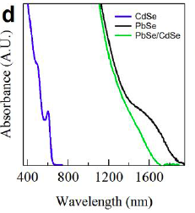
WP4 presentation
4. Status of Work: Achievements.
Task 4.3 Colloidal quantum dots with optimized gain and electrical injection scheme: MATERIALS
CATIONIC EXCHANGE PROCEDURE: 1) CdS initial rods, 2) Cu₂S rods. Scale bar 20 nm, 3) PbS rods. Scale bar 20 nm, 4) PbS/CdS rods (scale bar 5 nm).
optical amplification using PbS rod-shaped particles is possible (but high excitation occupation)
Normalized bleach never reaches transparency with increasing pumping
Rod-shaped PbS nanocrystals do cross the transparency threshold (45 excitons per rod )

Slide 9
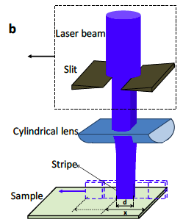
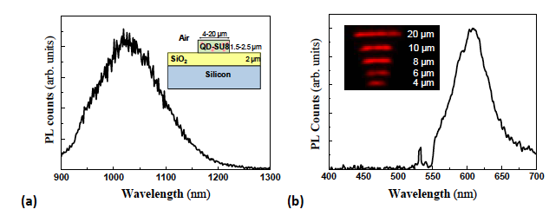
WP4 presentation
4. Status of Work: Achievements.
Task 4.3 Colloidal quantum dots with optimized gain and electrical injection scheme: GAIN (WG)
Variable Stripe Length (VSL) method and rate equation model (including gain saturation by Auger mechanism):
Best Gain/Losses ratio in PbS-CdS partially exchanged rods (PER)
Development of a ligand exchange method to introduce QDs in patternable polymers: SU-8

Slide 10
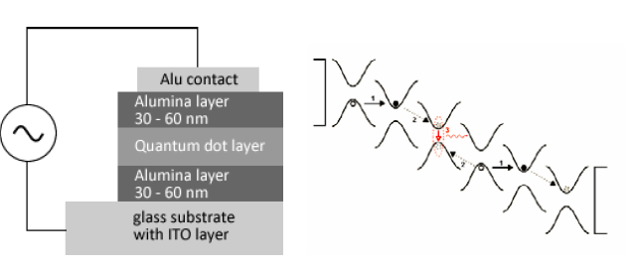
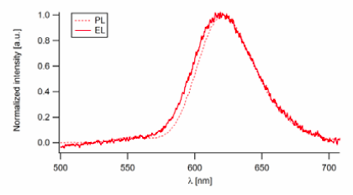
WP4 presentation
4. Status of Work: Achievements.
Task 4.3 Colloidal quantum dots with optimized gain and electrical injection scheme: EL-INJECTION
The concept of AC electroluminescence relies on charge tunneling between neighbouring QDs under internal fields comparable to the band gap of the material.
Photoluminescence of the QD colloid is comparable to the electroluminescence under AC excitation for visible emitting quantum rods (CdSe/CdS). Efficiencies of 0.14 lumen/watt were achieved (comparable to direct charge injection QD-LEDs)

Slide 11
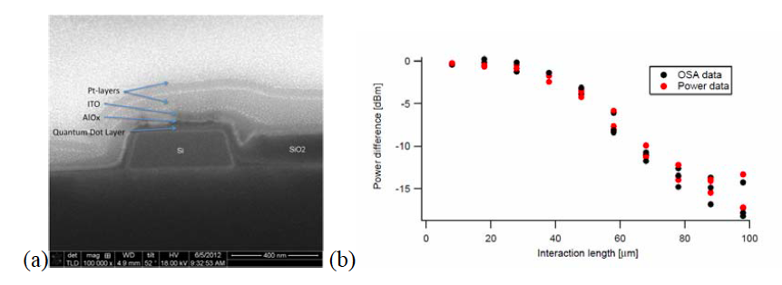
WP4 presentation
4. Status of Work: Achievements.
Task 4.4 Fabrication and characterization of QD-based plasmonic amplifiers
Gain (losses) is a bit higher (lower) in the plasmonic structure than in pure dielectric WG. Possibly because scattering. TM, TE surely are plasmonic/photonic hybrid modes
POLYMER DESIGN
Best Gain/Losses ratio in PbS-CdS partially exchanged rods (PER)
HYBRID SILICON DESIGN
Power transmission difference between waveguides with and without QDS (before deposition of
ITO). QDS interact with the
optical mode of the waveguide. After depositing the AlOx and ITO layers losses are more important.

Slide 12
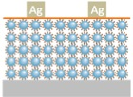
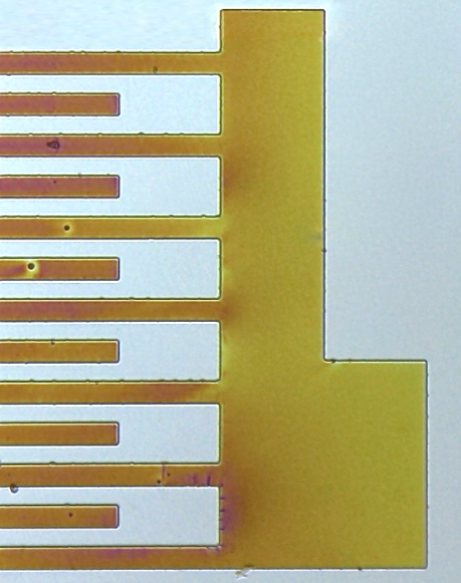
WP4 presentation
4. Status of Work: Achievements.
Task 4.5 Fabrication of plamsonic polymer QD based photodetectors
QD solids (layer-by-layer method) using different ligands exhibit different dark conducitivities and photocurrent
UV Light
Metal NP
Conducting
IPN Patterns
Photomask
Lithographic process
100 µm
Photoresist
Resist + precursor
Conductivity (S/cm)
No laser | Laser at 533 nm
6,43518599 | 6,47054798
0,03181512 | 0,03241319
Substrate
2. Post bake 120-140 ºC
200 µm
In-situ polymerization of 3T with Cu(ClO₄)₂ inside several host polymers. Particularly, Novolak photoresist was properly formulated to preserve as far as possible its negative lithographic characteristics and generate conductive (10⁻² S/cm) micropatterns by means of UV lithography. Syntesis in-situ of Au NPs inside this IPN is also possible.

Slide 13
WP4 presentation
4. Status of Work: Achievements.
MS16: Synthesis of high QY (complex) PbS nanorods is accomplished by the exchange cation method.
PbS quantum rods has shown ASE in 1300-1420 nm. By adjusting the quantum rod synthesis, this can be shifted to 1550 nm. A drawback of the obtained result is the short gain lifetime, which makes CW gain impossible to reach.
More complex PbX/CdX hetero-nanostructures have been synthesized and analyzed for optical amplification using the VSL method, which indicate the presence of optical gain in all samples. As a next step, a transient absorption spectroscopy study (and pulsed excitation in the VSL method) is planned with the PbX/CdX heteronanostructures as well, in order to corroborate our model of gain saturation under CW excitation.
MS17: Optimized structures for plasmonic amplifier, balanced in SPP confinement and propagation length is accomplished. Further, we can reduce the negative effect of high order TM modes (taking energy from emitters) by limiting the thickness of the gain layer (QR-PMMA), but conserving the symmetric design.
t = 30 nm
d₁ = d₂ ≈ 2-3 µm
t = 30 nm
d₁ = 1.4 µm
d₂ = 5-10 µm

Slide 14
5. Resources: Budget and Manpower.
WP4 presentation
Travels (Meetings+Confs): 5.036,80 €
Small equipment: 3.941,95 €
consumables: 12.689,56 €
Total expenses: 21.668,31 €

Slide 15
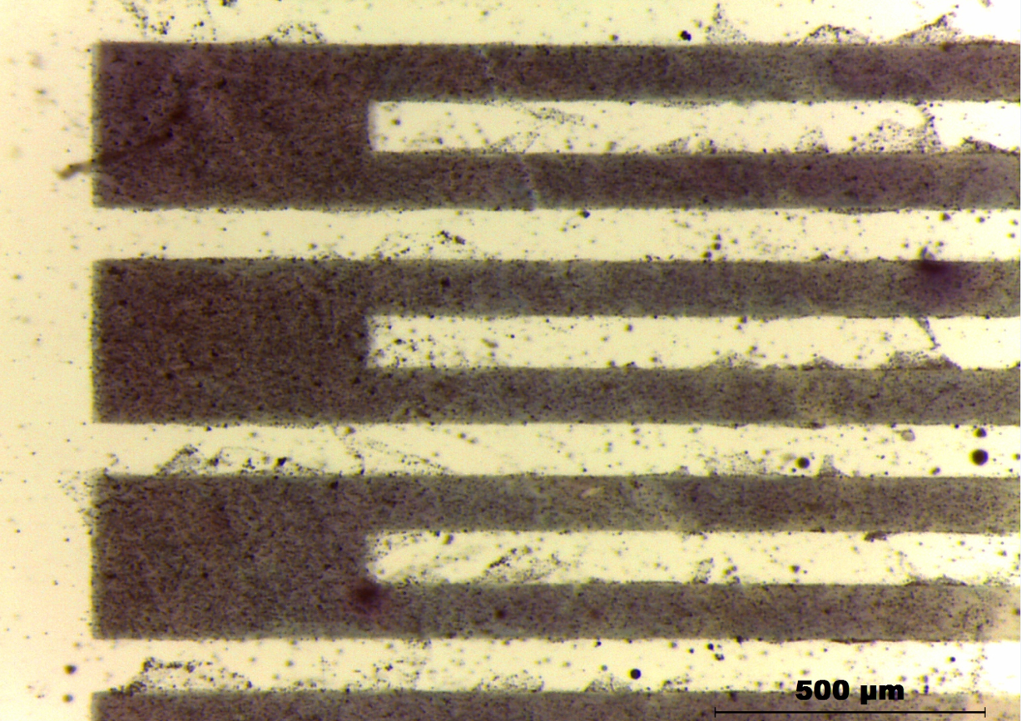
6. Summary and Outlook
WP4 presentation
Plasmonic Amplifier:
PbX/CdX hetero-nanostructures emitting at IR with high QY and exhibiting ASE
Design of optimized structures for SPP amplification using QD doped polymers
Selection of best materials doping polymers for gain (dielectric waveguides)
Results on symmetric and asymmetric plasmonic waveguide structures
Proof of concept of Si-based waveguides with QD gain and AC electroluminescence using QD layers
New method (patent pending) for developing nano/micro-patterns using a resist containing Ag-NPs
Photodetector:
Proof of concept of QD-solids (layer-by-layer method) as photoconductors
Conducting polymers interpenetrated in patternable polymers, including synthesis in-situ of metal NPs and hydrazine treatment to enhance photoconductivity
Materials: PbX/CdX hetero-nanostructures emitting at 1550 nm with high QY and optimized ASE.
Polymer-based PA: Corroborate experimentally conclusions on MS16 and begin with design and experiments on Au-2D waveguides (a new method has been developed to metalize nano/micro-patterns using a resist containing Ag-nanoparticles).
Hybrid-Si PA:

