Slide 1



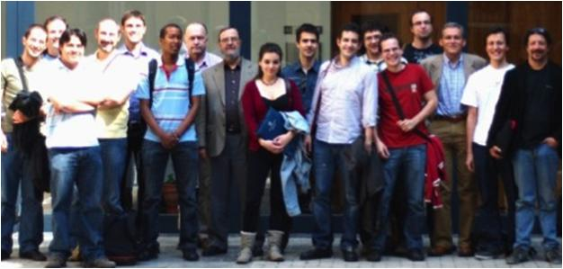
Unit of Materials and Optoelectronic Devices
University of Valencia
www.uv.es/umdo

Slide 2
Summary
1-Amplifier
2- Photodetector
3- Milestones
4- Dissemination
2/12

Slide 3
Plasmonic Amplifiers
Dielectric waveguides (IR)
Power dependence as a function of the stripe length (PER from UGENT)
A
B
A
B
C
C
Narrowing for the highest PL (B)? But S/N low
No dependence for PbS QDs
3/12

Slide 4



Plasmonic Amplifiers
New approaches
femptosecond Ti:Al₂O₃ laser: crystal to double wavelength (800nm ➔ 400 nm) already ordered
New symmetric plasmonic waveguides in the IR: we need new material from UGENT
IR CCD camera
20 µm
10 µm
8 µm
6 µm
4 µm
4/12

Slide 5
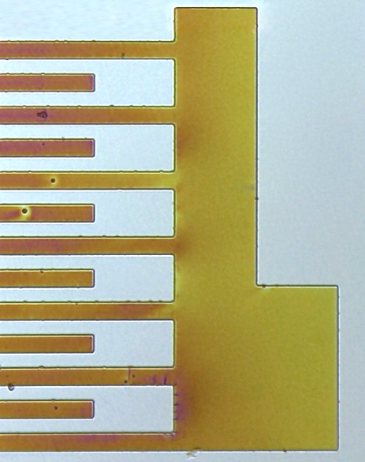
Photodetector
Conducting polymers
UV Light
Metal NP
Conducting
IPN Patterns
Photomask
100 µm
Lithographic process
Photoresist
Resist + precursor
200 µm
Substrate
2. Post bake 120-140 ºC
Starting-point: R. Abargues, P.J. Rodríguez-Cantó, R. García-Calzada, and J. Martínez-Pastor, Patterning of Conducting Polymers using UV lithography: The in-situ polymerization approach, J. Phys. Chem C 116, 17547-17553 (2012).
In-situ synthesis of conducting polymer into the patternable host matrix
In-situ synthesis of Au NPs into the PCP -> Increase of Photoconductivity due to local heating of AuNPs
5/12

Slide 6
Photodetector
Conducting polymers
Optical Properties
TEM Characterization
Polymerization and AuNPs generation can be followed by UV-Vis Spectroscopy
Conducting Polymer + Au NP
Transmission Electron Microscopy (TEM) images of the multicomponent material show Au NPs dispersed in the polymer matrix. NPs diameter obtained is between 4 and 8 nm.
3T + Au (III)
6/12

Slide 7
Photodetector
Conducting polymers
Percolation Theory:
σ = σ₀ (f-f_{c})^{t}
So far:
- Conductivity: 10-30 S/cm
- Responsivity at 533 nm: 0.004 A/W
QD solid
    QD solids (layer-by-layer method) using different ligands (MPA and EDT). MPA: 0.006 – 0.018 A/W EDT: 0.001 – 0.006 A/W
    Better dark conductivities and photocurrent with MPA due to shorter molecular distance between QDs (1.6 nm) and less surface defects.
7/12

Slide 8
Photodetector
Summary (conductive polymer+QDs layers)
- Needed of increase of Responsivity and EQE
- Optimization of the setup to measure photoconductivity
Optimization of electrode configuration -> 1-10 microns distance is required!!
New layout
8/12

Slide 9
Photodetector
Final design
9/12

Slide 10
Milestones
month 15
MS18:
Demonstration of conductive QD layers with photoconductive properties
Demonstration of metal-(lithographic) polymer and QD metal-(lithographic) polymer nanocomposites
in progress
patent application sent
MS19:
10/12

Slide 11
Milestones
month 18
MS20:
Demonstration and decision on photodetector
operation: nano-gap (MIM) vs Schottky/heterostructure
Electroluminscence from QD stack embedded within
conductive oxides (>1uW)
design done
MS21:
in progress
D4.1:
ok
Designs of plasmonic amplifiers
D4.2:
Report on optical properties of QDs layers and polymer nanocomposites
ok
11/12

Slide 12
Dissemination
Abstract sent to SPP: International conference on Surface plasmon photonics. (in collaboration with AIT, UGENT, IMEC)
http://www.conferium.com/WPclients/spp6/
Paper about coupling between PMMA and SU-8 waveguides to be submitted to Journal of Lightwave technology
Patent sent about prepaterning of metallic nanostructures
12/12

