Slide 1
Navolchi Telco – 14 Jan 2013

Slide 2
Summary
WP4: Characterisation of interaction QDOTS with silicon waveguide
(Writing paper: see UGent presentation)
WP4: New mask design completed
Should resolve contacting problem
WP4: Etching + litho tests SiN-films with embeddd QDOTS successfully completed
WP5: Free space gratings
Calculations started
WP2: Provide input to Emmanouil
Still pending – sorry ☺

Slide 3
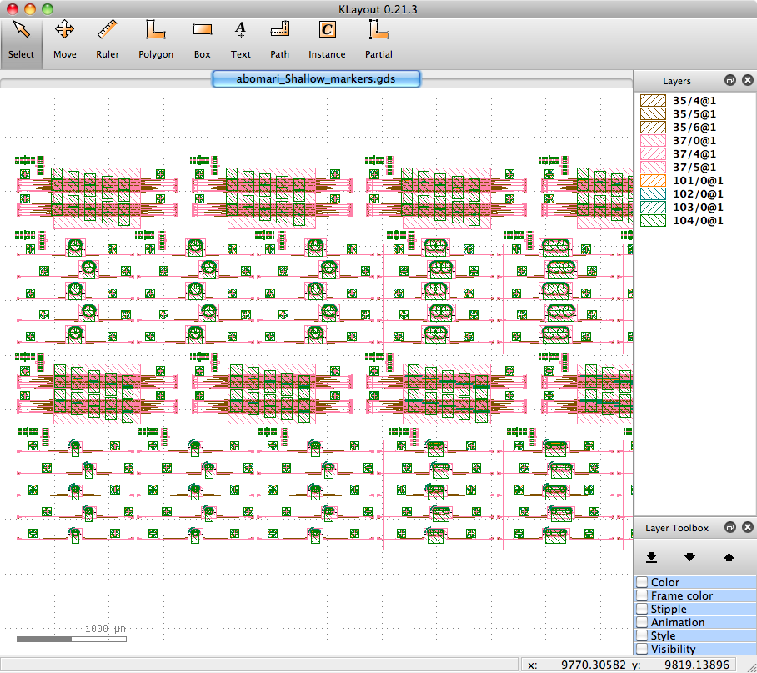
New mask

