Slide 1



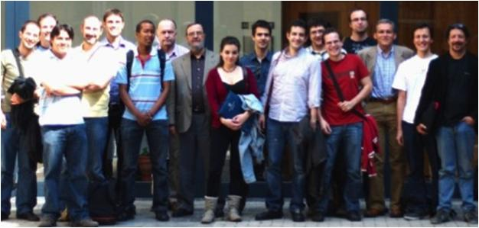
Unit of Materials and Optoelectronic Devices
University of Valencia
www.uv.es/umdo

Slide 2
Summary
1-Amplifier
2- Photodetector
3- Milestones
4- Dissemination
2/9

Slide 3
Plasmonic Amplifiers
PMMA cladding on thin nanocomposite
CdSe QDs as a probe of concept
Different cladding thicknesses (d) between 0 and 9 µm
QDs overlap mostly with SPP
Reduce losses
3/9

Slide 4
Plasmonic Amplifiers
PMMA cladding on thin nanocomposite
Caracterization with VSL method
gain similar for all cladding thicknesses
losses reduced as long as cladding thickness is increased
4/9

Slide 5
Plasmonic Amplifiers
PMMA cladding on thin nanocomposite
Caracterization by end fire coupling
With thick claddings it is possible to couple the pump laser from the edge (sample length~5 mm) to photonic modes in the cladding
pump excites QDs which PL can be coupled to the SPP
5/9

Slide 6
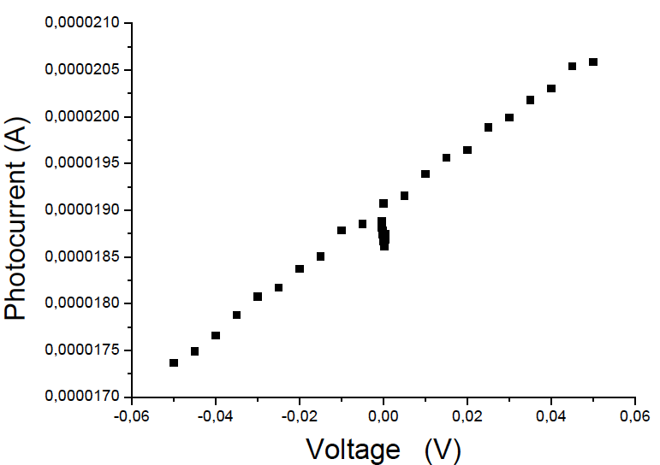
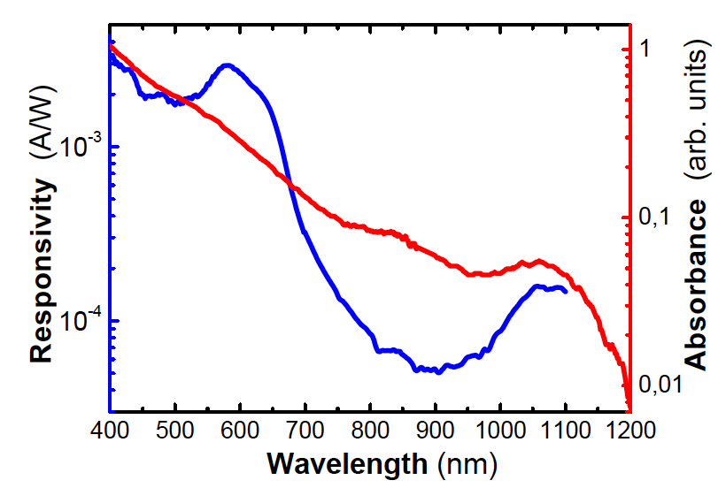
QD Photodetectors
Photodetector with PbS QDs by LbL
Caracterization by in-house set-ups
Resistivity of the layers: r ≈ 2.10⁵ W cm
Responsivities >1 mA/W in the visible and 0.2 mA/W at 1100 nm (exciton ground state absorption)
Photoconductive gain >10 mA/W (1 V) with whole spectrum of the lamp
- Good stability after several weeks in air
6/9

Slide 7
Milestones
month 15
MS18:
Demonstration of conductive QD layers with photoconductive properties
Demonstration of metal-(lithographic) polymer and QD metal-(lithographic) polymer nanocomposites
sent
sent
MS19:
7/9

Slide 8
Milestones
month 18
MS20:
Demonstration and decision on photodetector
operation: nano-gap (MIM) vs Schottky/heterostructure
In progress
D4.1:
ok
Designs of plasmonic amplifiers
D4.2:
Report on optical properties of QDs layers and polymer nanocomposites
ok
8/9

Slide 9
Dissemination
Abstract sent to ICTON (24-27 Cartagena Spain) about bilayer structures
Conference papers and talk to SPIE Advanced lithography (24-28 Feb, 2013 California)
  Novel patternable and conducting metal-polymer nanocomposite: a step toward advanced mutlifunctional materials
  Metal-polymer nanocomposite resists: a step toward in situ nanopatterns metallization
Paper submitted to Journal of Display and Technology
  UV-Patterning of In Situ Synthesized Conducting Polymers for Polymeric Display Devices
9/9

