Slide 1



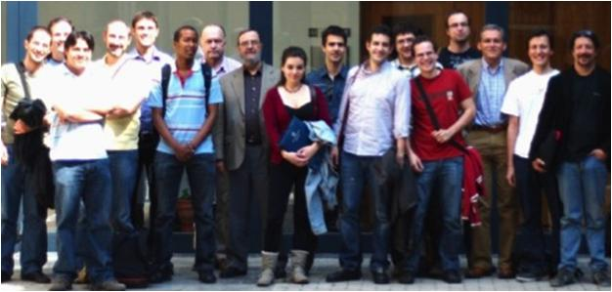
Unit of Materials and Optoelectronic Devices
University of Valencia
www.uv.es/umdo

Slide 2
Summary
1-Amplifier
2- Photodetector
3- Milestones
4- Dissemination
2/12

Slide 3
Plasmonic Amplifiers
PMMA cladding on thin nanocomposite
Maximize overlap SPP with QDs
Reduce losses
Possible coupling through the edge for low enough lengths and thick enough claddings
Last presentation…
1- Pump coupled to the dielectric (TE and TM)
2- PL collected in the gold (TM)
Green beam (533 nm)
PL coupled to the SPP
3/12

Slide 4
Plasmonic Amplifiers
PMMA cladding on thin nanocomposite
Simulation of waveguides at 1.55 μm
d1≈1-1.4 µm ➔ close to evanescent queue +avoid high order TM modes
d2 dependent on the structure.
  asymmetric: plasmonic for d₂ <3 µm but for thicker claddings fundamental mode centered on the dielectric.
  symmetric: allways plasmonic
4/12

Slide 5
Plasmonic Amplifiers
PMMA cladding on thin nanocomposite
Experimental results: samples
PbS QDs form UGENT (1.55 µm)
not high filling factor (to avoid losses)
d₁ = 1 µm
d₁ = [0-9] µm
5/12

Slide 6
Plasmonic Amplifiers
PMMA cladding on thin nanocomposite
Experimental results: variable stripe method
PL coupled
gain close to zero
losses decrease with thickness of the cladding and higher in TM
6/12

Slide 7
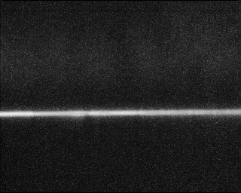
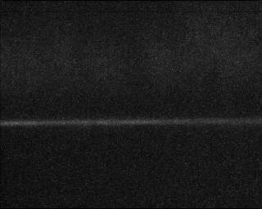
Plasmonic Amplifiers
PMMA cladding on thin nanocomposite
Experimental results: end fire coupling
Absorption of PbS limits strongly the pump in the visible➔ optimize thickness and concentrations and reduce waveguide length (< 1 mm)
TE
TM
7/12

Slide 8
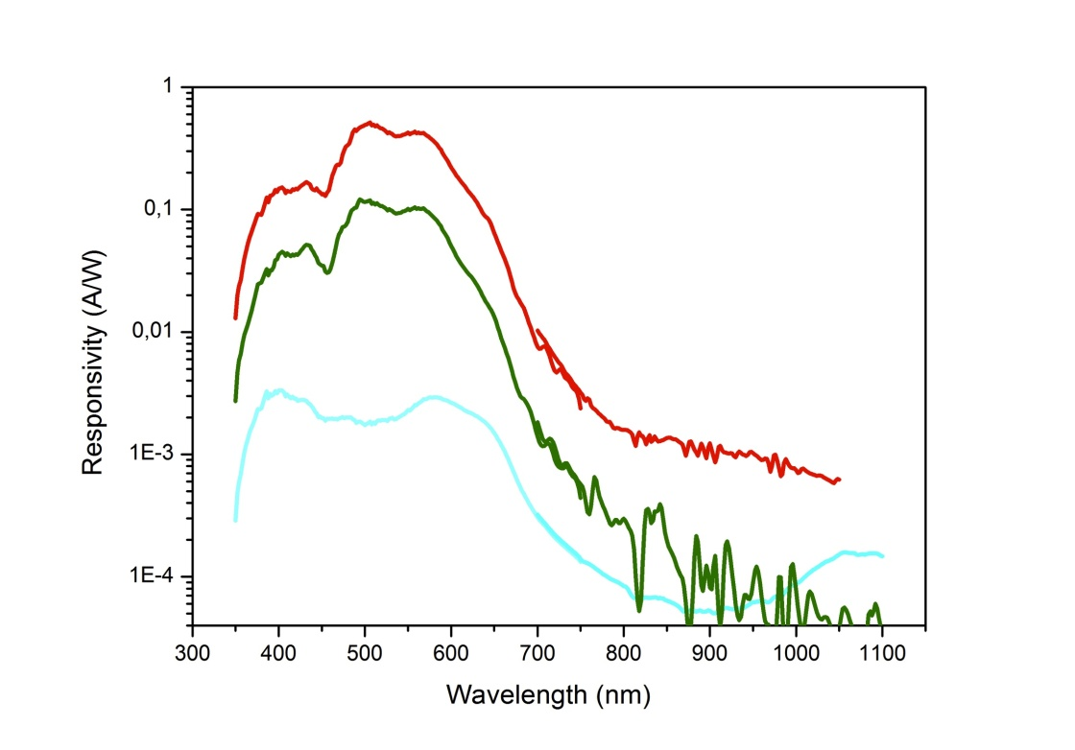
QD Photodetectors
Photodetector with PbS QDs by LbL
New data by using PbS with more passivated surface
Resistivity of the layers: ρ ≈ 5-8.10⁴ Ω cm
Responsivities 0.5 A/W in the visible and 1 mA/W at 1000 nm (exciton ground state absorption)
Photoconductive gain 50 mA/W (1 V) at single wavelength (600 nm)
TOP
S = 1 mm²
Absorption edge
Ag
I
QD-layer (300 nm)
PDOT
ITO
8/12

Slide 9
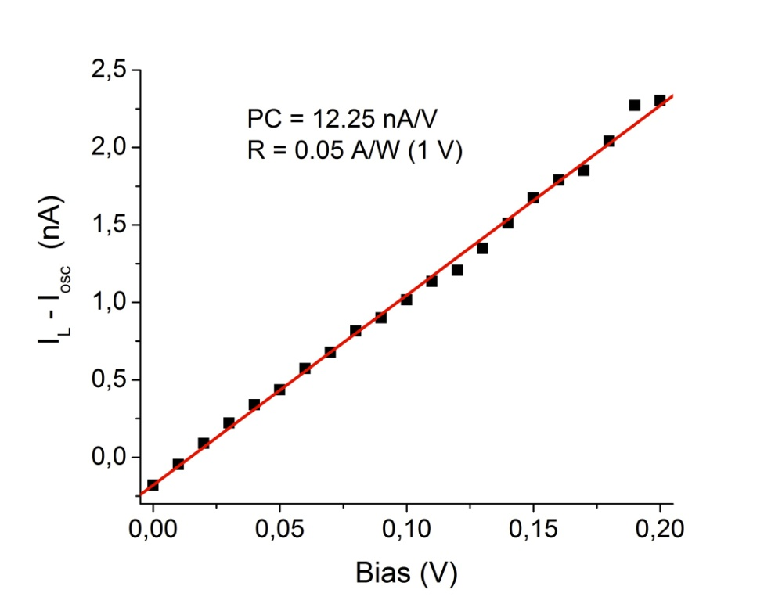
QD Photodetectors
Photodetector with PbS QDs by LbL
New data by using PbS with more passivated surface
Resistivity of the layers: ρ ≈ 5-8.10⁴ Ω cm
Responsivities 0.5 A/W in the visible and 1 mA/W at 1000 nm (exciton ground state absorption)
Photoconductive gain 50 mA/W (1 V) at single wavelength (600 nm)
TOP
100 μm
I
I
Ag
QD-layer (300 nm)
GLASS
9/12

Slide 10
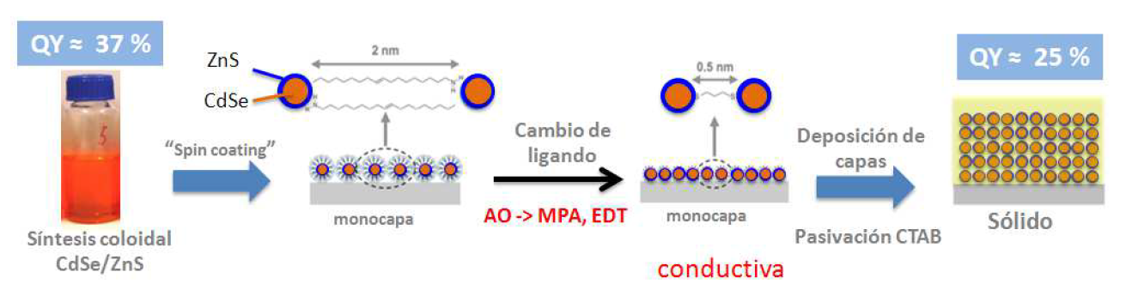
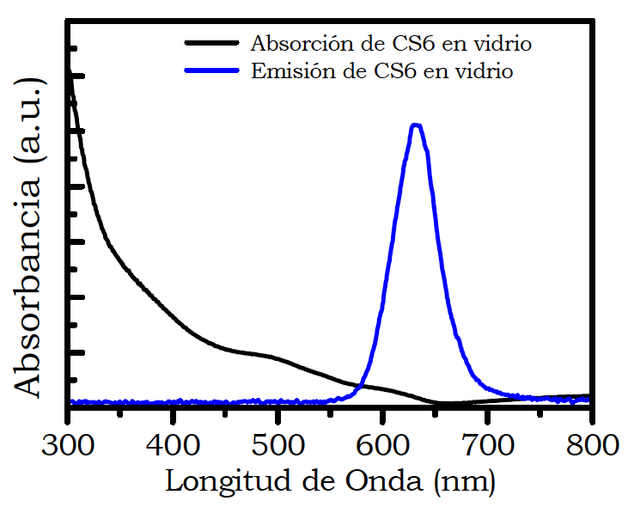
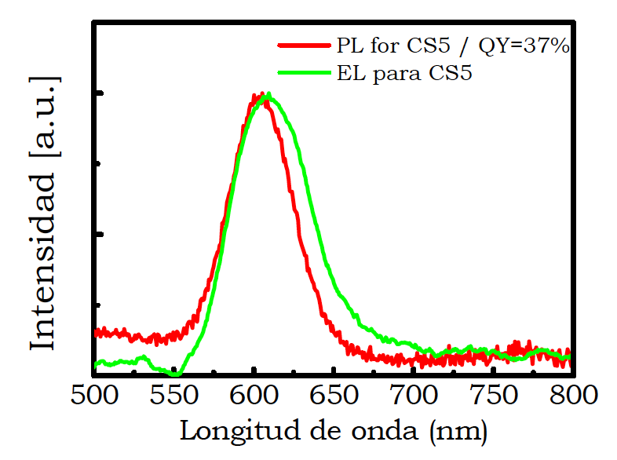

QD LED (600 nm)
QD-LED with CdSe/ZnS (600 nm)
10/12

Slide 11
Milestones/Deliverables
month 18
MS20:
Demonstration and decision on photodetector
operation: nano-gap (MIM) vs Schottky/heterostructure
In progress
D4.1:
ok
Designs of plasmonic amplifiers
D4.2:
Report on optical properties of QDs layers and polymer nanocomposites
ok
11/12

Slide 12
Dissemination
Abstract sent to ICTON (24-27 Cartagena Spain) about bilayer structures
Conference papers and talk to SPIE Advanced lithography (24-28 Feb, 2013 California)
  Novel patternable and conducting metal-polymer nanocomposite: a step toward advanced mutlifunctional materials
  Metal-polymer nanocomposite resists: a step toward in situ nanopatterns metallization
Paper submitted to Journal of Display and Technology
  UV-Patterning of In Situ Synthesized Conducting Polymers for Polymeric Display Devices
12/12

