Slide 1


NAVOLCHI - Nano Scale Disruptive Silicon-Plasmonic Platform for Chip-to-Chip Interconnection

Slide 2
AGENDA

Slide 3
Agenda
Welcome.
Progress of work: Short report from every partner about status of work.
Actual deliverables and milestones.
Open issues.
Next TelConf.

Slide 4
Status of Work:
Partner Presentations
Notes:
Partner presentations (10min each)
Institute / company (short)
Contribution to the project, own work effort and timeline (focus)

Slide 5
Work Progress
For every phone conference every partner is pleased to contribute with a short statement about his last work progress!

Slide 6
  If appropriate: Discussion
  Deliverables & Milestones

Slide 7
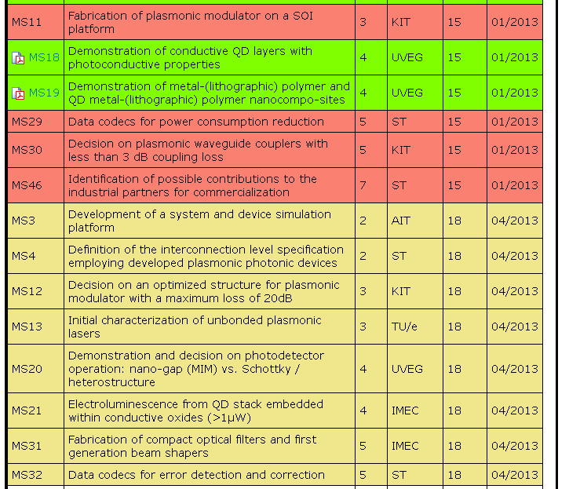
January and April Milestones

Slide 8
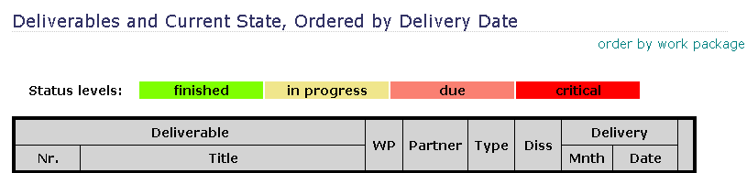
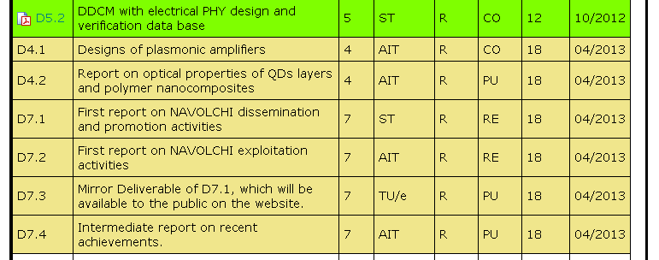
April Deliverables

Slide 9
  Open Issues
  Next Tel. Conf.

Slide 10
Open Issues
Any important things to discuss?

Slide 11
Next Phone Conference
First Monday of the next month,
4:00 pm (CET)
April 8th, 2013

Slide 12
  Bye!

