Slide 1
NAVOLCHI - Nano Scale Disruptive Silicon-Plasmonic Platform for Chip-to-Chip Interconnection

Slide 2
AGENDA

Slide 3
Agenda
Welcome.
Progress of work: Short report from every partner about status of work.
Actual deliverables and milestones.
ST
Meeting in Karlsruhe
Open issues.
Next TelConf.

Slide 4
Status of Work:
Partner Presentations
Notes:
Partner presentations (10min each)
Institute / company (short)
Contribution to the project, own work effort and timeline (focus)

Slide 5
Work Progress
For every phone conference every partner is pleased to contribute with a short statement about his last work progress!

Slide 6
If appropriate: Discussion
Deliverables & Milestones

Slide 7
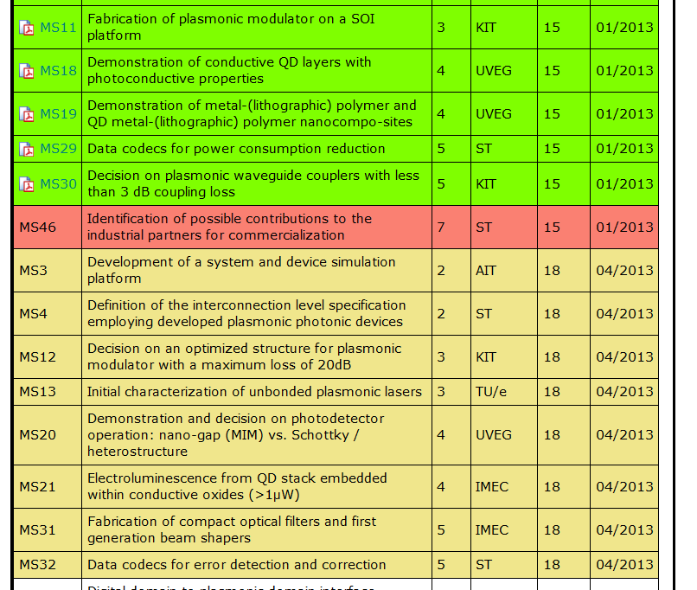
January and April Milestones

Slide 8
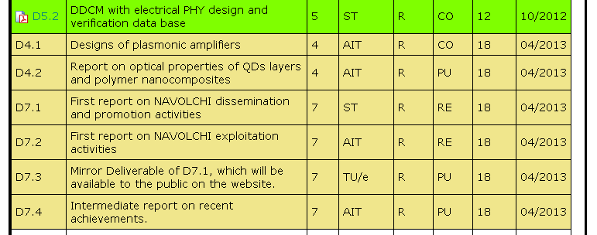
April Deliverables

Slide 9
ST contribution
Who can help with MS46? Urgent!
What is with MS4 and MS32?
Will ST stay in the project?

Slide 10
Meeting in Karlsruhe 26th of April
Organization:
Please confirm attendence, hotel and get-together
Help line: gerda.flohr@kit.edu
Content:
Work progress
Preparation for the Review Meeting
Agenda follows

Slide 11
Open Issues
Next Tel. Conf.

Slide 12
Open Issues
Any important things to discuss?

Slide 13
Next Phone Conference
First Monday of the next month,
4:00 pm (CET)
May 6th, 2013
Shifted to May 13th, 2013
due to previous meeting in Karlsruhe

Slide 14
Bye!

