Slide 1




Unit of Materials and Optoelectronic Devices
University of Valencia
www.uv.es/umdo
I. Suárez, P.J. Rodríguez-Cantó and J.P. Martínez-Pastor
Current State of the work and preparation of Review Meeting
Phone Conference May13th 2013

Slide 2
Outline
1-Deliverables and milestones
2-Current Status of the work
2.1-Plasmonic amplifiers by using polymers doped with QDs
2.2-Photodetectors based on QDs and polymers
3- Collaboration with other partners
2/10

Slide 3
Deliverables and Milestones
 | Names of the Milestones | Month | Partner
MS16 | Decision on optimized structures for plasmonic amplifiers | 12 | UVEG
MS17 | Synthesis of nanoparticles with gain at 1550nm | 12 | UGENT
MS18 | Demonstration of conductive QD layers with photoconductive properties | 15 | UVEG
MS19 | Demonstration of metal-(lithographic) polymer and QD metal-(lithographic) polymer nanocompo-sites | 15 | UVEG
MS20 | Demonstration and decision on photodetector operation: nano-gap (MIM) vs. Schottky / heterostructure | 18 | UVEG
MS22 | Demonstration of plasmonic amplifiers with optical pumping exhibiting 10dB gain | 21 | IMCV
MS23 | Operation of QD based photodetector with responsivity > 0.1 A/W | 24 | UVEG
MS24 | Demonstration of SPP amplifiers with electrical injection exhibiting 10dB/cm gain | 30 | UVEG
3/10

Slide 4
Deliverables and Milestones
 | Names of the Deliverables | Month | Partner
D4.1 | Designs of plasmonic amplifiers | 18 | UVEG
D4.2 | Report on optical properties of QDs layers and polymer nanocomposites | 18 | UVEG
D4.3 | Designs of plasmonic photodetectors | 24 | UVEG
D4.4 | Report on SPP amplifiers by using QDs | 30 | IMEC
D4.5 | Report on plasmonic photodetectors | 33 | UVEG
D.7.1 | First report on NAVOLCHI dissemination and promotion activities | 18 | AIT
D.7.2 | First report on NAVOLCHI exploitation activities | 18 | AIT
4/10

Slide 5
Plasmonics amplifiers
Design of plasmonic amplifiers
Objective: QD-PMMA nanocomposites to provide gain in a SPP at λ=1.55 µm
Bilayer symmetric waveguides at 1.55 µm
PbS QDs (UGent)
t=30 nm
d₁= 0.7 µm
d₂=1.8 µm
d₃=0-9 µm
TE
TM
5/10

Slide 6
Plasmonics amplifiers
2-D modelling
Preliminary results with effective index method
Dielectric PMMA load on a gold film
Problem: accurately of the algorithm and computation time…
6/10

Slide 7
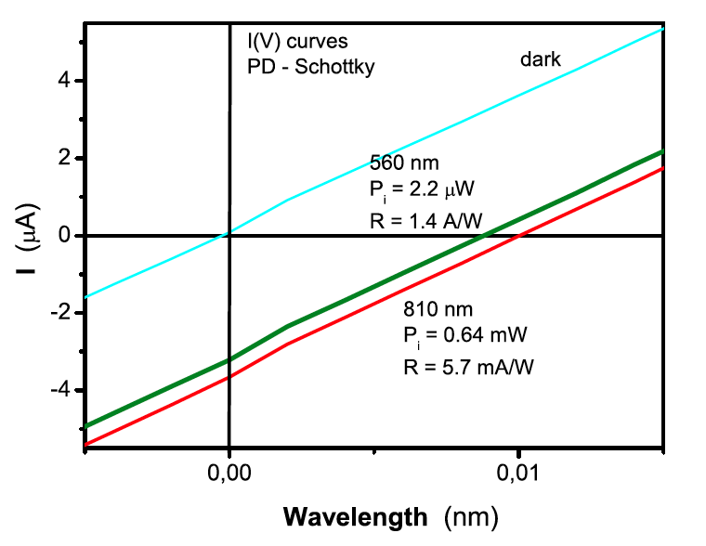
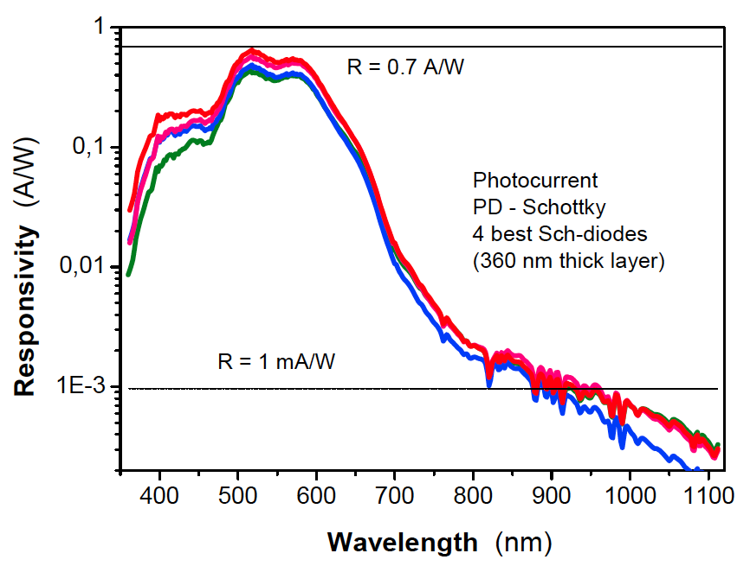
Photodetectors
Schottky/Heterostructure Photodetector
Resistivity of the layers: ρ ≈ 7.10⁵ Ω cm
Responsivities 0.7 A/W in the visible and 1 mA/W at 1000 nm (exciton ground state absorption)
TOP
S = 1 mm²
810 nm
P_{i}= 1.3 mW
R= 2.9 mA/W
Ag
810 nm
P_{i}= 1.3 mW
R= 2.9 mA/W
I
QD-layer (300 nm)
PDOT
ITO
Bias (V)
Further improvement:
Metals with higher work function as top electrode (i.e. LiF / Al)
ZnO transparent conductive layers also interesting ti improve Schottky contact with QDs
7/10

Slide 8
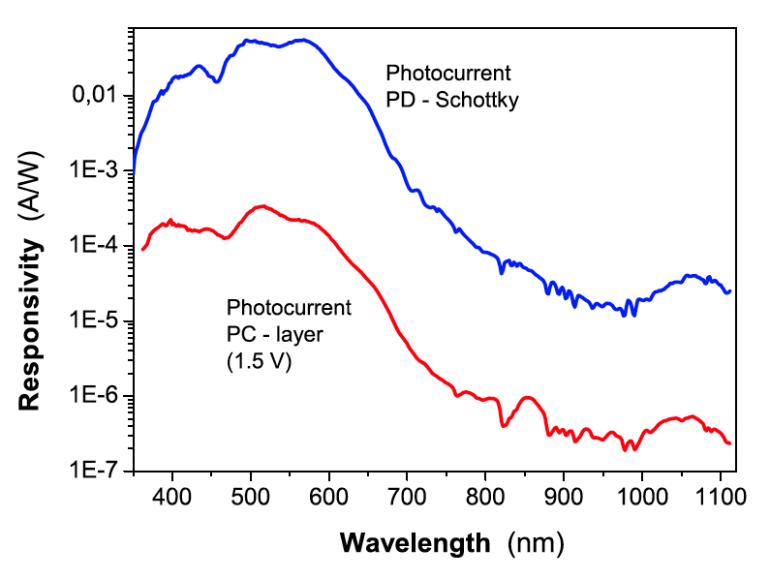
Photodetectors
Micro/Nano-gap Photodetector
(to reduce the response time for fast operation receivers)
Resistivity of the layers: r ≈ 7.10⁵ W cm (280 nm thick layer)
Responsivities ≈ 0.01-0.1 A/W (1 V) at visible wavelengths (depending on sample), smaller than measured in Schottky photodiodes.
TOP
45 μm
Responsivity of micro-gap photoconductor (45 mm) at 1.5 V bias is about 2 orders of magnitude below that of a Schottky
I
I
Ag
QD-layer (300 nm)
GLASS
8/10
Notes:
Given the technical difficulties to achieve nano-gap distances and the possible difficulties to couple light leaving the plasmonic amplifier into this photoconductive device, we also consider the study of micro-gap photoconductors
The responsivity curve of a micro-gap photoconductor (45 mm distance between electrodes) at 1.5 V bias is about 2 orders of magnitude below that of a Schottky photodiode made on a PbS QD film with similar thickness and preparation conditions. Such a difference can be attributed to the still long distance between electrodes as compared to diffusion length of the material and the small in-plane electric field

Slide 9
Photodetectors
Further work and improvements:
Preparation of devices with QD-solids to have absorption and good responsivity at 1550 nm: optimization of layer thickness and surface roughness.
Use of other ligands between QDs.
Optimization of separation between lateral electrodes in the mm-range (micro-gap photoconductors).
- Optimization of Schottky/heterostructure photodiodes: use of Al as metal electrode and ZnO instead of ITO (or ITO/ZnO).
9/10

Slide 10
Collaboration with other partners
UGENT and IMEC
Sample exchange: PbS, PbS/CdS, PbS/CdSe, PER, PbS/CdS
New material to provide gain ?
Common deliverables: 4.1 and 4.2
AIT
Plasmonic modelling: 2-D modelling
Common deliverables: 4.1
Nanogap fabrication (other partners?)
10/10

