Slide 1


NAVOLCHI - Nano Scale Disruptive Silicon-Plasmonic Platform for Chip-to-Chip Interconnection

Slide 2
AGENDA

Slide 3
Agenda
Welcome.
Progress of work: Short report from every partner about status of work.
Actual deliverables and milestones.
18 month periodic report
Brussels meeting
Open issues.
Next TelConf.

Slide 4
Status of Work:
Partner Presentations
Notes:
Partner presentations (10min each)
Institute / company (short)
Contribution to the project, own work effort and timeline (focus)

Slide 5
  If appropriate: Discussion
  Deliverables & Milestones

Slide 6
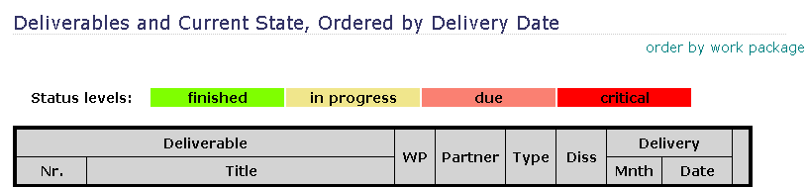
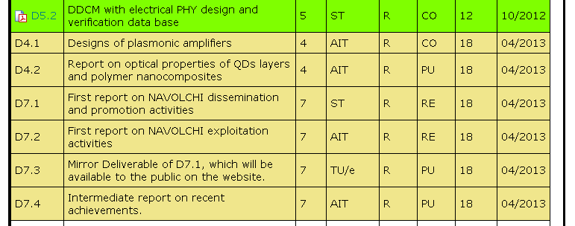
April Deliverables

Slide 7
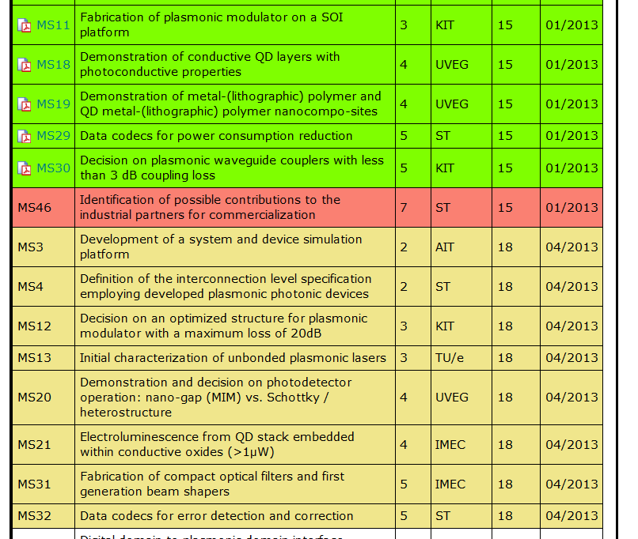
January and April Milestones

Slide 8
18 months periodic report
What Coordinator needs from you:
Work package summary
WP objectives
WP progress, status and future work
Finances table ( including Form C)
Man power table
→ Until May 17th!

Slide 9
18 months periodic report
Please refer to
Project reference manual on web site
Template for periodic report on web site
Last 9 month intermediate report on web site

Slide 10
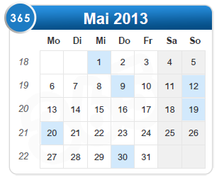
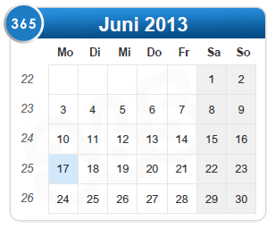
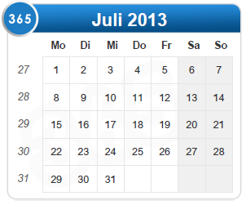
Brussels preparation
Next (additional) phone conferences:
May 13th
May 27th
June 10rd
July 1st
(& meeting?)

Slide 11
  Open Issues
  Next Tel. Conf.

Slide 12
Open Issues
Any important things to discuss?

Slide 13
Next Phone Conference
First Monday of the next month,
4:00 pm (CET)
May 27th, 2013

Slide 14
  Bye!

Slide 15
Preparation to Brussels
Important topics to prepare:
18 month periodic report
Brussels presentation
  Work progress
  Reaction on reviewers recommendations
Separate documents with reactions on reviewers comments

Slide 16
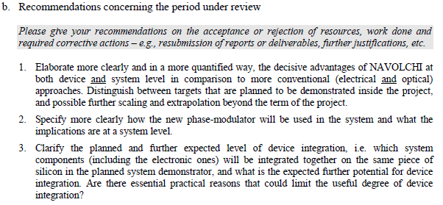
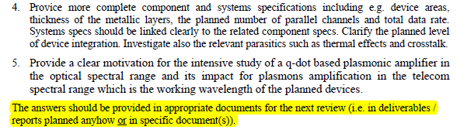
Reviewers Comments: Responsibilities
Recommendations concerning the period under review
AIT
AIT/KIT
AIT/ST
AIT
IMEC/UVEG

Slide 17
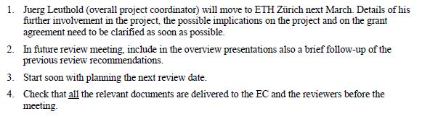

Reviewers Comments: Responsibilities
Recommendations concerning future work
J. L.
KIT
KIT

