Slide 1
Unit of Materials and Optoelectronic Devices
University of Valencia
www.uv.es/umdo
I. Suárez, P.J. Rodríguez-Cantó and J.P. Martínez-Pastor
Current State of the work and preparation of Review Meeting
Phone Conference June 17th 2013

Slide 2
Outline
1-Deliverables and milestones
2-Current Status of the work
3- Review meeting
2/9

Slide 3
Deliverables and Milestones
Previous milestones
 | Names of the Milestones | Month | Partner
MS16 | Decision on optimized structures for plasmonic amplifiers | 12 | UVEG
MS17 | Synthesis of nanoparticles with gain at 1550nm | 12 | UGENT
MS18 | Demonstration of conductive QD layers with photoconductive properties | 15 | UVEG
MS19 | Demonstration of metal-(lithographic) polymer and QD metal-(lithographic) polymer nanocompo-sites | 15 | UVEG
3/9

Slide 4
Deliverables and Milestones
Current milestone
 | Names of the Milestones | Month | Partner
MS20 | Demonstration and decision on photodetector operation: nano-gap (MIM) vs. Schottky / heterostructure | 18 | UVEG
Preliminary version already sent, but there was no results in the case of nano-gap design. EM-distribution by COMSOL have been performed (under analysis).
In collaboration with V. Calzadilla (Cobra) to develop e-beam lithography of nano/micro-gap designs.
4/9

Slide 5
Deliverables and Milestones
Current deliverables
 | Names of the Deliverables | Month | Partner
D4.1 | Designs of plasmonic amplifiers | 18 | UVEG
D4.2 | Report on optical properties of QDs layers and polymer nanocomposites | 18 | UVEG
D.7.1 | First report on NAVOLCHI dissemination and promotion activities | 18 | AIT
D.7.2 | First report on NAVOLCHI exploitation activities | 18 | AIT
5/9

Slide 6
Deliverables and Milestones
Next milestones and deliverables
 | Names of the Milestones | Month | Partner
MS22 | Demonstration of plasmonic amplifiers with optical pumping exhibiting 10dB gain | 21 | IMCV
MS23 | Operation of QD based photodetector with responsivity > 0.1 A/W | 24 | UVEG
MS24 | Demonstration of SPP amplifiers with electrical injection exhibiting 10dB/cm gain | 30 | UVEG
 | Names of the Deliverables | Month | Partner
D4.3 | Designs of plasmonic photodetectors | 24 | UVEG
D4.4 | Report on SPP amplifiers by using QDs | 30 | IMEC
D4.5 | Report on plasmonic photodetectors | 33 | UVEG
6/9

Slide 7
Current status of the work
Plasmonic amplifiers
Set-up to double 800 nm line from Ti:Al₂O₃ pulsed laser with a BBO crystal ➔ 50 mW in fs pulsed operation.
Photodetectors
Method to improve QD stack deposition by Dr Blade
EM-study of nano/micro-gap designs at 1550 nm.
8/9

Slide 8
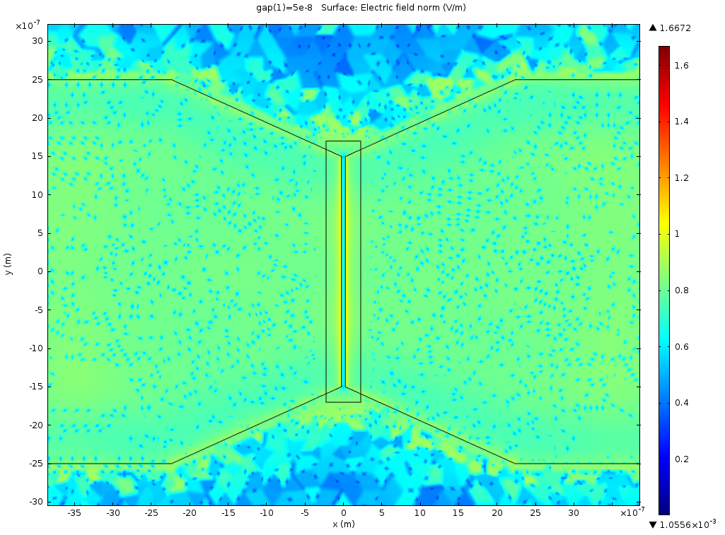
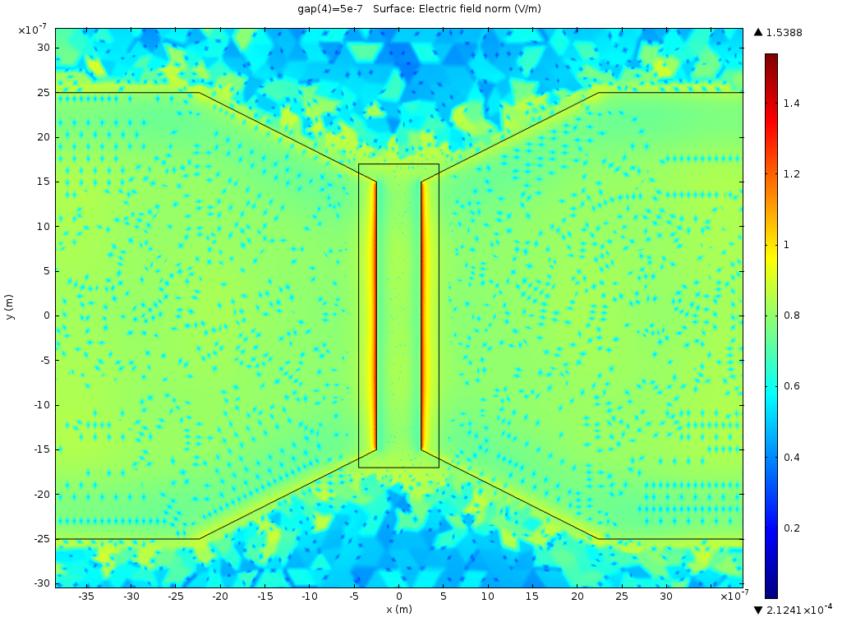
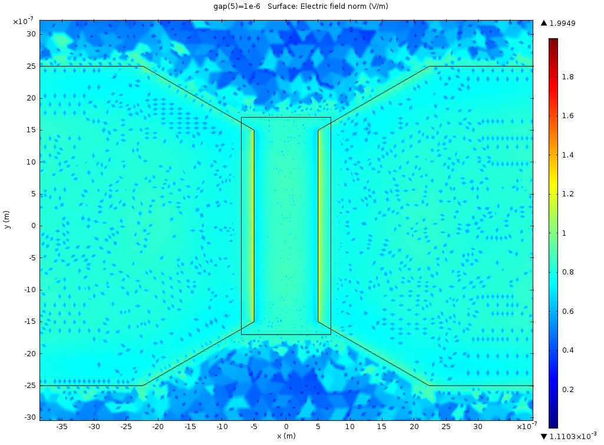
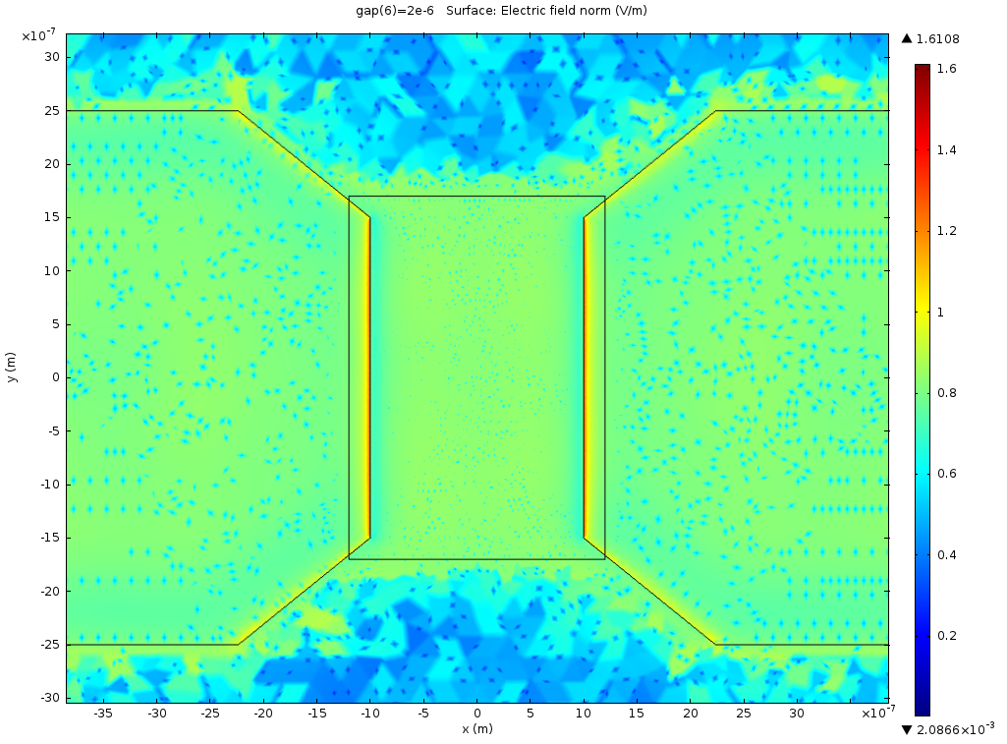
Current status of the work
Photodetectors
EM-study of nano/micro-gap designs at 1550 nm.
50 nm
500 nm
1 μm
2 μm
8/9

