Slide 1
Navolchi Telco
Activity June 2013

Slide 2
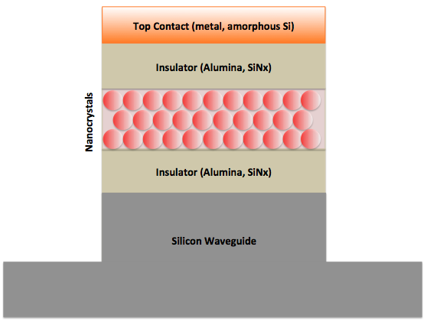
D4.1 – Design of amplifier
D4.1 completed with AIT, UVEG
Insulating layers: 50nm each, thickness of Qdot stack varied from 3 layers (24nm) up

Slide 3
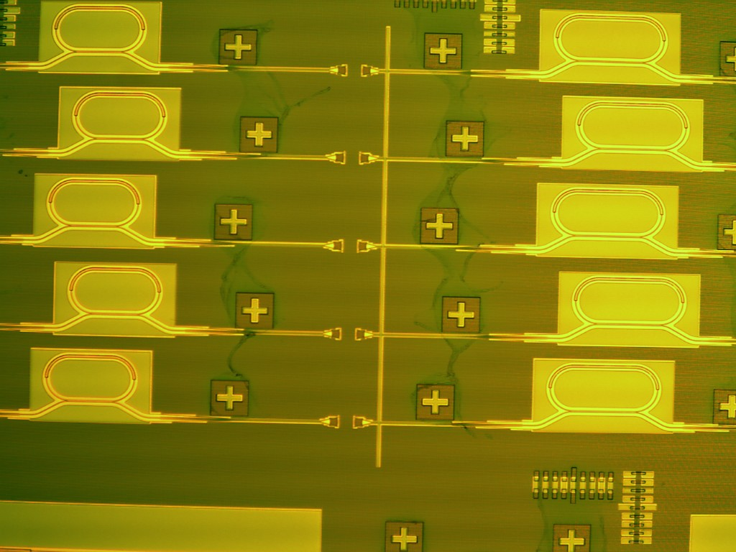
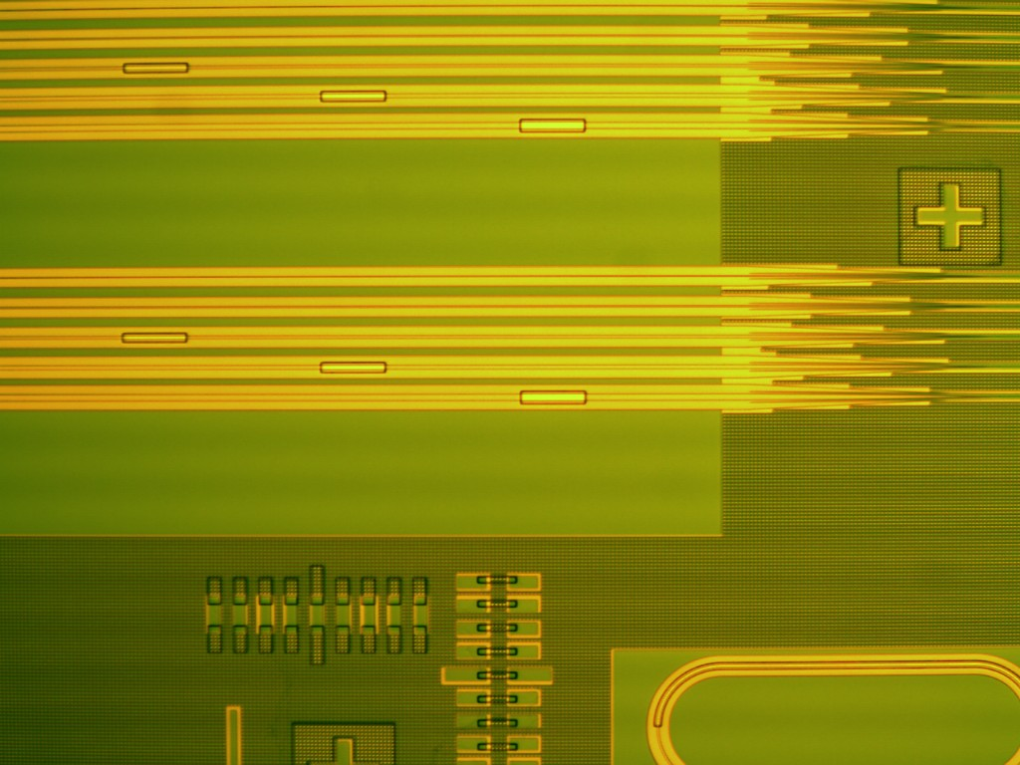

Fabrication of hybrid amplifier
Fabrication ongoing

Slide 4
Bonding
2-samples prepared and sent to TU/e

