Slide 1


NAVOLCHI - Nano Scale Disruptive Silicon-Plasmonic Platform for Chip-to-Chip Interconnection

Slide 2
AGENDA

Slide 3
Agenda
Welcome.
Progress of work: Short report from every partner about status of work.
Actual deliverables and milestones.
18 month periodic report
Brussels meeting
Open issues.
Next TelConf.

Slide 4
Status of Work:
Partner Presentations
Notes:
Partner presentations (10min each)
Institute / company (short)
Contribution to the project, own work effort and timeline (focus)

Slide 5
  If appropriate: Discussion
  Deliverables & Milestones

Slide 6
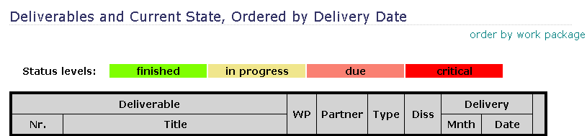
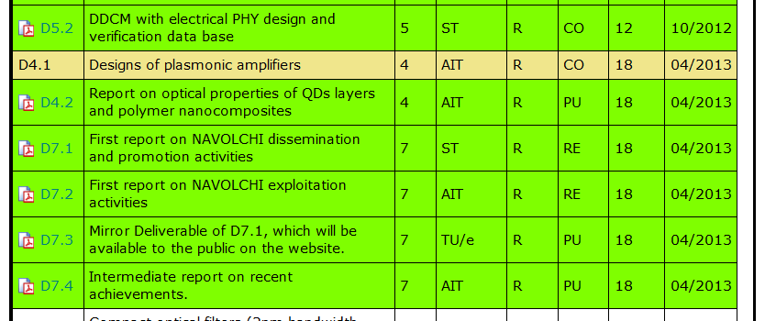
April Deliverables

Slide 7
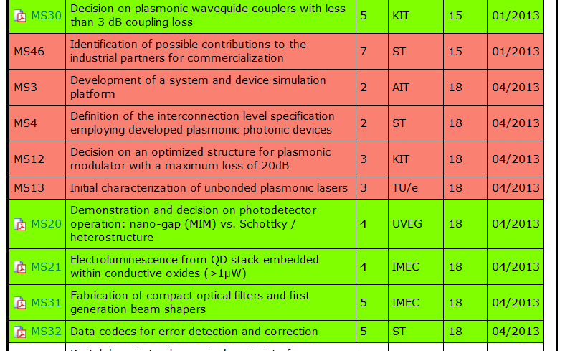
January and April Milestones

Slide 8
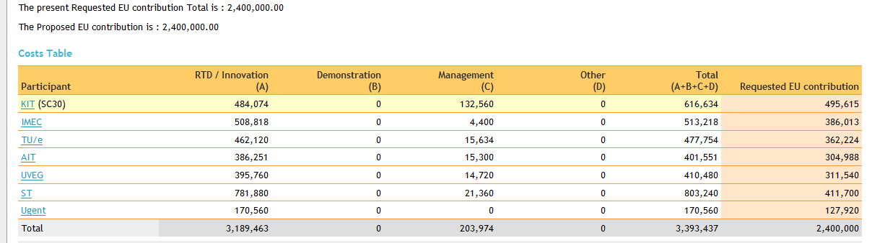
Financials
 | actual claimed costs Reporting Period M1 – M18 | planned costs Funding Period 1 M1 – M18 | actual requested funding Funding Period 1 M1 – M18 | planned requested funding Funding Period 1 M1 – M18
KIT |  | 287 807.50 € | 290 000.00 € | 287 807.50 €
IMEC
TU/e ^{(a)} | 181 645.39 € | 238 877.00 € | 138 620.25 € | 179 157.75 €
AIT | 115 425.00 € | 158 704.00 € | 88 302.00 € | 121 411.00 €
UVEG | 194 466 74 € | 215 000.00 € | 148 48.21 € | 161 250.00 €
ST
UGent
?

Slide 9
18 months periodic report
Missing: Financials → IMEC, ST Ugent; man power → ST, Ugent „Besides the electronic submission, Forms C as well as certificates
(if applicable), have to be signed and sent in parallel by post.“
Please check with your financial staff
Next steps:
Internal revision: Comments until Thursday 20th.
All deliverables, milestones and the report should be sent to the EC and the reviewers until Wednesday 26th.

Slide 10
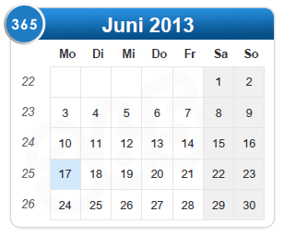
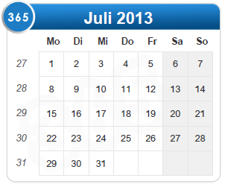
Brussels preparation
Next (additional) phone conferences:
June 24th ?
July 1st
Pre-meeting July 9th 1:30 pm in Brussels

Slide 11
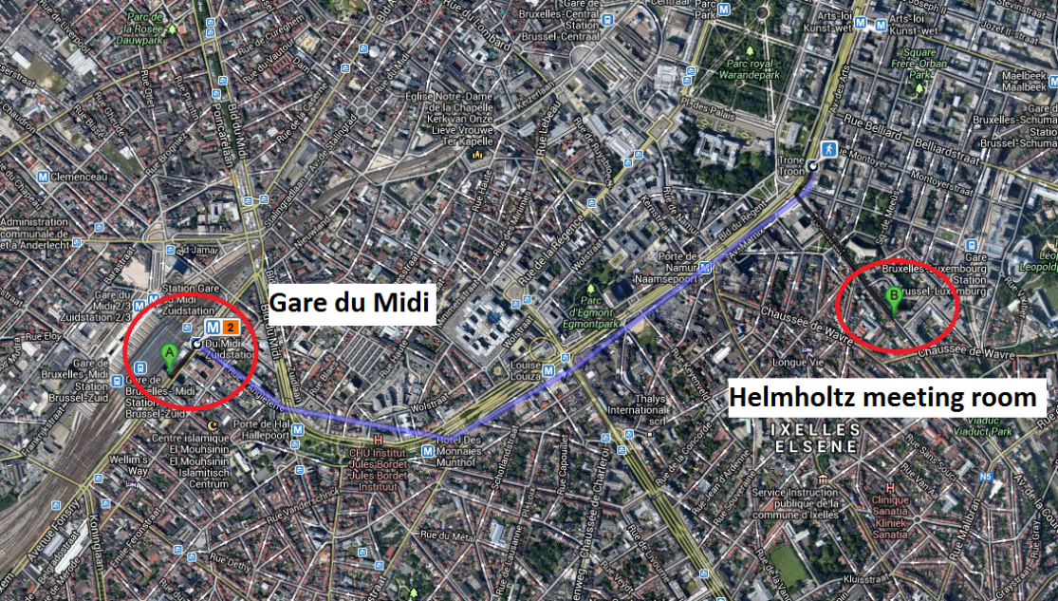
Preparation Meeting July, 9th
Where:
Helmholtz Association of German Research Centres e.V. Brussels Office, Rue du Trône 98 1050 Brussels, BELGIUM
~15 min. from train station Midi via Metro
~1h from Brussels airport via bus or train
When:
1.30pm – 5.30pm
Office closes after 5.30, no extension possible. Please be on time

Slide 12
Preparation to Brussels
Important topics to prepare:
18 month periodic report
Brussels presentation
  Work progress
  Reaction on reviewers recommendations
Separate documents with reactions on reviewers comments

Slide 13
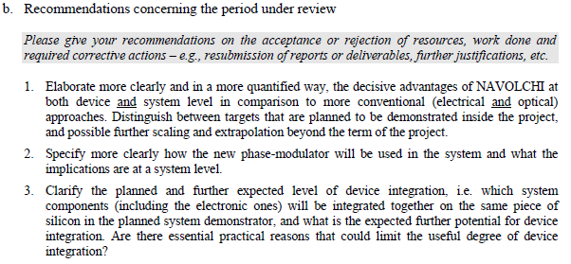
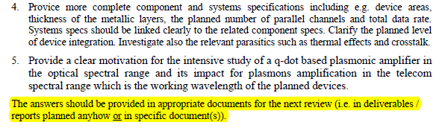
Reviewers Comments: Responsibilities
Recommendations concerning the period under review
AIT
AIT/KIT
AIT/ST
AIT
IMEC/UVEG

Slide 14
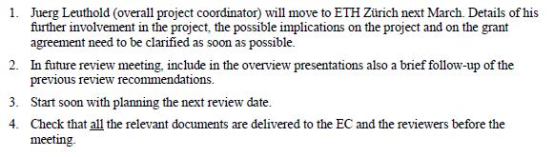

Reviewers Comments: Responsibilities
Recommendations concerning future work
J. L.
KIT
KIT

Slide 15
  Open Issues
  Next Tel. Conf.

Slide 16
Open Issues
Any important things to discuss?

Slide 17
Next Phone Conference
First Monday of the next month,
4:00 pm (CET)
July 1st, 2013

Slide 18
  Bye!

