Slide 1


NAVOLCHI - Nano Scale Disruptive Silicon-Plasmonic Platform for Chip-to-Chip Interconnection

Slide 2
AGENDA

Slide 3
Agenda
Welcome.
Progress of work: Short report from every partner about status of work.
Next deliverables and milestones.
Brussels meeting
Open issues.
Next TelConf.

Slide 4
Status of Work:
Partner Presentations
Notes:
Partner presentations (10min each)
Institute / company (short)
Contribution to the project, own work effort and timeline (focus)

Slide 5
  If appropriate: Discussion
  Deliverables & Milestones

Slide 6
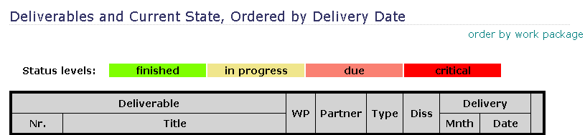
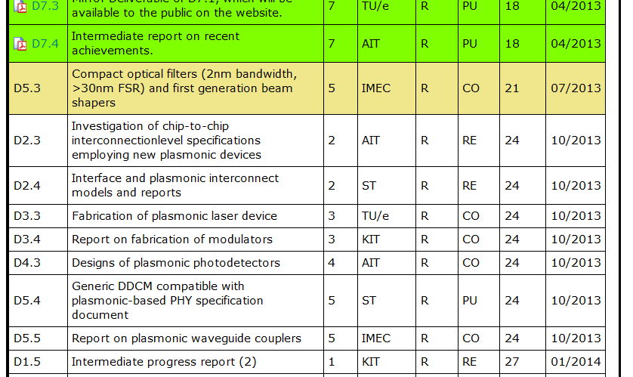
July Deliverable

Slide 7
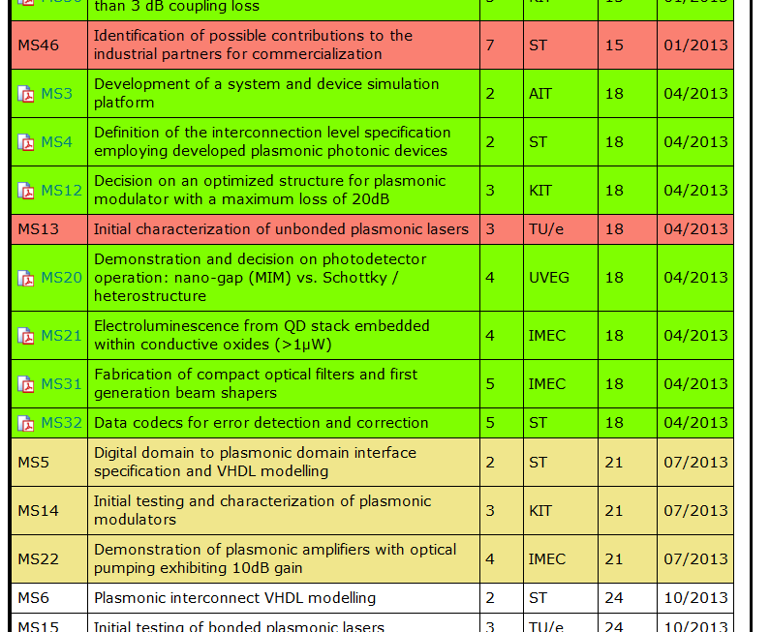
July Milestones

Slide 8
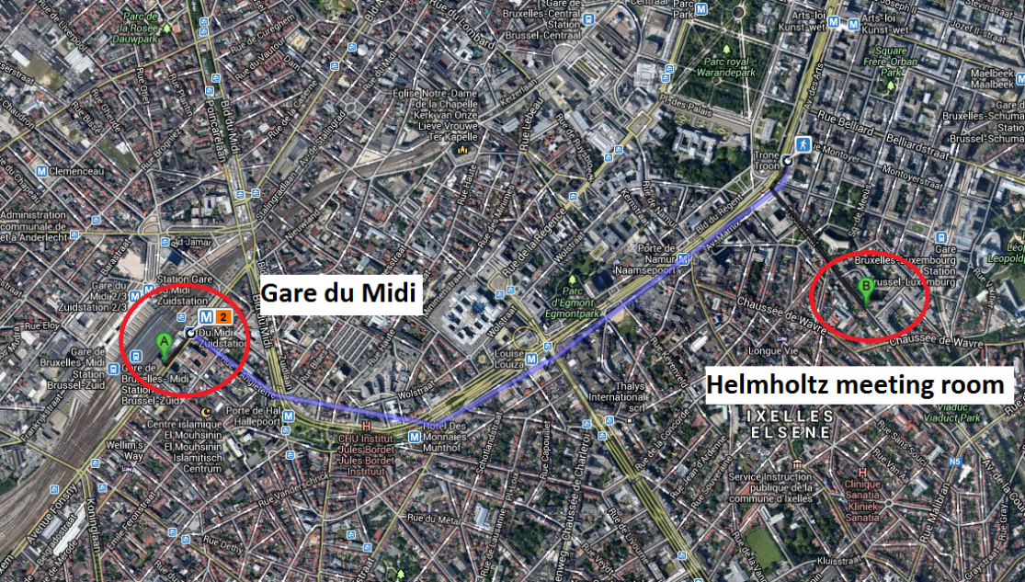
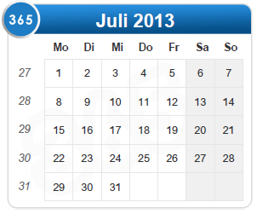
Preparation Meeting July, 9th
Where:
Helmholtz Association of German Research Centres e.V. Brussels Office, Rue du Trône 98 1050 Brussels, BELGIUM
~15 min. from train station Midi via Metro
~1h from Brussels airport via bus or train
When:
1.30pm – 5.30pm
Office closes after 5.30, no extension possible. Please be on time

Slide 9
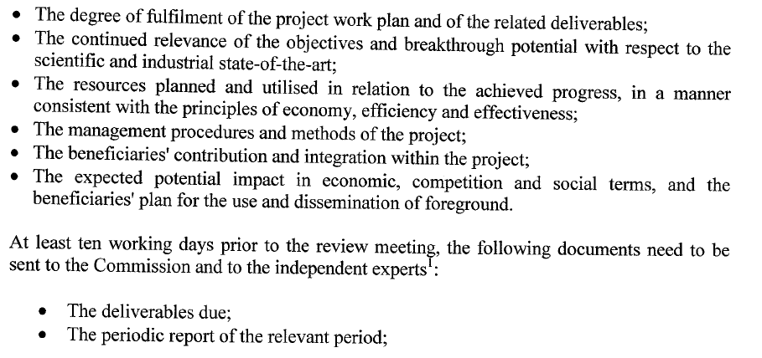
Preparation to Brussels
To prepare for Brussels presentations:
  Work progress for each WP
  WP-Summaries for Co-ordinators talk (1 or 2 pages, until Tuesday 3rd)
  Reaction on reviewers
  recommendations
!

Slide 10
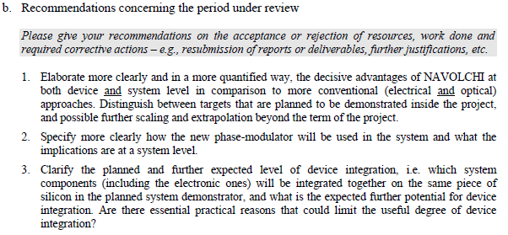
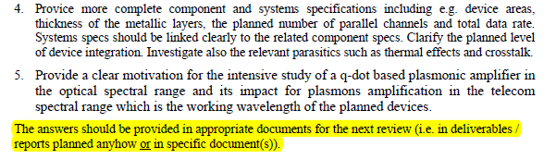
Reviewers Comments: Responsibilities
Recommendations concerning the period under review
AIT
AIT/KIT
AIT/ST
AIT
IMEC/UVEG

Slide 11
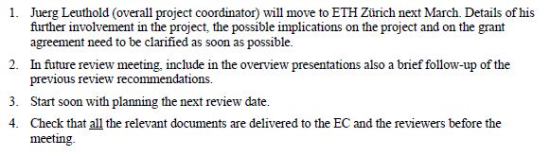

Reviewers Comments: Responsibilities
Recommendations concerning future work
J. L.
KIT

Slide 12
  Open Issues
  Next Tel. Conf.

Slide 13
Open Issues
Any important things to discuss?

Slide 14
Next Phone Conference
First Monday of the next month,
4:00 pm (CET)
August 5th, 2013

Slide 15
  Bye!

