Slide 1




Unit of Materials and Optoelectronic Devices
University of Valencia
www.uv.es/umdo
I. Suárez, P.J. Rodríguez-Cantó and J.P. Martínez-Pastor
Current State of the work
Phone Conference September 23th 2013

Slide 2
Outline
1-Deliverables and milestones
2-Current Status of the work
2.1-Plasmonic amplifiers by using polymers doped with QDs
2.2-Photodetectors based on QDs and polymers
3- Collaboration with other partners
2/11

Slide 3
Deliverables and Milestones
 | Names of the Milestones | Month | Partner
MS16 | Decision on optimized structures for plasmonic amplifiers | 12 | UVEG
MS17 | Synthesis of nanoparticles with gain at 1550nm | 12 | UGENT
MS18 | Demonstration of conductive QD layers with photoconductive properties | 15 | UVEG
MS19 | Demonstration of metal-(lithographic) polymer and QD metal-(lithographic) polymer nanocompo-sites | 15 | UVEG
MS20 | Demonstration and decision on photodetector operation: nano-gap (MIM) vs. Schottky / heterostructure | 18 | UVEG
MS22 | Demonstration of plasmonic amplifiers with optical pumping exhibiting 10dB gain | 21 | IMEC
MS23 | Operation of QD based photodetector with responsivity > 0.1 A/W | 24 | UVEG
MS24 | Demonstration of SPP amplifiers with electrical injection exhibiting 10dB/cm gain | 30 | UVEG
3/11

Slide 4
Deliverables and Milestones
 | Names of the Deliverables | Month | Partner
D4.1 | Designs of plasmonic amplifiers | 18 | UVEG
D4.2 | Report on optical properties of QDs layers and polymer nanocomposites | 18 | UVEG
D4.3 | Designs of plasmonic photodetectors | 24 | UVEG
D4.4 | Report on SPP amplifiers by using QDs | 30 | IMEC
D4.5 | Report on plasmonic photodetectors | 33 | UVEG
D.7.1 | First report on NAVOLCHI dissemination and promotion activities | 18 | AIT
D.7.2 | First report on NAVOLCHI exploitation activities | 18 | AIT
4/11

Slide 5
Plasmonics amplifiers
Design of plasmonic amplifiers
Objective: QD-PMMA nanocomposites to provide gain in a SPP at λ=1.55 µm
Symmetric ➔ propagate LR-SPP at 1.55 µm
Bilayer ➔ Pump beam coupled from the input edge (increase P/area)
  Layer 1: with high QRs concentration
  Layer 2: with no nanoparticles
Initial design : PbS QRs, d₁= 0.7 µm, d₂= 2 µm, d₃=0-9 µm, t= 30 nm
TE
TM
5/11

Slide 6
Plasmonics amplifiers
Excitation conditions
State of the art (amplification of colloidal QDs)
  Planar waveguides by close-packed films or sol-gel matrices
  Variable stripe length method
  Energy thresholds of 1 mJ/cm² with fs laser pulses (100 fs, 100 KHz) ➔ P_{th}=E_{th}/τ=10⁸ mW/cm²
Laser sources:
  404 nm CW : P= 150 mW
  450 nm CW : P= 450 mW
  400 nm doubled Ti:Al₂O₃ (100 fs, 76 MHz): E=1.3·10⁻³ μJ
  533 nm doubled Nd:Yag (1 ns, 20 KHz): E=1.3·10⁻³ μJ
Excitation areas:
  Surface: 10⁻⁴-10⁻³ cm²
  Edge: 10⁻⁸-10⁻⁷ cm²
➔Excitation from the edge with 450 nm CW and Ti:Al₂O₃
6/11

Slide 7
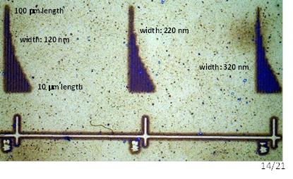
Plasmonics amplifiers
New samples
Layer QDs stack
  Increase QD concentration at the maximum of the mode
  Propagate pump beam through the polymer
  ➔ Engineer ff and thicknesses
  ➔ Improve method of deposition
Dielectric loaded waveguides:
  Improve confinement
Metal nanowaveguides:
7/11

Slide 8


Plasmonics amplifiers
Mode characterization
Detection and analysis of the SPP in the IR (PbS QDs)
  Light detected can be deconvoluted to lorentzian/Gaussian distributions ~ teoretical modes
  VSL method can be used to extract Lp➔ 180 μm in experiment and 280 μm in simulations
8/11

Slide 9
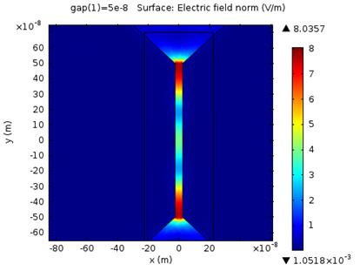
Photodetectors
Deliverable 4.3
Focus on nanogap design for which electric field enhancement is possible by plasmonics associated to metal contacts -> 2 configurations (nanoantena/slit) under study with different gap distances:
COMSOL
ongoing simulations
1 μm
1 -5 μm
Y
Y
    E-enhancement produced for sub-wavelength nanogap
    Fabrication under progress
9/11

Slide 10
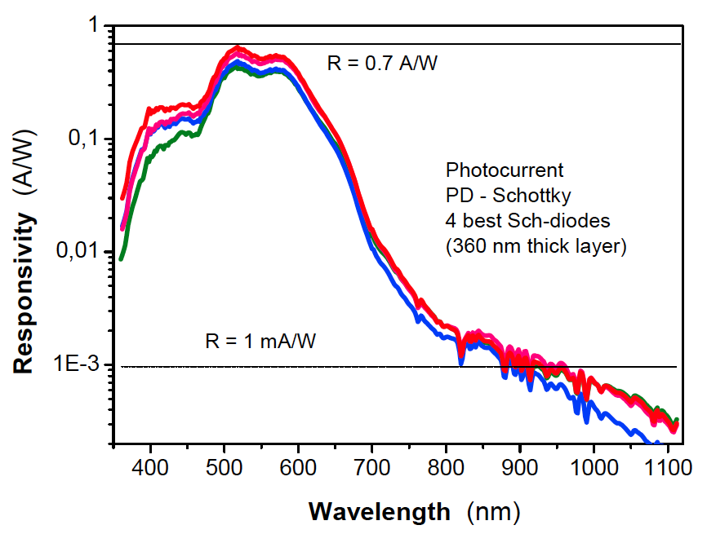
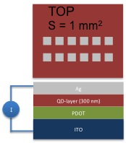
Photodetectors
Milestone 22
Current tasks:
Enhancement of Responsivity at the near and mid IR of QD-Schottky PD
Nanogap design under fabrication and simulation. Microgap does not enhance Responsivity because the electrode distance is still too big (> diffusion lenght)
R = 1 mA/W
still low!
R = 0.7 A/W
    Devices with a better stability have been successfully produced.
    Improvement of stoichiometry and purification leaded to better Responsivities
    Responsivity at the visible reaches the specs, however at the IR Responsivity are still low!!
    Improvement are possible by increasing thickness (Dr. Blade), roughness reduction and electrode optimization (metals with higher work function).
10/11

Slide 11
Collaboration with other partners
UGENT and IMEC
Sample exchange: TeHg
Common deliverables: MS22
AIT
Plasmonic modeling: 2-D modeling
Tu/e
Nanogap fabrication in photodetector
11/11

