Slide 1
Navolchi Telco
Activity Sep. 2013

Slide 2
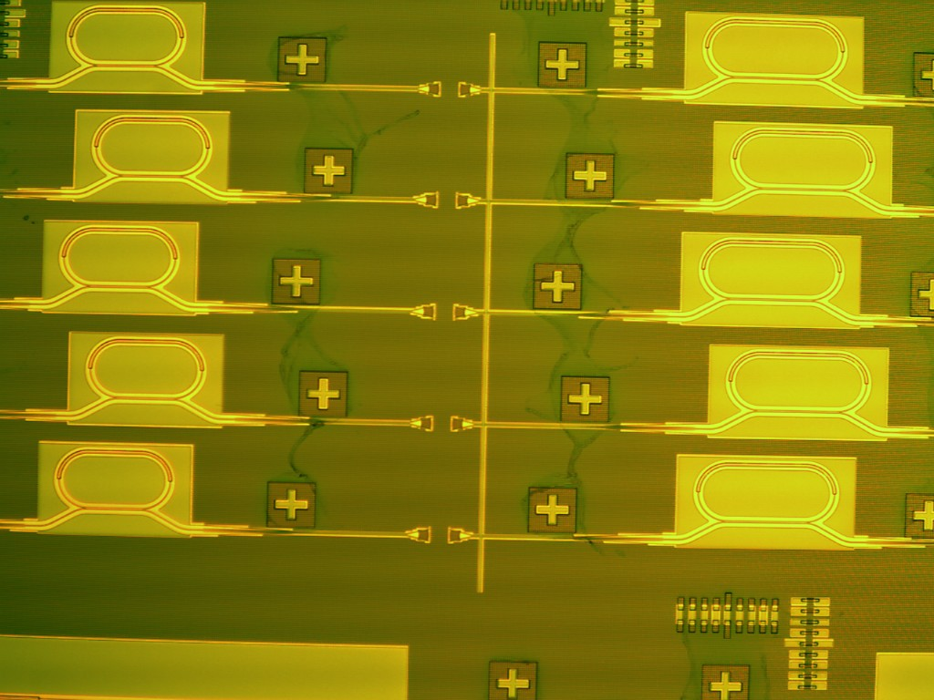
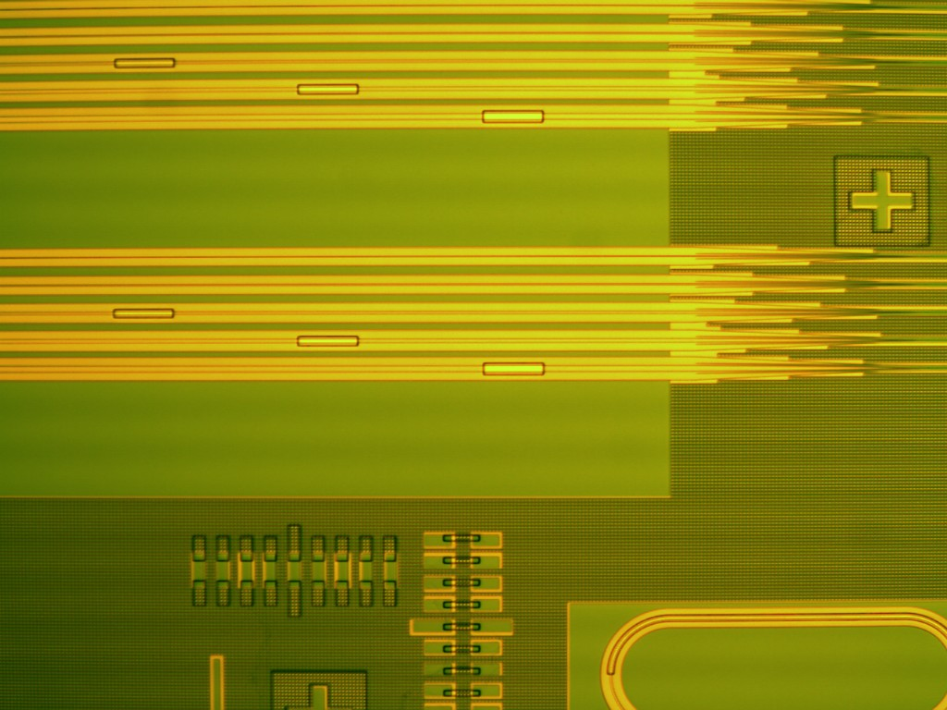

Fabrication of hybrid amplifier
Fabrication delayed due to good results HgTe (focus on material characterisation)

Slide 3
Supporting technologies
Bonding
  2-samples prepared and sent to TU/e before summer
  Question: quality OK ?
  Question: when new samples needed ?
Localised deposition of quantum dots
  Optimised deposition process
  Now down to 60nm patterns
Embedding in SiN-stack
  Low loss SiN waveguides measured at 650nm, 900nm and 1300nm
  Loss remains low after embedding quantum dots

Slide 4
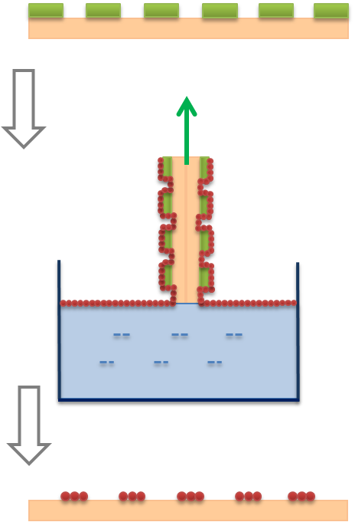
Controlled deposition quantum dots

Slide 5
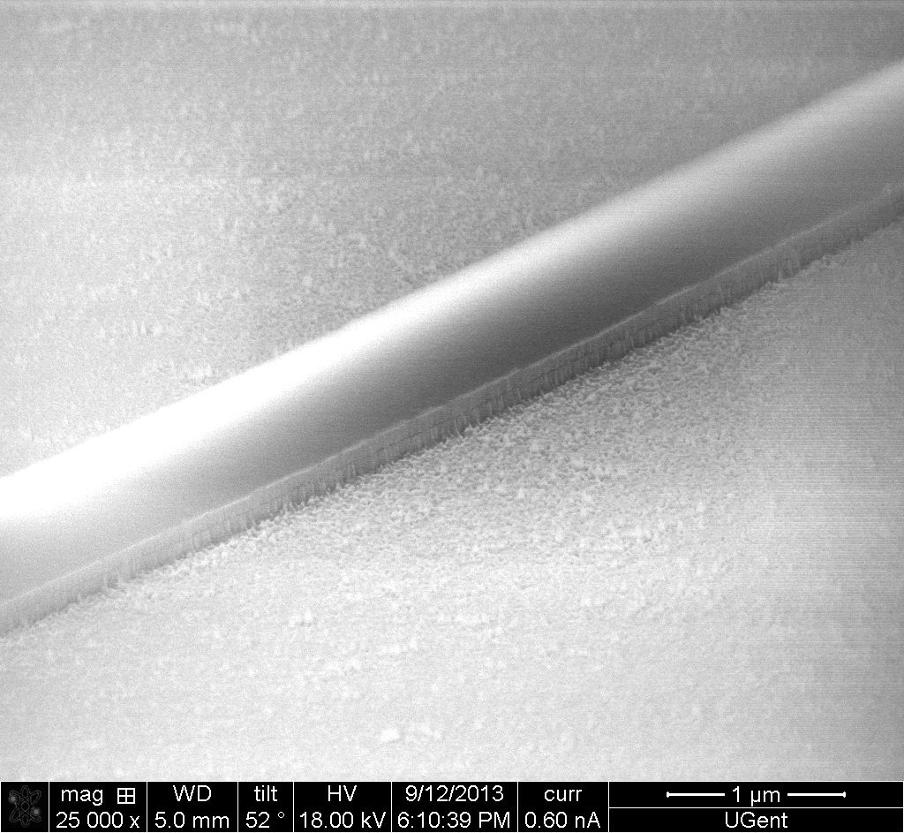
SiN waveguides with embedded quantum dots

Slide 6
Deliverables and milestones
D5.3 (filters and couplers): forgot to write it ☹ - planned for beginning of October
D5.5 Report on plasmonic waveguide couplers → KIT to provide input ?
MS22 Demonstration of plasmonic amplifiers with optical pumping exhibiting 10dB gain → not ready

