Slide 1


NAVOLCHI - Nano Scale Disruptive Silicon-Plasmonic Platform for Chip-to-Chip Interconnection

Slide 2
AGENDA

Slide 3
Agenda
Welcome.
Progress of work: Short report from every partner about status of work.
Next deliverables and milestones.
Demonstrator device: Interfaces of sub-devices
Next face-to-face meeting
Open issues.
Next TelConf.

Slide 4
Status of Work:
Partner Presentations
Notes:
Partner presentations (10min each)
Institute / company (short)
Contribution to the project, own work effort and timeline (focus)

Slide 5
  If appropriate: Discussion
  Deliverables & Milestones

Slide 6
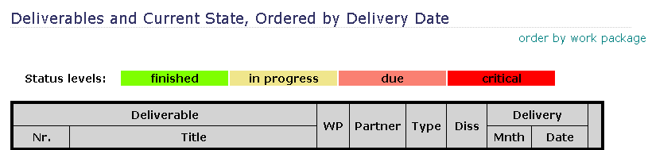
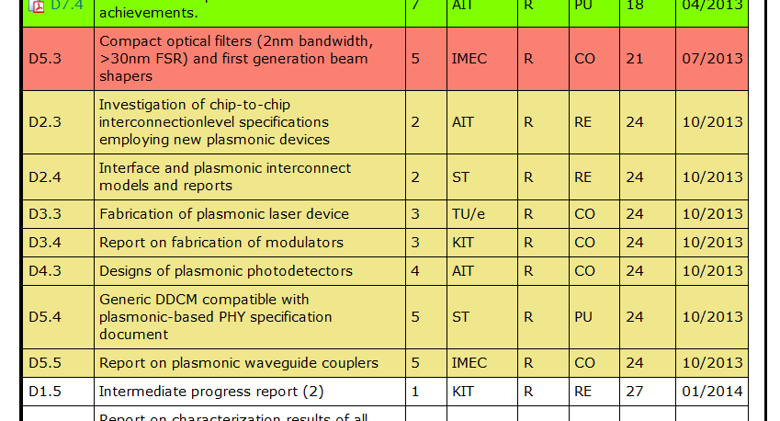
October Deliverable

Slide 7
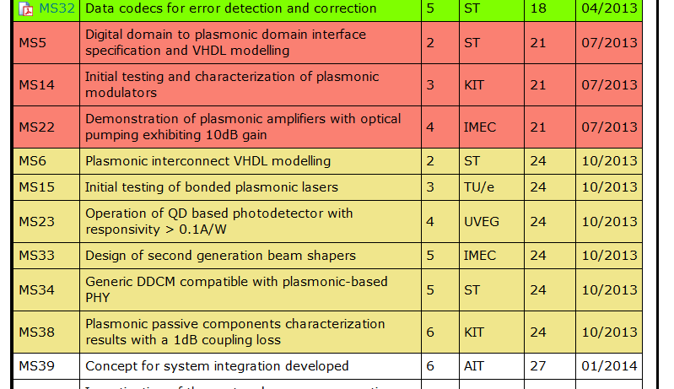
July & Oktober Milestones

Slide 8
  Open Issues
  Next Tel. Conf.

Slide 9
Demonstrator: Interfaces of sub-devices
Can the sub-devices of the demonstrator work together?
Definition of demonstrator capabilities
What sub-devices?
Interface definition of sub-device
Responsibilities:
  AIT: Demonstrator
  Each partner: Sub-devices

Slide 10
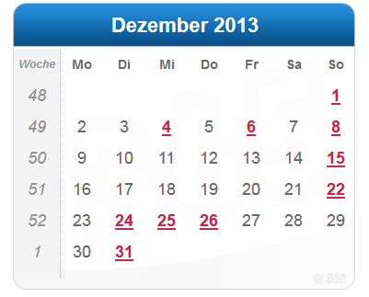
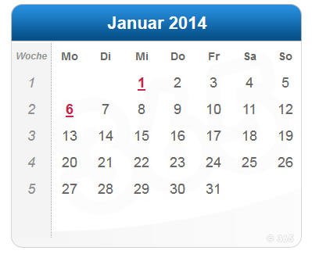
Next face-to-face meeting
Suggested date:
Last week of January 2014?
Location: TUe?

Slide 11
Open Issues
Any important things to discuss?

Slide 12
Next Phone Conference
First Monday of the next month,
4:00 pm (CET)
November 4th, 2013

Slide 13
  Bye!

