Slide 1




Unit of Materials and Optoelectronic Devices
University of Valencia
www.uv.es/umdo
I. Suárez, P.J. Rodríguez-Cantó and J.P. Martínez-Pastor
Current State of the work
Phone Conference November 4th 2013

Slide 2
Plasmonics amplifiers
PMMA ridge waveguides
Fabrication in LAAS-CNRS by I. Suárez
PMMA
SiO₂
Si
2/9

Slide 3
Plasmonics amplifiers
Active HgTe waveguides
No problem with fabrication conditions
Wave-guiding PL when pumped in the UV
Current experiments with Nd:Yag and Ti:Al₂O₃
3/9

Slide 4
Photodetectors: Milestone 23
Milestone 23 – in progress (delayed up to December?)
Issues being addressed:
Enhancement of Responsivity at the near and mid IR of QD-Schottky PD
Nanogap design under fabrication and simulation.
    Current tasks:
    Improvement of stoichiometry and purification of “big” PbS (5-6 nm), PbSe (7-8 nm) QDs to get better Responsivities - > under characterization
    Samples with a thickness between 300-500 nm successfully produced by using Dr. Blade
    Compared to MPA as ligand, Br- and I- may reduce defect density -> improved QD Passivation -> increase of electrical length - > under characterization
    Lead-free Ag₂S (QY 2-3%) and Ag₂S/ZnS CS (QY up to 40%) NCs are being synthesized as promising candidates for the PD application.
4/9

Slide 5
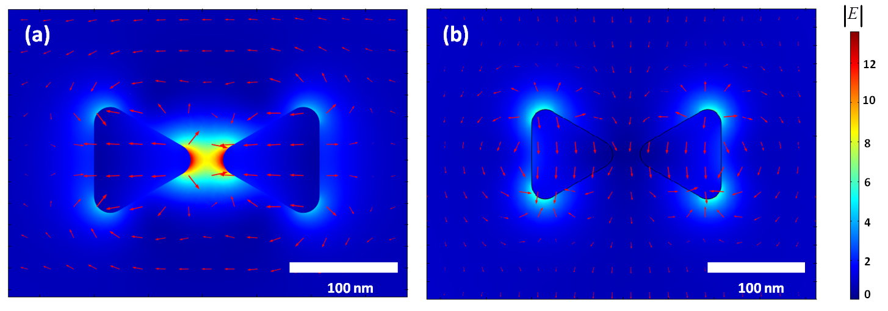
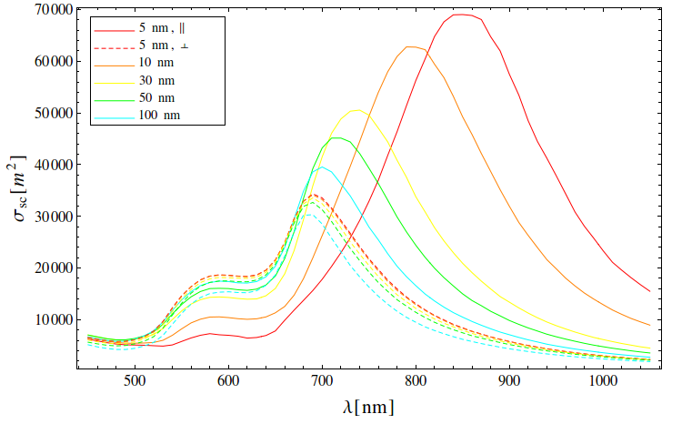
D4.3 Design of Plasmonic Photodetectors
Nanogap-photodetector: nanoantenna-type
    Distribution of electric field at 780 nm in the plane of a bowtie nanoantenna (gap distance = 30 nm) along the direction parallel (a) and perpendicular (b) to its gap major axis; (c) Scattering cross-section as a function of the wavelength.
5/9

Slide 6
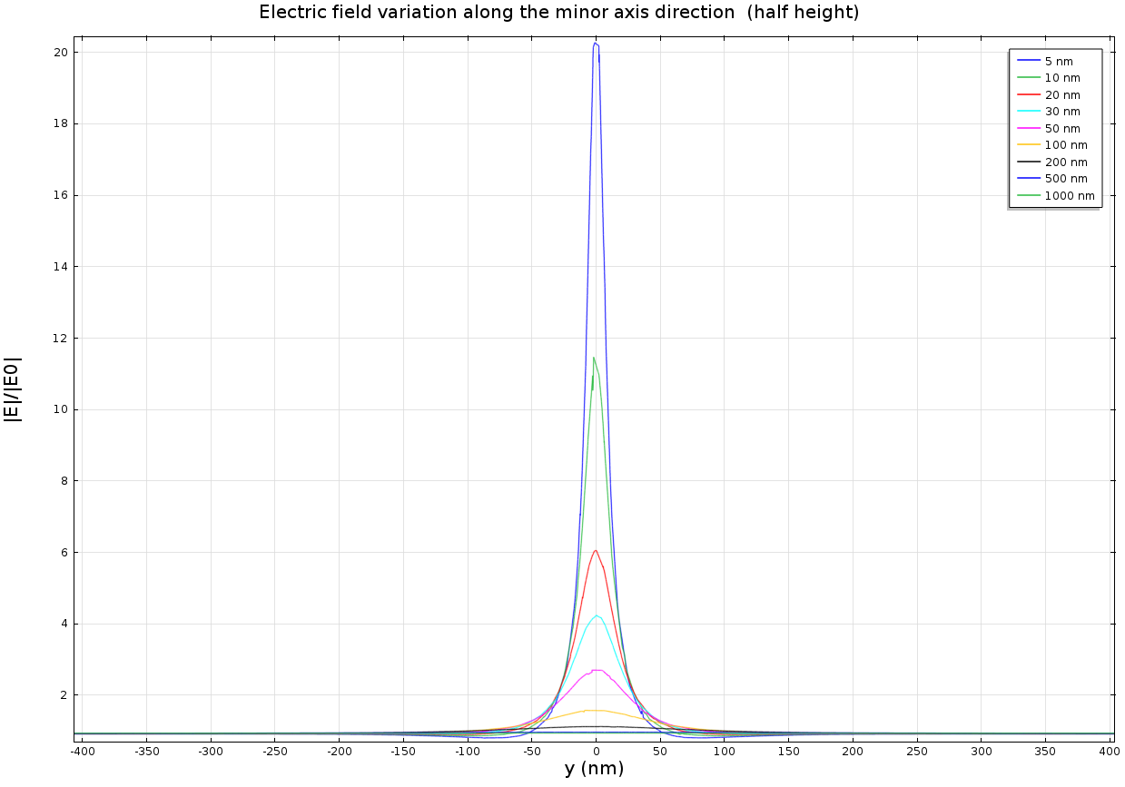
D4.3 Design of Plasmonic Photodetectors
Nanogap-photodetector: nanoantenna-type
    Electric field enhancement at 1550 nm along the direction perpendicular to the gap major axis of the bowtie nanoantenna for several gap distances.
6/9

Slide 7
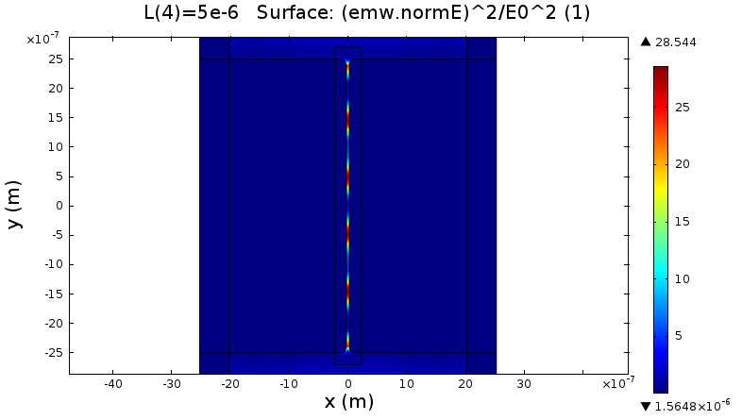
D4.3 Design of Plasmonic Photodetectors
Nanogap-waveguide photodetector
    Distribution of electric field intensity at 1550 nm in a nano-GPW 5 mm long and gap distance equal to 50 nm (top panel).
7/9

Slide 8
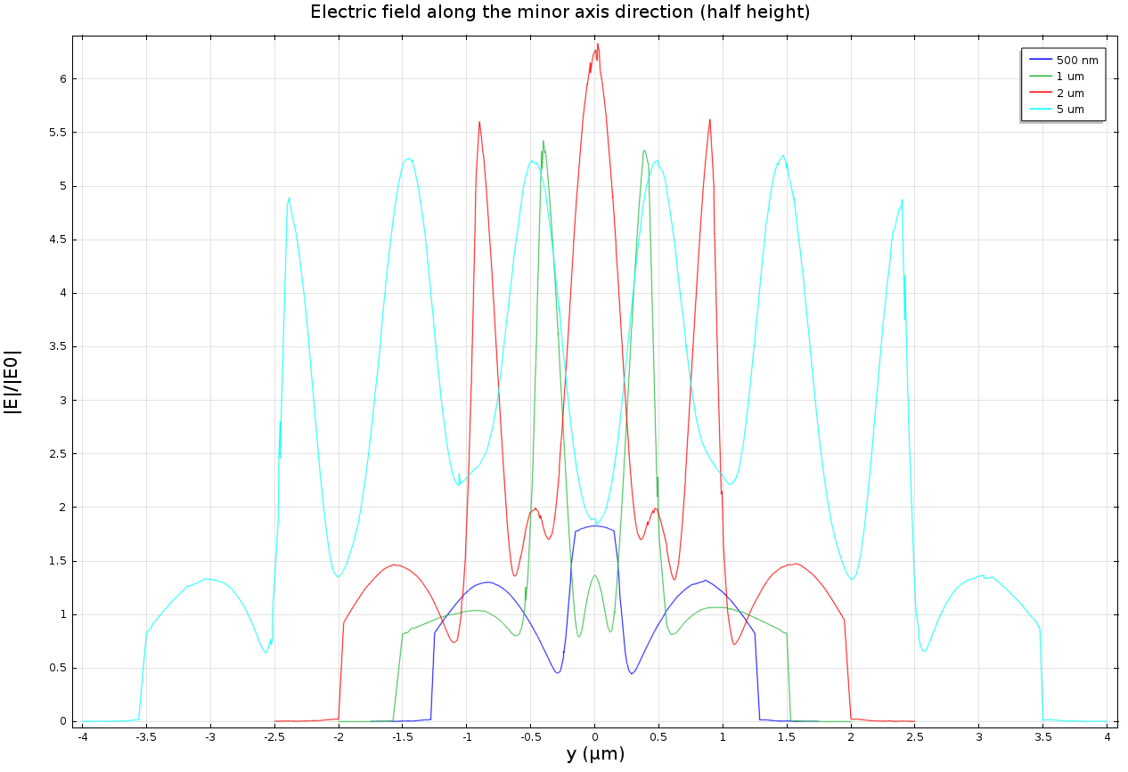
D4.3 Design of Plasmonic Photodetectors
Nanogap-waveguide photodetector
    Electric field variation at 1550 nm in a nano-GPW of different lengths (the gap distance is fixed to 50 nm)
8/9

Slide 9
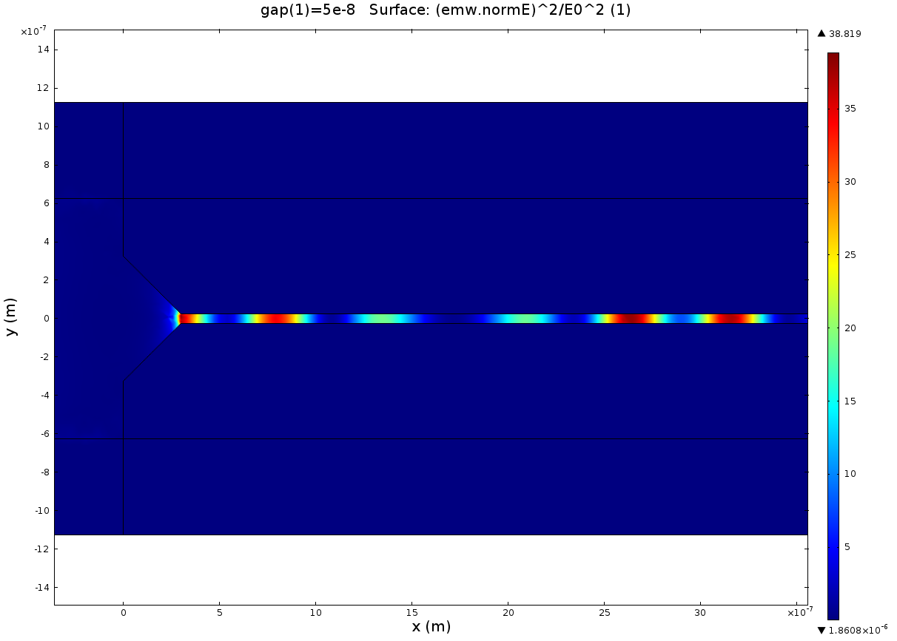
D4.3 Design of Plasmonic Photodetectors
Nanogap-waveguide photodetector
    Distribution of electric field intensity at 1550 nm in a nano-GPW 5 mm long and gap distance equal to 50 nm (top panel) by coupling in-plane light (planar wave from the left).
9/9

