Slide 1

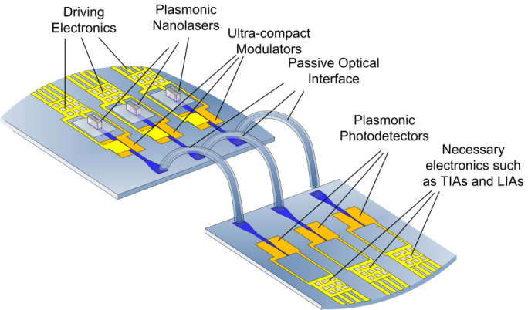
STMicroelectronics
Progress Report

Slide 2
NAVOLCHI demonstrator implementation
Board
FPGA
Plasmonic LASERs
Bi-synchronous FIFO
OBI Enc
BI
Enc
Plasmonic modulators
Ser
Driver
89
89
90
3
4
4
4
Light beams
Optical Bus Inverter (OBI) Encoder minimizes the number of ones in 89 bits data word in order to reduce the number of LASERs turned on
Bus inverter (BI) encoder minimizes the Hamming distance between back to back 4 bits data words in order to minimize the switching activity of each LASER

Slide 3
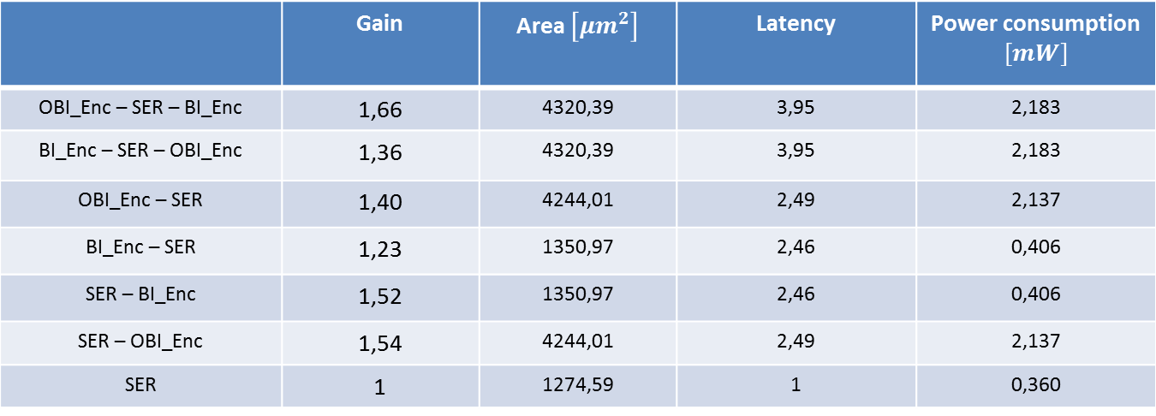
Analysis Results
We carried out several tests placing the C language model of the blocks OBI_Enc, SER and BI_Enc alternately in a different sequence; in each one we used the same input vectors and verified that the best arrangement is OBI_Enc-SER-BI_Enc in terms of minimization of the number of ‘1’ and transactions between two back-to-back data words.
The analysis results and the characterization of the different arrangements in terms of area occupation, latency and power consumption are shown in the following table.
Arrangement | Average Gain % |  | Latency
OBI_Enc – SER – BI_Enc | 60 | 4320,39 | 4 | 2,183
SER – OBI_Enc | 41 | 4244,01 | 2 | 2,137
SER – BI_Enc | 38 | 1350,97 | 2 | 0,406
OBI_Enc – SER | 23 | 4244,01 | 3 | 2,137
BI_Enc – SER – OBI_Enc | 20 | 4320,39 | 4 | 2,183
BI_Enc – SER | 9 | 1350,97 | 3 | 0,406
SER | 0 | 1274,59 | 1 | 0,360

Slide 4
Analysis Result
The Average Gain %, shown in the table on the previous slide, is the arithmetic mean of the percentage gains obtained for each bit vector taken as input sample.
This gain was calculated as the ratio between the percentage of '0 'obtained in output compared to that present at the input.
Input vectors consisting of all ‘1’ or all ‘0’ have been excluded from the tests, because they represent two limiting cases of zero and infinite gain, regardless of the arrangement of the blocks.

Slide 5
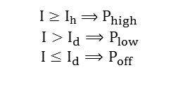
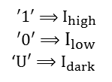
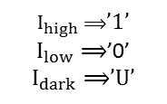
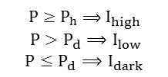

VHDL Models of Plasmonic Devices
ModulatorDriver
Laser
Optical
Power
Plasmonic Waveguide
Optical
Power
Optical
Power
Plasmonic Photodetector
TIA
CMOS
0/1
Current
Current
0/1
Plasmonic
Amplifier
4
4
4
4
4
4
4
$τ$,G(<1)
G(>1)
$$′1′⟹I_{high}$$
$$′0′⟹I_{low}$$
‘$U′⟹I_{dark}$
${I≥I}_{h}⟹$ $P_{high}$
$${I>I}_{d}⟹P_{low}$$
$${I≤I}_{d}⟹P_{off}$$
${P≥P}_{h}⟹$ $I_{high}$
$${P>P}_{d}⟹I_{low}$$
$${P≤P}_{d}⟹I_{dark}$$
$I_{high}⟹$’1’
$I_{low}⟹$’0’
$I_{dark}⟹$’U’

Slide 6
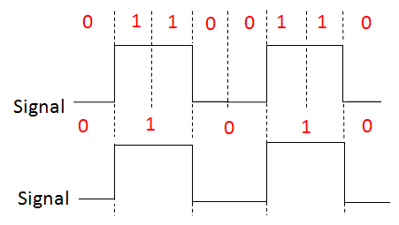
Digital Clock Recovery
Serial data stream could have multiple interpretations in the Receiver as shown in the next figure
TIAs
4
4
There is need to recover the clock from the data stream and to use it to sample the data to extract the individual data bits.
This task is carried out by a Clock Recovery Circuit.

Slide 7
Digital Clock Recovery
Decision Making Circuit
Data
TIAs
4
4
Clock Recovery Circuit
Incoming data
Recovered
Clock
Clock
Clock Recovery Circuit allows the Receiver to regenerate serial data with the fewest bit errors and to obtain a correct interpretation of itself.

Slide 8

Digital Clock Recovery
Edge Detection
Sampling Circuit
D
Q
D-Flip Flop
Serial data
Digital Clock Recovery Circuit
The implemented Digital Clock Recovery Circuit consists of two main blocks:
an Edge Detection Circuit
a Sampling Circuit
The first generates a pulse when ‘0’ to ‘1’ or ‘1’ to ‘0’ transition of the incoming data occurs; the second contains a 3 bit counter whose clock signal is approximately 8 times the data rate and the MBS of its output is used as the Sampling Point of data. This is approximately in the centre of the data bit. Moreover, an input transition gets reset the counter; then the output of Sampling Circuit is the clock signal for a D-flip flop to regenerate the real content of the data.

Slide 9
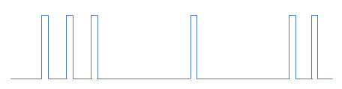
Edge Detection Circuit
The circuit which implements this function is shown in the following figure.
Vcc
Vcc
D
PRN
Q
CLRN
Vcc
Vcc
EDGES
D
PRN
Q
CLRN
The upper flip-flop generates a pulse from a negative transition of the incoming data, while
the lower generates a pulse from a positive transition.
Pulse width depends on flip-flop and inverter delay.

Slide 10

Sampling Circuit
Counter
1
0
0
Data
CLK*8
SAMPLE
$$\left[2…0\right]$$
Edges
EDGES
Sample
Counter
0 1 2 3 4 5 6
0 1 2 3 4 5 6 7
0 1 2 3 4
If a edge signal occurs, the counter is reset early.
If there are successive bits of the same states, the counter free-runs and continues to sample the data correctly.
1
0
0
Data
Recovered
Clock
t

Slide 11
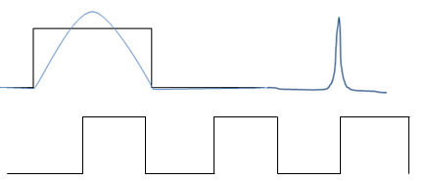
Question
The presence of a glitch in correspondence of the instant of sampling may cause a misinterpretation of the signal.
Data
Recovered
Clock
1
0
1
Could the laser cause glitch in the transmitted signal?

Slide 12
Short term plan
Fine tuning of plasmonic components models
Full verification of VHD building-blocks
Sythesis for FPGA of all VHDL building-blocks
Deliverables (D2.4, D5.4) and milestones (M6, M34) forecasted for end of October will suffer of some delay.

