Slide 1


NAVOLCHI - Nano Scale Disruptive Silicon-Plasmonic Platform for Chip-to-Chip Interconnection

Slide 2
AGENDA

Slide 3
Agenda
Welcome.
Progress of work: Short report from every partner about status of work.
Deliverables and Milestones.
Intermediate Report.
Meeting in Eindhoven.
Open issues.
Next TelConf.

Slide 4
Status of Work:
Partner Presentations
Notes:
Partner presentations (10min each)
Institute / company (short)
Contribution to the project, own work effort and timeline (focus)

Slide 5
  If appropriate: Discussion
  Deliverables & Milestones

Slide 6
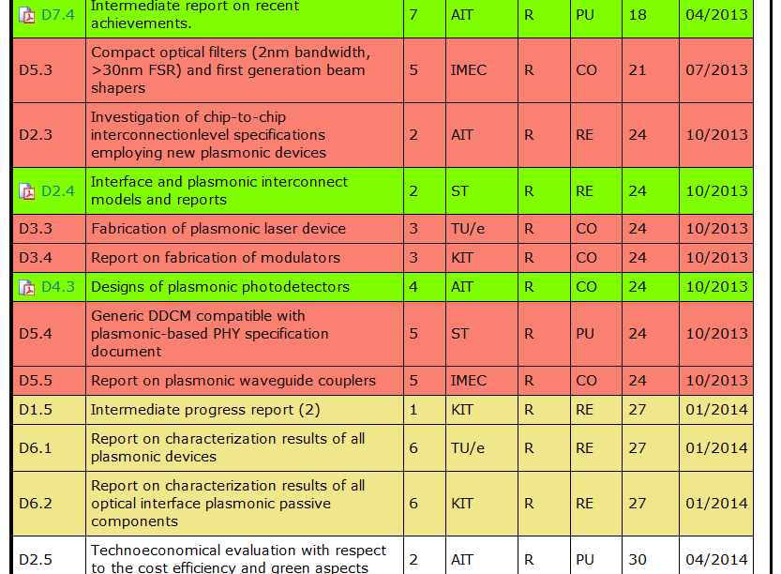
Missing and Upcoming Deliverables

Slide 7
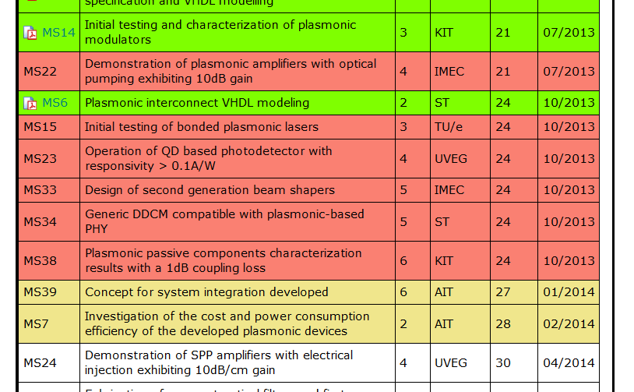
Missing and Upcoming Milestones

Slide 8
Open Issues
Second Intermediate Report
WP leaders:
Please send WP contribution to me
until mid of January!
(no FormCs, no finances)

Slide 9
Open Issues
Meeting in Eindhoven (27th/28th of Jan.)
Further contributions from ST, AIT
Demonstrator (concept, design, status of subdevices, integration, ..
..

Slide 10
  Open Issues
  Next Tel. Conf.

Slide 11
Open Issues
Any important things to discuss?

Slide 12
Next Phone Conference
First Monday of the next month,
4:00 pm (CET)
Skip February,
→ March 3rd, 2014

Slide 13
  Bye!

