Slide 1
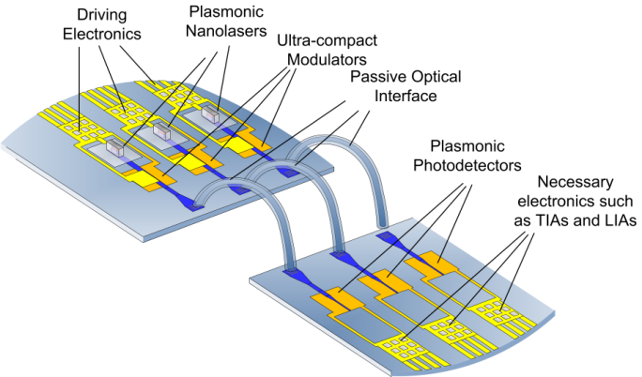
STMicroelectronics Progress Report

Slide 2
Recent progress
Completed digital building-blocks design and verification
Completed plasmonic interconnect models and verification
In order to simplify and speed up FPGA mapping, instead of the whole system (two DDCM modules) only PHY Adapter will be mapped and driven from external sources

Slide 3
NAVOLCHI demonstrator implementation (1/2)
Board
FPGA
Plasmonic LASERs
Bi-synchronous FIFO
OBI Enc
BI
Enc
Plasmonic modulators
Ser
Driver
89
89
90
3
4
4
4
Light beams
Optical Bus Inverter (OBI) Encoder minimizes the number of ones in 89 bits data word in order to reduce the number of LASERs turned on
Bus inverter (BI) encoder minimizes the Hamming distance between back to back 4 bits data words in order to minimize the switching activity of each LASER

Slide 4
NAVOLCHI demonstrator implementation (2/2)
Board
Light beams
FPGA
Bi-synchronous FIFO
OBI Dec
BI Dec
Plasmonic detectors
Des
Comparators
TIAs
89
89
90
3
4
4
4

Slide 5
VHDL Models of Plasmonic Devices
ModulatorDriver
Laser
Optical
Power
Plasmonic Waveguide
Optical
Power
Optical
Power
Plasmonic Photodetector
TIA
CMOS
0/1
Current
Current
0/1
Plasmonic
Amplifier
4
4
4
4
4
4
4
$τ$,G(<1)
G(>1)
$$′1′⟹I_{high}$$
$$′0′⟹I_{low}$$
‘$U′⟹I_{dark}$
${I≥I}_{h}⟹$ $P_{high}$
$${I>I}_{d}⟹P_{low}$$
$${I≤I}_{d}⟹P_{off}$$
${P≥P}_{h}⟹$ $I_{high}$
$${P>P}_{d}⟹I_{low}$$
$${P≤P}_{d}⟹I_{dark}$$
$I_{high}⟹$’1’
$I_{low}⟹$’0’
$I_{dark}⟹$’U’

Slide 6
Short term plan
Full verification of VHD building-blocks and plasmonic component models (this week)
Synthesis for FPGA of all VHDL building-blocks (this and next week, delayed for some HW failures)
Deliverables (D5.4) and milestones (M34) forecasted for end of October suffered of some delay, related documents will be delivered within this week

Slide 7
Issues
ISG (Interconnect Systems Group) has been closed and all its resources have been moved to MCD (Micro Controller Division)
MCD has no interest in NAVOLCHI project, nevertheless ST doesn’t want to leave the project at this stage
MCD can guarantee only the completion of the digital parts design and the FPGA mapping, while board design and implementation for demonstrator cannot be carried out
Activity and related budget has to be moved to another partner
Not possible to attend the meeting in Eindhoven for heavy cost reduction

