Slide 1
NAVOLCHI - Nano Scale Disruptive Silicon-Plasmonic Platform for Chip-to-Chip Interconnection

Slide 2
AGENDA

Slide 3
Agenda
Welcome.
Deliverables and Milestones.
Intermediate Report.
Future of WP6
Progress of work: Short report from every partner about status of work.
Open issues.
Next TelConf.

Slide 4
Deliverables & Milestones

Slide 5
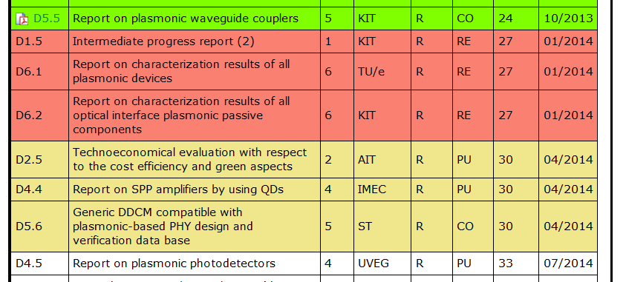
Missing and Upcoming Deliverables

Slide 6
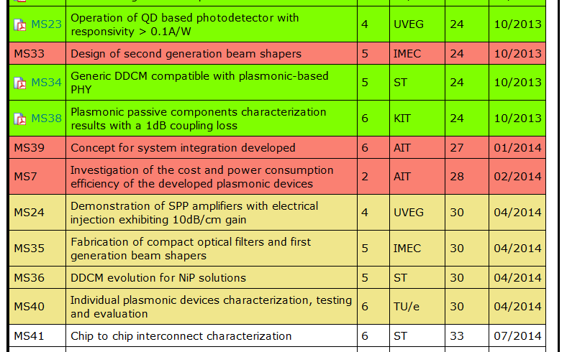
Missing and Upcoming Milestones

Slide 7
Second Intermediate Report
Missing:
Confirmation of Extension: UVEG, ST
IPR2:
WP4: Summary, Objectives → UVEG
WP6: T6.1, T6.4: All, except KIT → AIT
WP4 (UVEG) and WP7 (AIT) seem to be incomplete
Publications: Send to AIT & KIT, Confirm!
@WP leaders:
Please send contributions to me
until Wednesday!

Slide 8
Future of WP6
Task 6.1: Characterisation of active and passive plasmonic devices [M7-M33, TL: AIT]
Task 6.2: Assembly and packaging of plasmonic devices into System in Package [M30-M36 , TL: KIT]
Task 6.3: Plasmonic chip to chip interconnect prototype testing and evaluation [M32-M36 , TL: AIT]
Task 6.4: System-in-Package integration and Characterization [M22-M36 , TL: AIT]

Slide 9
Status of Work:
Partner Presentations
If appropriate: Discussion
Notes:
Partner presentations (10min each)
Institute / company (short)
Contribution to the project, own work effort and timeline (focus)

Slide 10
Open Issues
Next Tel. Conf.

Slide 11
Open Issues
Any important things to discuss?

Slide 12
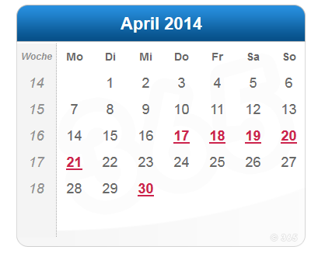
Next Phone Conference
First Monday of the next month,
4:00 pm (CET)
→ April 7th, 2014

Slide 13
Bye!

