Slide 1
NAVOLCHI V. Calzadilla April 2014

Slide 2
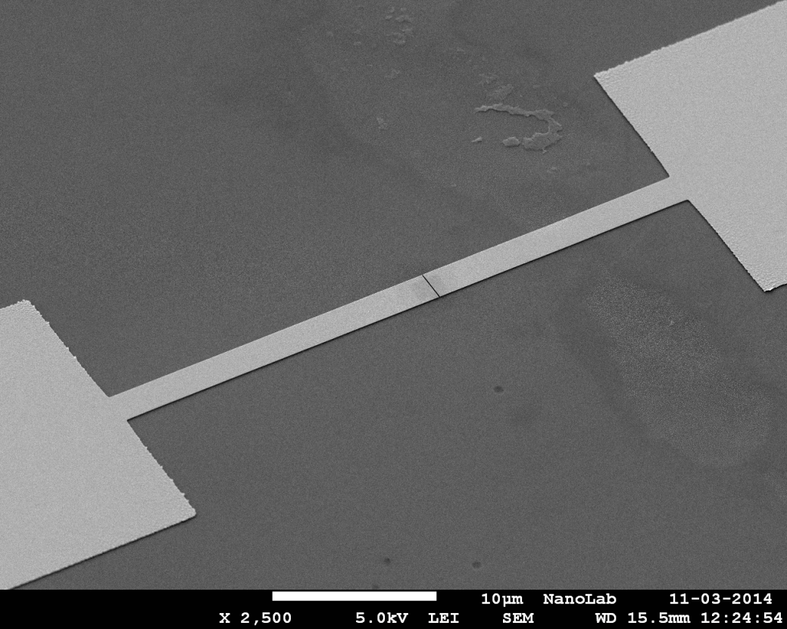
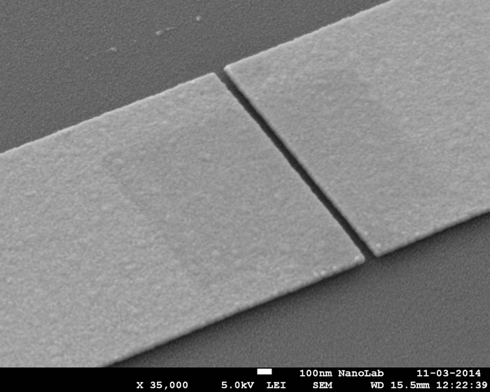
Nanogap structures for University of Valencia
Line width: 1um, 2um, and 5um
Gaps: 40um – 80um
Samples sent to Valencia

Slide 3
Bonding issue (outgassing)
Outgassing at temperatures higher than 300C
Experiments:
High temperature bonding (350C) → failed
Bonding on vacuum → to be tested in UGhent (a wafer has been sent)
Currently learning to do III-V/Si bondings

