Slide 1


NAVOLCHI - Nano Scale Disruptive Silicon-Plasmonic Platform for Chip-to-Chip Interconnection

Slide 2
AGENDA

Slide 3
Agenda
Welcome.
Deliverables and Milestones.
ST Situation.
Progress of work: Short report from every partner about status of work.
Open issues.
Next TelConf.

Slide 4
  Deliverables & Milestones

Slide 5
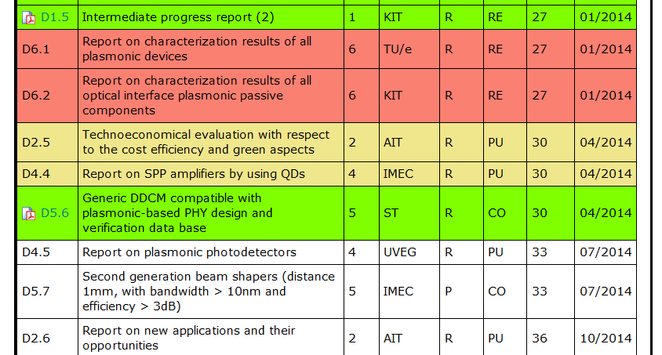
Missing and Upcoming Deliverables

Slide 6
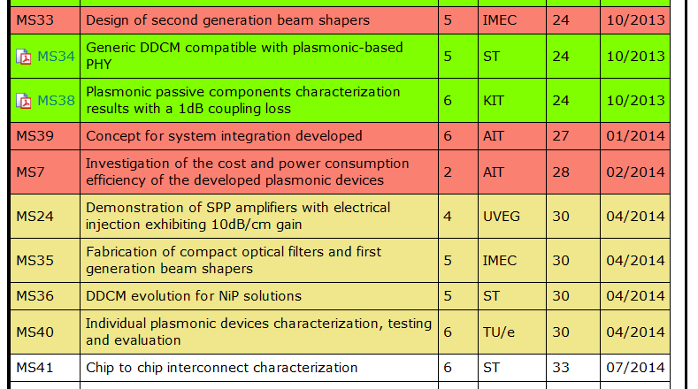
Missing and Upcoming Milestones

Slide 7
Status of Work:
Partner Presentations
  If appropriate: Discussion
Notes:
Partner presentations (10min each)
Institute / company (short)
Contribution to the project, own work effort and timeline (focus)

Slide 8
  Open Issues
  Next Tel. Conf.

Slide 9
Open Issues
Any important things to discuss?

Slide 10
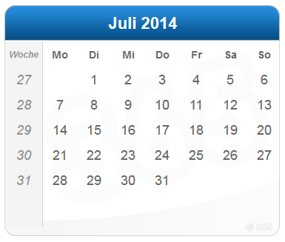
Next Phone Conference
First Monday of every month,
4:00 pm (CET)
July 7th, 2014

Slide 11
  Bye!

