Slide 1

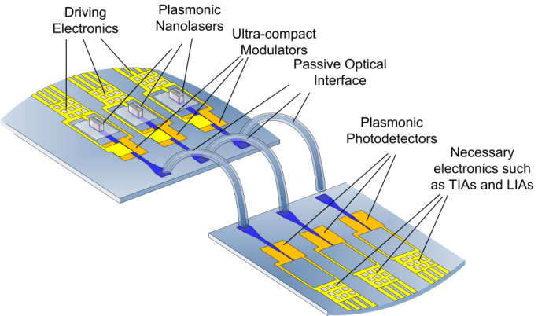
STMicroelectronics
Progress Report

Slide 2
Current situation
All deliverables and milestones, except MS36 (DDCM evolution for NiP solutions), have been released
Not clear what to do with MS36, since no activity is now scheduled for that
NAVOLCHI-specific activities, except documentation, have been stopped for 3 months up to now
Depending on partners activities schedule, a plan to refine Valentina Cernuto’s activity result (design of electronic parts of off-chip link and mapping on FPGA) and deliver it to partners will be defined

