Slide 1




Unit of Materials and Optoelectronic Devices
University of Valencia
www.uv.es/umdo
I. Suárez, P.J. Rodríguez-Cantó and J.P. Martínez-Pastor
Current State of the work
Phone Conference July 25th 2014

Slide 2
Outline
1-Deliverables and milestones
2-Current Status of the work
2.1-Plasmonic amplifiers by using polymers doped with QDs
2.2-Photodetectors based on QDs and polymers
2/11

Slide 3
Deliverables and Milestones
 | Names of the Milestones | Month | Partner
MS24 | Demonstration of SPP amplifiers with electrical injection exhibiting 10dB/cm gain | 30 | UVEG
 | Names of the Deliverables | Month | Partner
D4.4 | Report on SPP amplifiers by using QDs | 30 | IMEC
D4.5 | Report on plasmonic photodetectors | 33 | UVEG
3/11

Slide 4
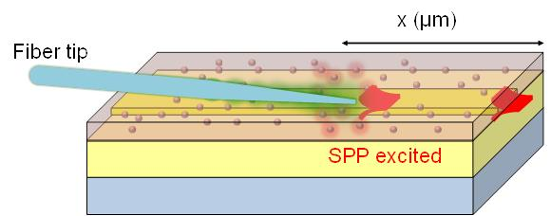
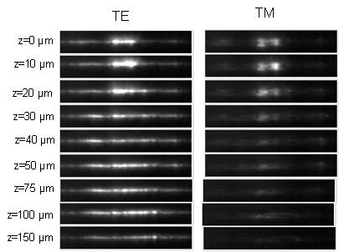
Plasmonics amplifiers: HgTe
Plasmonic waveguides at 1550 nm
z (μm)
ff <0.1 to avoid roughness and refractive index mismatching
Clear difference between TE and TM
Good correspondence with simulations but Lp is not enhanced (low ff)
4/11

Slide 5
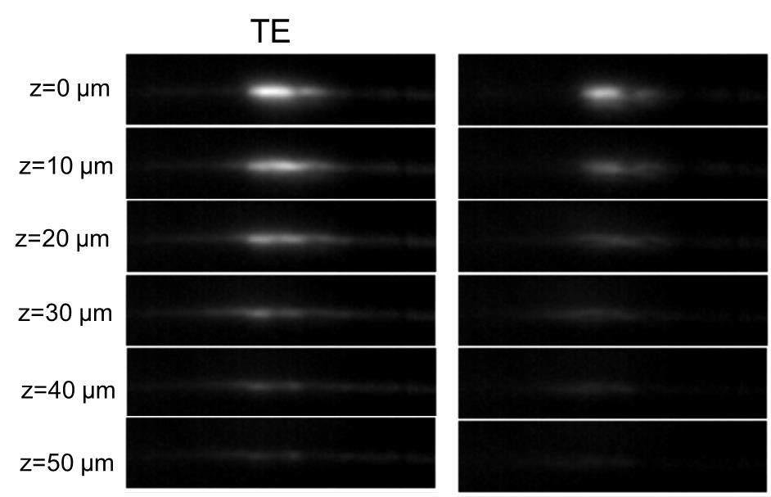
Plasmonics amplifiers: HgTe
Plasmonic waveguides at 1550 nm
z (μm)
High ff provides better signal but refractive index mismatching and LR-SPP is converted to a hybrid plasmonic-photonic mode
Losses increased due to roughness and some losses compensation in the modes (14 % in the SR-SPP and 15 % in the hybrid mode)
10 dB
5/11

Slide 6
Plasmonics amplifiers: HgTe
Plasmonic waveguides at 1550 nm
Summary
Low ff it is possible to see LR-SPP but no enhancement
High ff LR-SPP becomes a hybrid photonic-plasmonic mode but there is enhancement
It is possible to measure and see some enhancement in the SR-SPP
Target of Navolchi: 10 dB gain ➔ There is no net gain but losses compensation allow a 10 fold enhancement of the PL for z>100 μm
Next steps
Other materials with different QY and stokes shift to confirm results:
PbS with emission at 1550 (UVEG)
New badge of HgTe from UGENT?
6/11

Slide 7
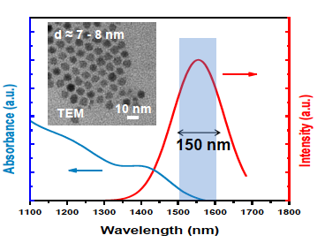
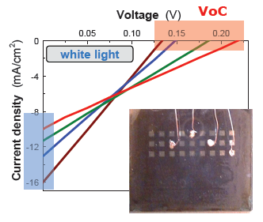
Photodetectors: Schottky
- PbS QDs prepared for absorption at NIR
- PbS QD films prepared by Dr Blade
Best photodiodes with a QD-layer
400 nm thick
7/11

Slide 8
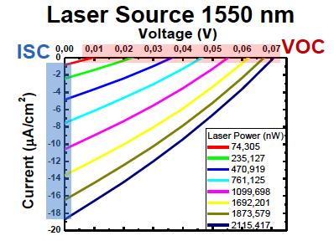
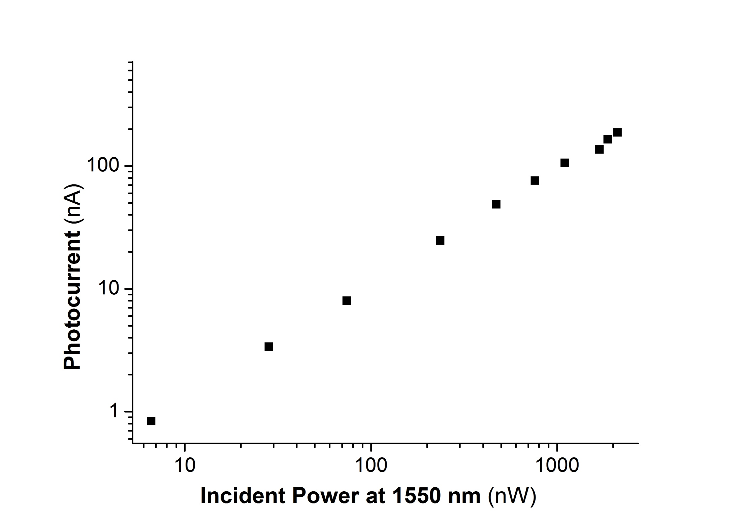
Photodetectors: Schottky
- PbS QDs prepared for absorption at NIR
- PbS QD films prepared by Dr Blade
I₀ = 70 nA
A = 3.1
R_{sh} decreases with illumination
8/11

Slide 9
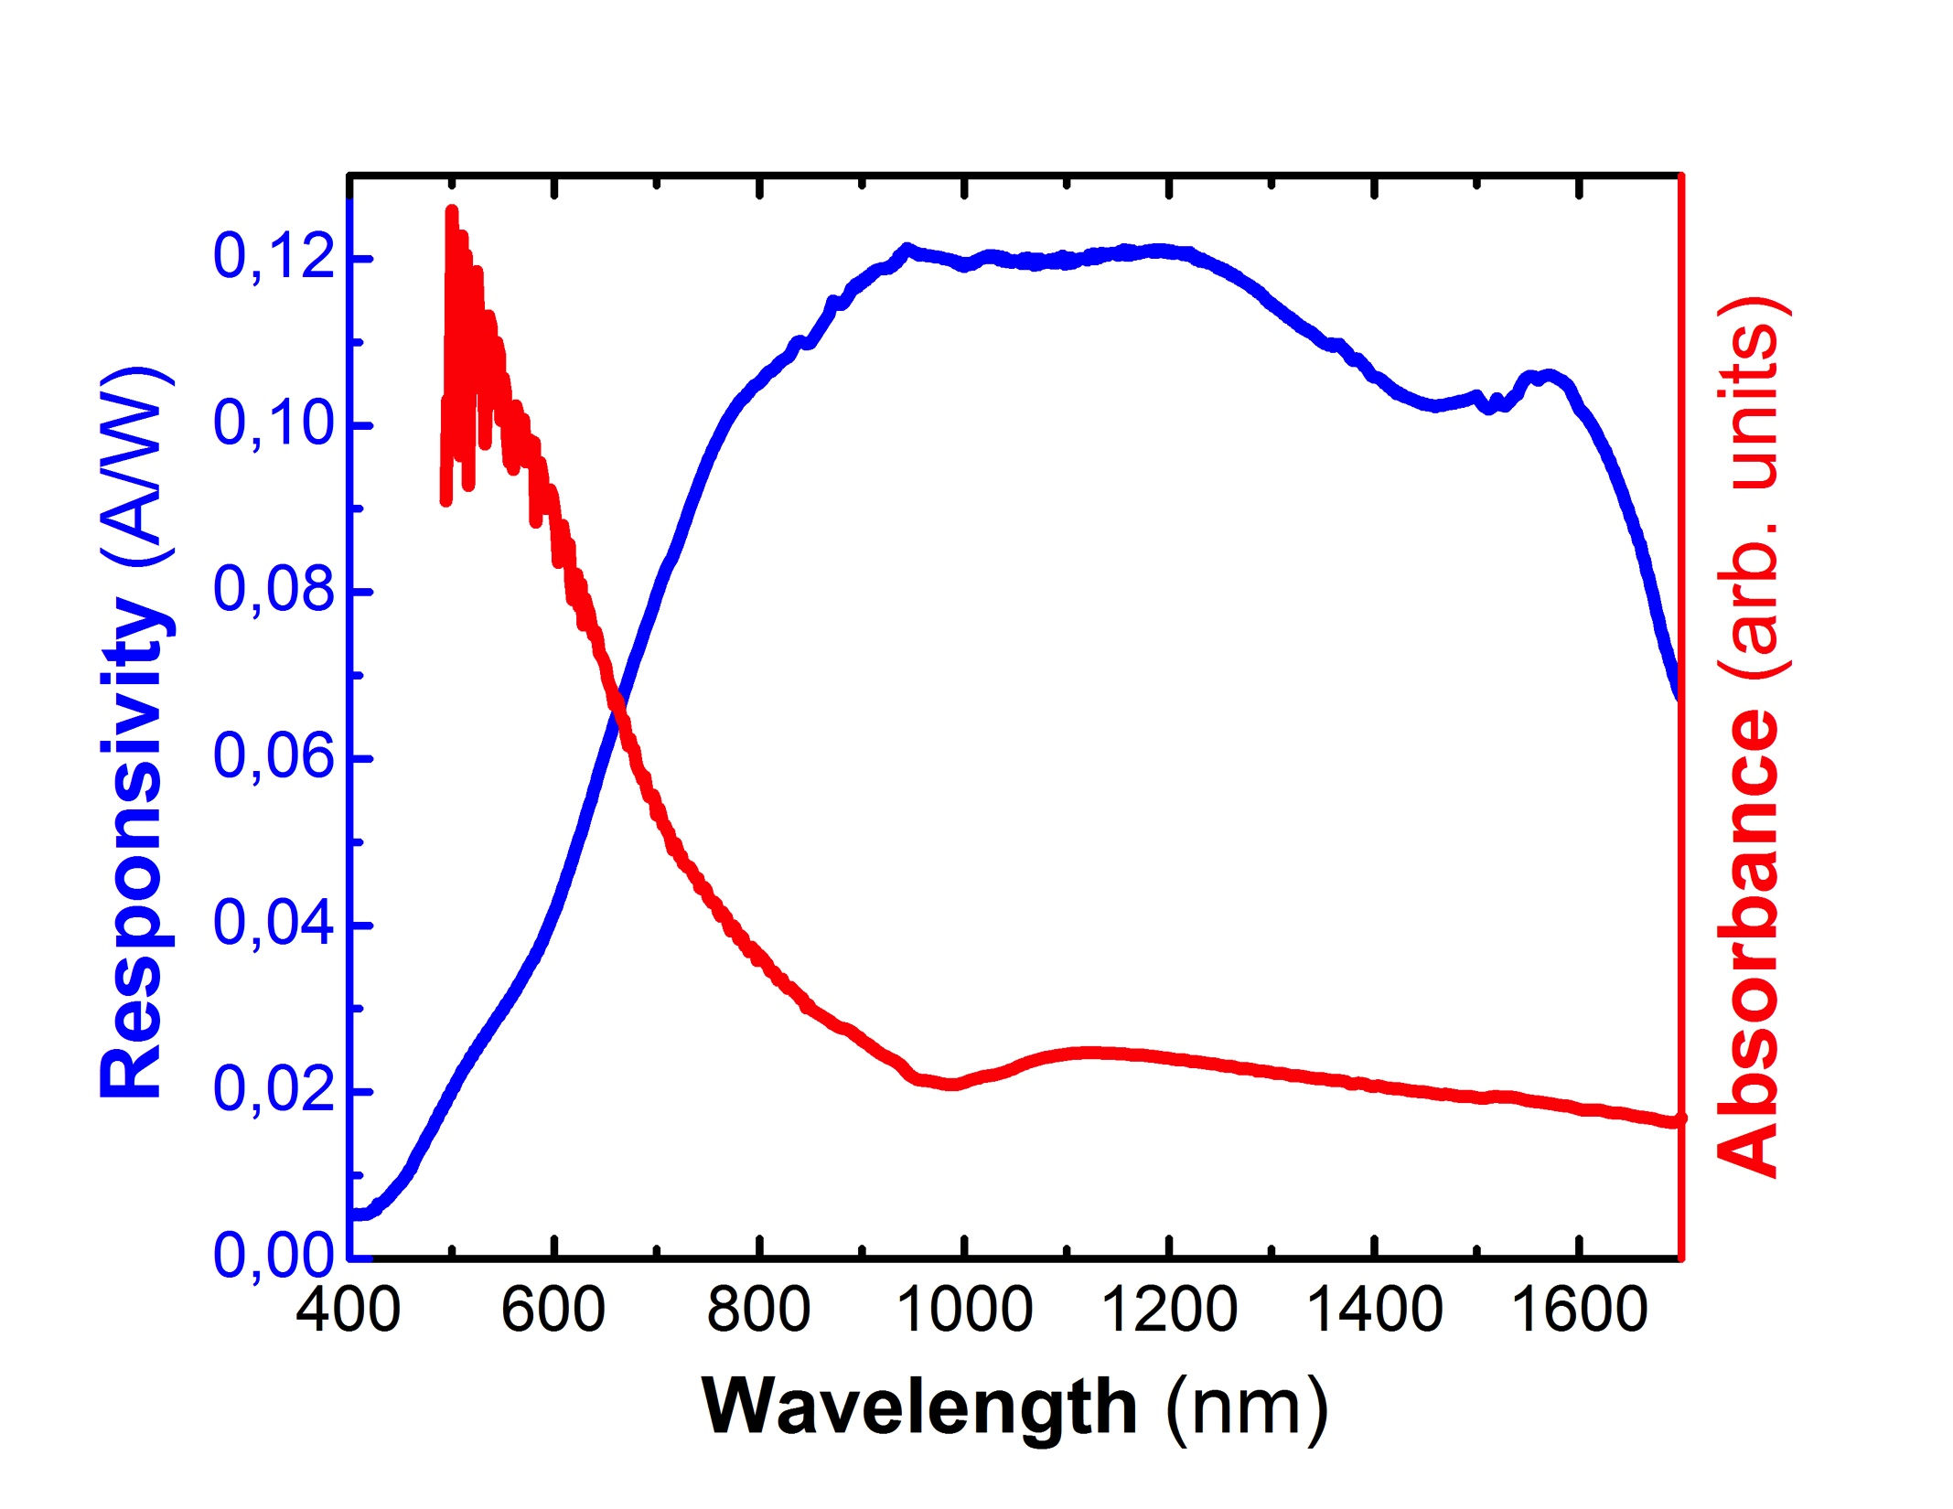
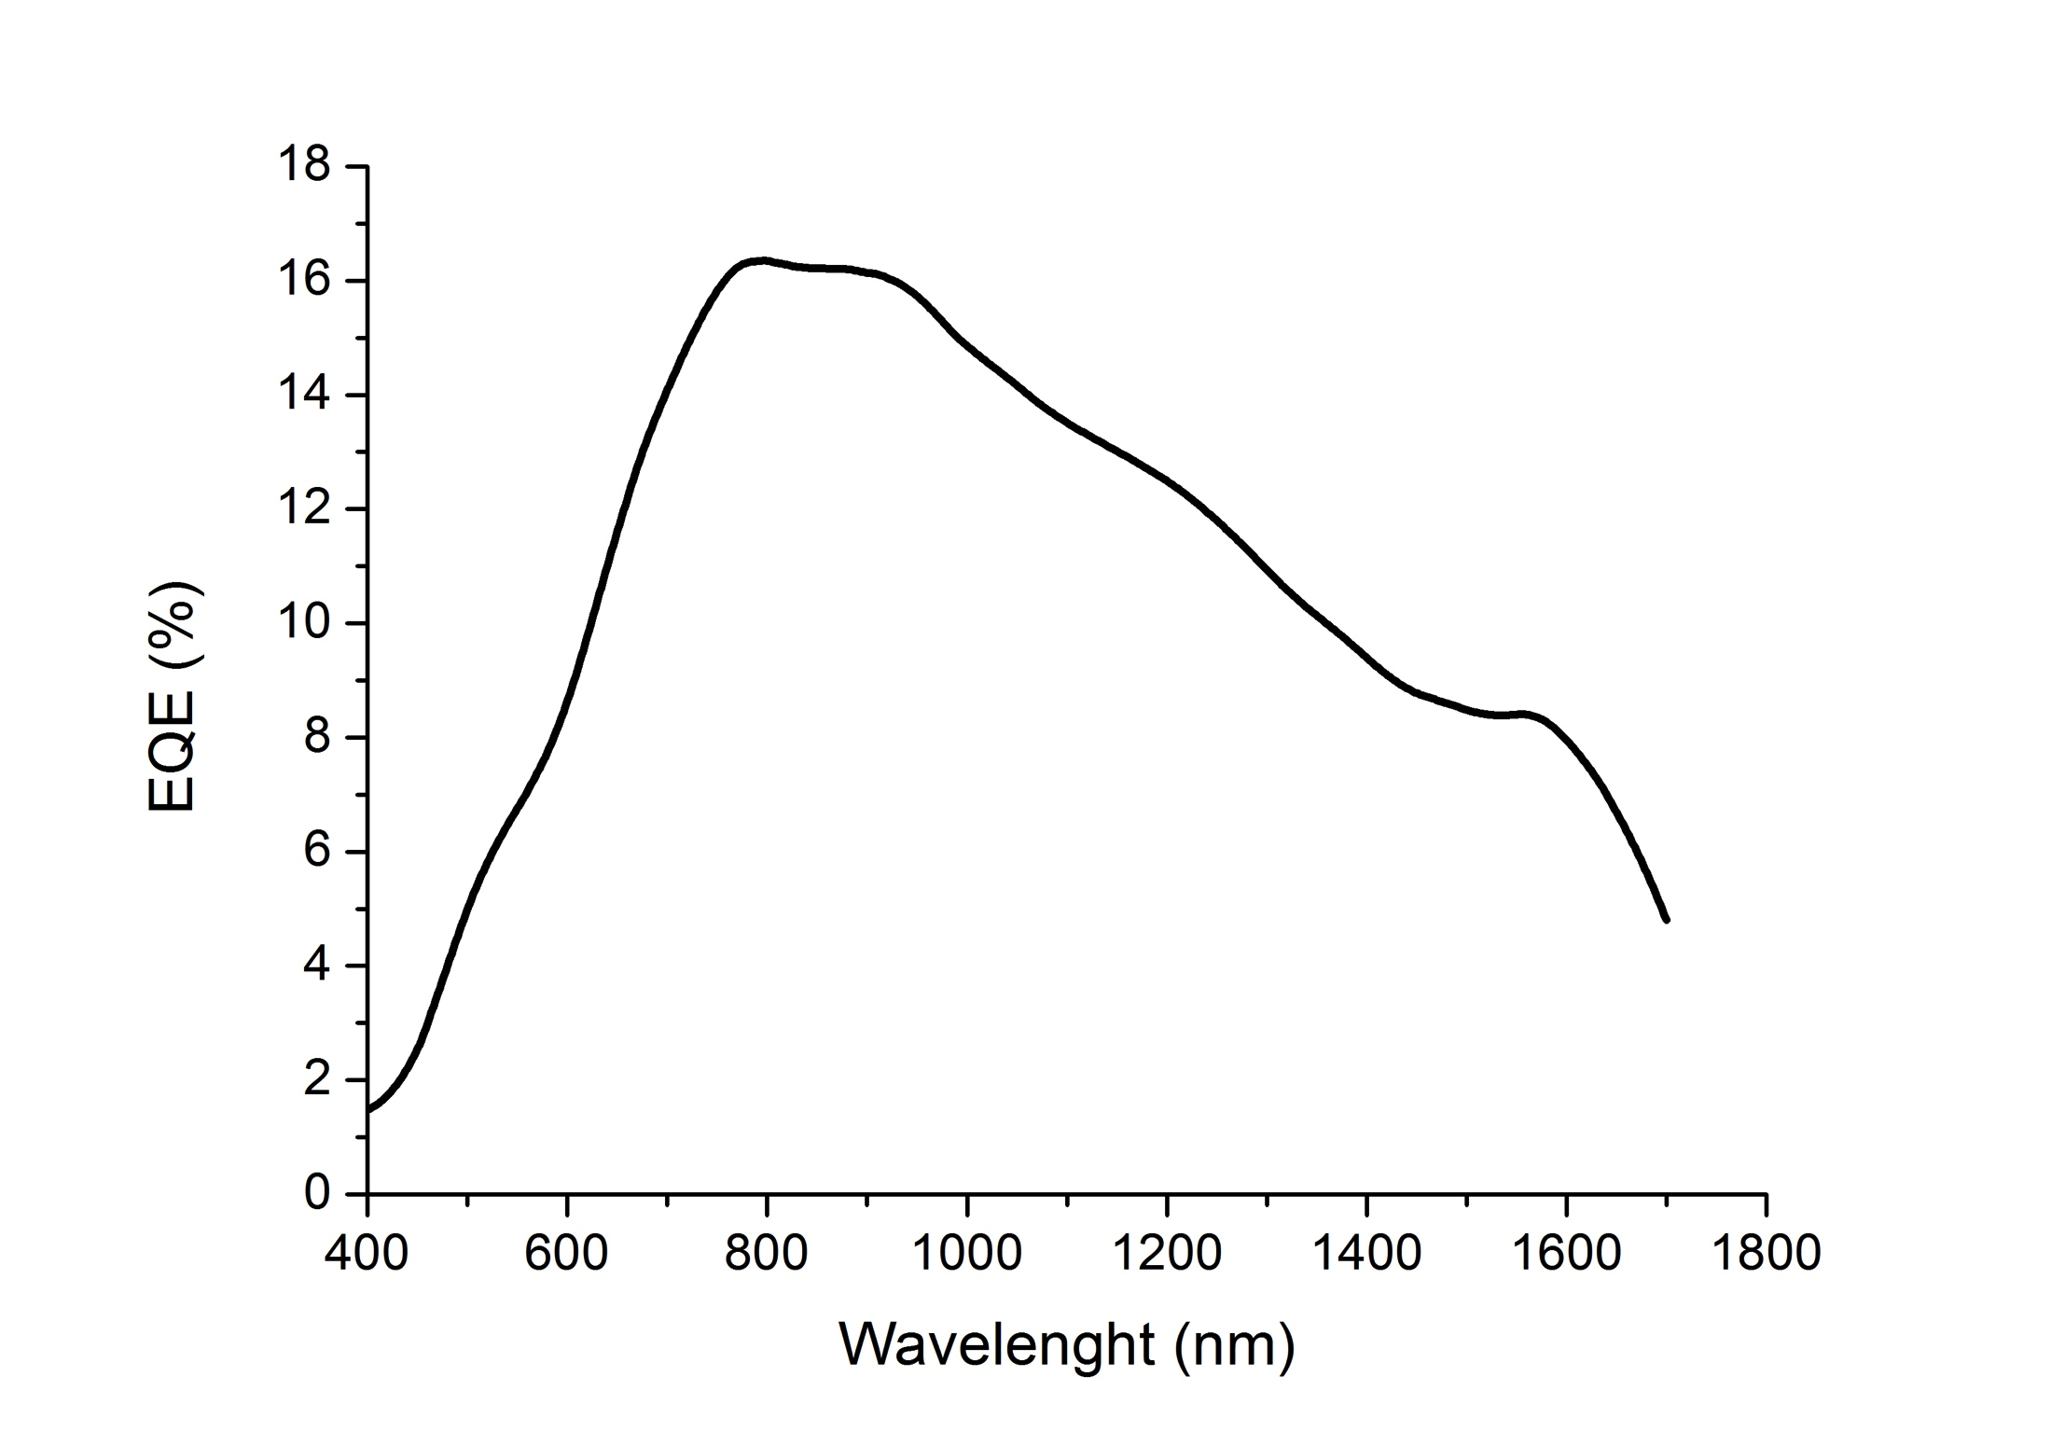
Photodetectors: Schottky
- PbS QDs prepared for absorption at NIR
- PbS QD films prepared by Dr Blade
The photodiodes are stable after several months even if response at visible decreases significantly
9/11

Slide 10
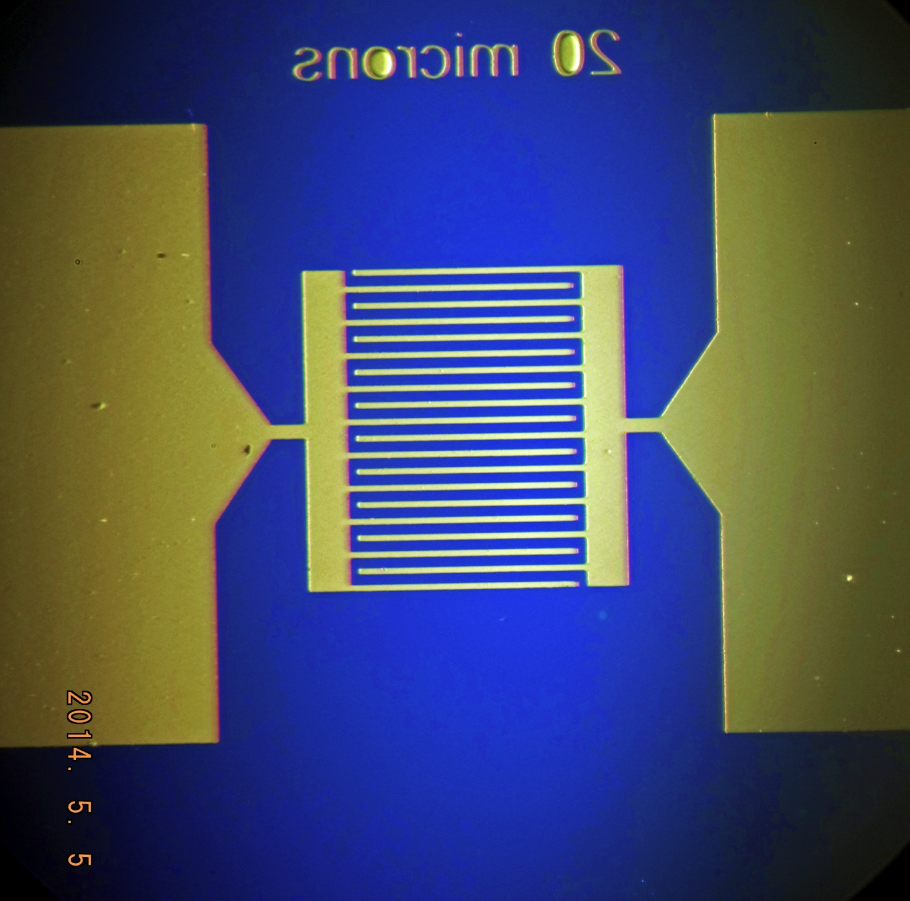
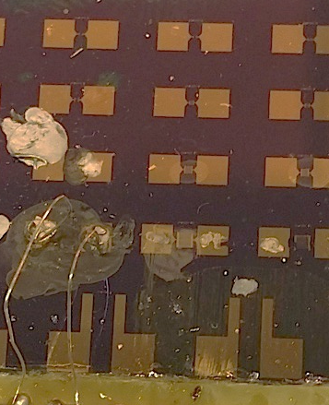
Photodetectors: Schottky
Currently working on microgap devices to optimize the layer deposition together with ligand exchange. Possibly we will try on nanogap without ligand exchange.
Applied voltages up to 100 V
Photocurrent up to 43 nW under some μW illumination at 1550 nm (possibly ligand exchange not produced)
10/11

Slide 11
Dissemination
Talk at ICTON 2014 (Graz, Austria):
“Photon plasmon coupling in nanocomposite plasmonic waveguides”
Summary of enhancement with CdSe QDs
Talk at Quantum Dot 2014 (Pisa, Italy)
“Colloidal QD-solid photodetectors produced by doctor-blanding based on two configuration gap vs Schottky/heterostructure”
Poster at 4th Int. Colloids Conf.: Surface Design & Engineering (Madrid, Spain)
“Fabrication of solution-processed QD-solids by doctor blading technique and their application for photodetection”
PhD work by Alberto Maulu on the subject of PbS-QD based photodetectors since April 2013
Paper accepted in Optics Letters
“Efficient excitation of photoluminescence in a two-dimensional waveguide consisting of a QD-polymer sandwich-type structure”
Dielectric waveguide based on CdSe close packed films
11/11

