Slide 1
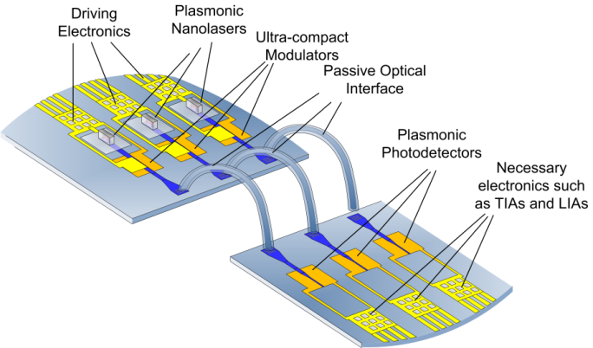
STMicroelectronics Progress Report

Slide 2
Status (1/2)
Once ST left WP6, all forecasted deliverables and milestones, except MS36 (DDCM evolution for NiP solutions), have been released
No feedback on how to go ahead with MS36, since no activity is now scheduled for that
My personal feeling is that we (ST) should declare no activity will be carried out on this topic since after reorganization the interest toward this approach is over

Slide 3
Status (2/2)
ST agreed to ask for the 9 months extension in order to allow the project to be completed successfully, however ST can not guarantee its commitment within the extra 9 months
No feedback yet about the status of FPGA related activity in KIT, so no idea about possible contingency plan

Slide 4
Next future
A basic support can be delivered till the completion of the third year (October the 31st 2014)
The more we approach the end of the third year, the more support activities will be difficult, due to deeper and deeper involvement in new group activities
Only management activities can be carried out till the actual end of the project

