Slide 1
Simulations of typical transceivers configurations based on VPI measurements
External modulation setup
Exported curves

Slide 2
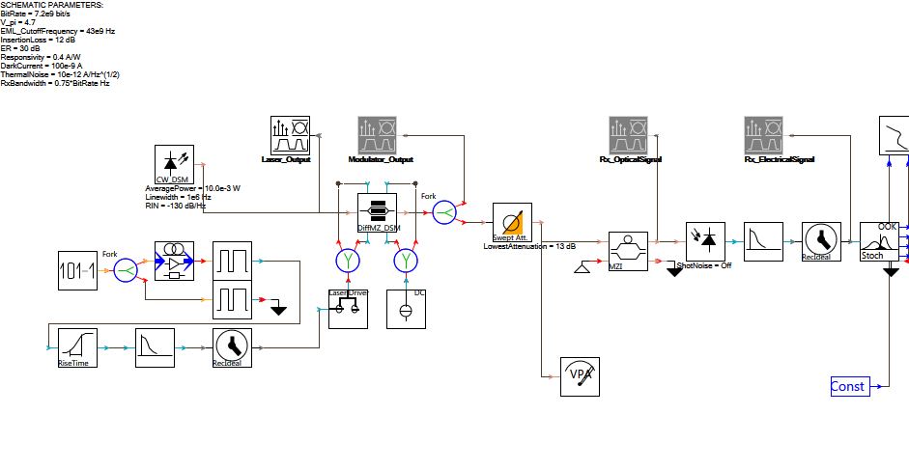
External Modulation scenario setup

Slide 3
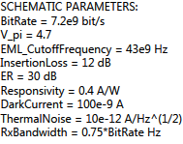
Set of critical parameters

Slide 4
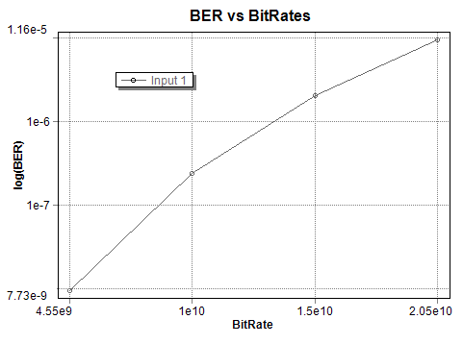

Slide 5
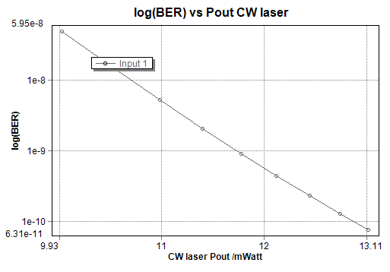

Slide 6
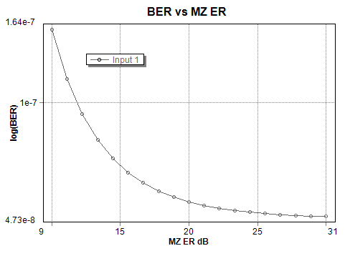

Slide 7
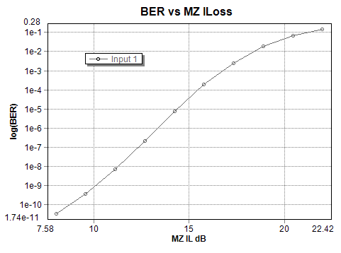

Slide 8
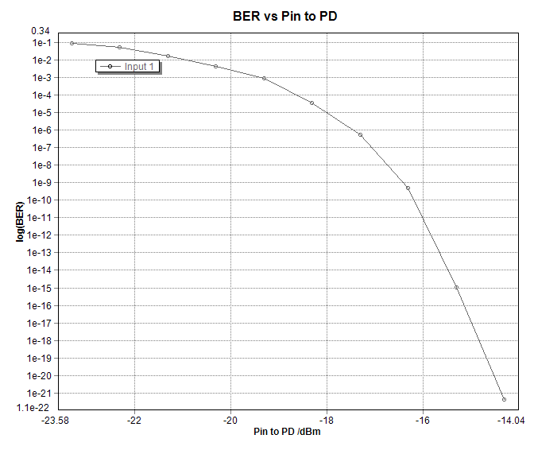

Slide 9
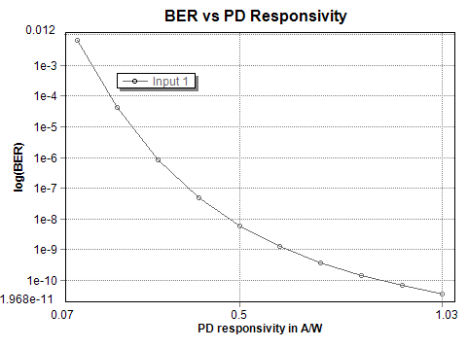

Slide 10
Action items for all partners
WP7 PR
Dissemination activities (papers in conferences, journals, etc.)
Exploitation activities (Theses, patents, etc.)
Promotion activities
Deadline: 7/10/2014

