Slide 1


NAVOLCHI - Nano Scale Disruptive Silicon-Plasmonic Platform for Chip-to-Chip Interconnection

Slide 2
AGENDA

Slide 3
Agenda
Welcome
Progress of work: Short report from every partner about status of work
Amendment
Open Deliverables and Milestones
Intermediate Review Report
Consortium / Intermediate Review Meeting
Open issues
Next TelConf

Slide 4
Status of Work:
Partner Presentations
  If appropriate: Discussion
Notes:
Partner presentations (10min each)
Institute / company (short)
Contribution to the project, own work effort and timeline (focus)

Slide 5
Amendment
Notes:
Partner presentations (10min each)
Institute / company (short)
Contribution to the project, own work effort and timeline (focus)

Slide 6
GA Amendment
- Amendment agreed by Commission!
- Modified Version of DoW at our WEB-Site
(https://www.imt.kit.edu/projects/navolchi/restricted/Administration/Files/NAVOLCHI%20DOW-2%202014-07-25.pdf)
- Modified Deliverables and Milestones
  D3.3 m24 → m33
  D4.5 m33 → m42
  D5.6 m30 → m39
  D5.7 m33 → m42
  D6.3, D6.4 m36 → m45
  D7.5 - D7.7 m36 → m45
  MS35, MS36, MS40 m30 → m39
  MS41, MS42 m33 → m42
  MS43, MS48, MS49 m36 → m45

Slide 7
  Deliverables & Milestones

Slide 8
Open Deliverables and Milestones
TUe: D6.1; (MS40 shifted to m39)
KIT: D6.2
AIT: D2.5; MS39 and MS7
IMEC: D4.4 and D5.7 (shifted to m42);
  MS33 and MS35 (shifted to m39)
UVEG: D4.5 (shifted to m42); MS24

Slide 9
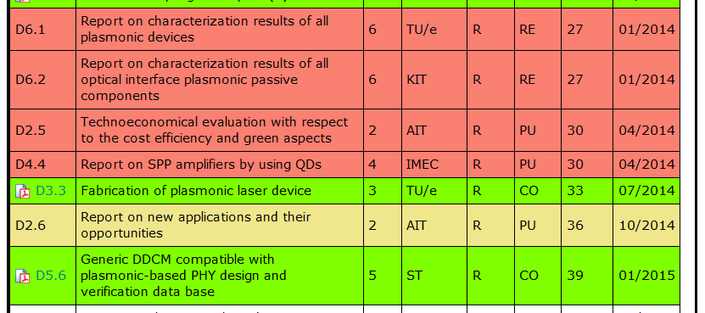
Open Deliverables

Slide 10
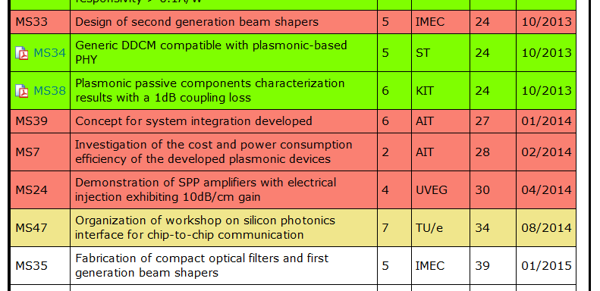
Open Milestones

Slide 11
Extension of Intermediate Review Report
Notes:
Partner presentations (10min each)
Institute / company (short)
Contribution to the project, own work effort and timeline (focus)

Slide 12
Input needed for Intermed’ Review Report
Extension of the Intermediate Review Report D1.5:
What has been achieved in the last 9 months?
Which deliverables and milestones have been delayed,
by how many months and what have been the reasons for that?
What are the remaining issues for the final 9 months?
Which goals of the DoW can be reached and which not?
All Partners are asked to comment on the above items and
to submit their contributions by October 8 !

Slide 13
Dates of Upcoming Consortium Meetings
Notes:
Partner presentations (10min each)
Institute / company (short)
Contribution to the project, own work effort and timeline (focus)

Slide 14
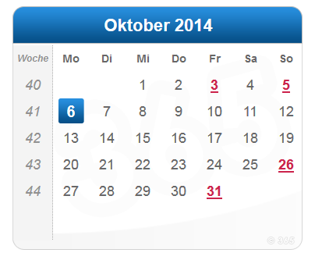
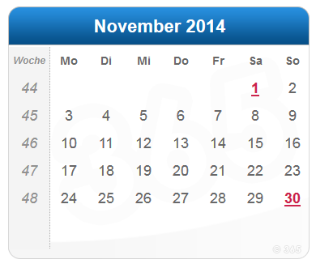
Dates of Upcoming Consortium Meetings
  Nov. 4./5. : Consortium and Review Meeting
  Oct. 22. : 10 days before: Documents at reviewers
  Oct. 15. : Final report, Ds and MSs to be sent from KIT
  Oct. 8. : All documents (IPR3, Ds and MSs) at KIT
  Oct. 27. : 2 pages per WP for Coordinator
  Oct. 6. (now) : Number of participants

Slide 15
  Open Issues
  Next Tel. Conf.

Slide 16
Open Issues
Any important things to discuss?

Slide 17
Next Phone Conference
First Monday of every month,
4:00 pm (CET)
December 1st, 2014

Slide 18
  Bye!

