Slide 1
NAVOLCHI - Nano Scale Disruptive Silicon-Plasmonic Platform for Chip-to-Chip Interconnection

Slide 2
AGENDA

Slide 3
Agenda
Welcome
Open deliverables and milestones, including new milestones 50 and 51
Preparation of next meeting and final report
Progress of work: Short report from every partner about status of work
Open issues
Next TelCo

Slide 4
Deliverables & Milestones
And New Milestones MS50 and MS51

Slide 5
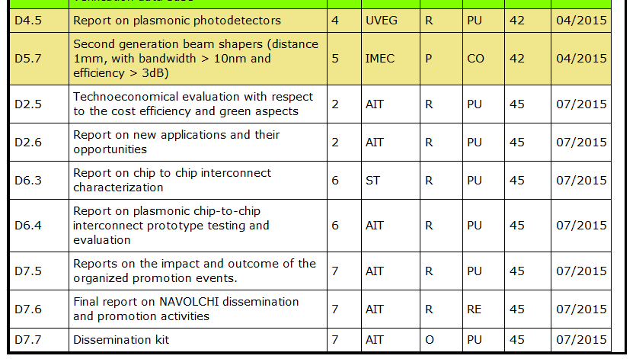
Open Deliverables

Slide 6
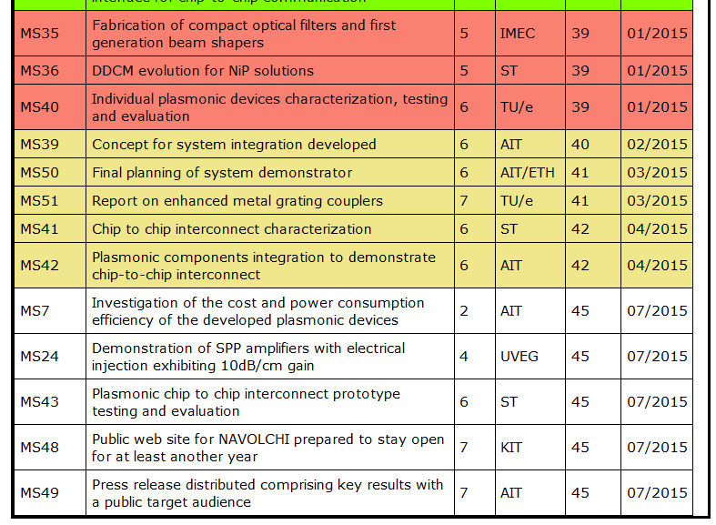
Open Milestones
!
→ ETH
!
→ ETH

Slide 7
Planning the Final Report
Notes:
Partner presentations (10min each)
Institute / company (short)
Contribution to the project, own work effort and timeline (focus)

Slide 8
Final Report
End of project: July 2015
Every WP leader is responsible to activate his WP-partners.
KIT will compile the input of all WP-leaders.
Template: Periodic report of month 18.
Keep summer break in mind!
A very draft version form all WP-leaders is expected by
end of June!

Slide 9
Planning the Next Consortium Meeting
Notes:
Partner presentations (10min each)
Institute / company (short)
Contribution to the project, own work effort and timeline (focus)

Slide 10
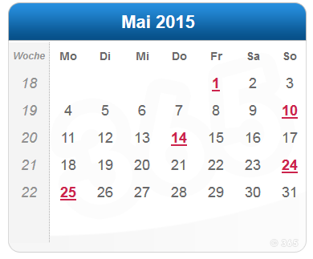
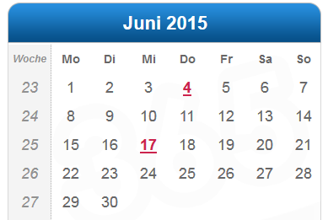
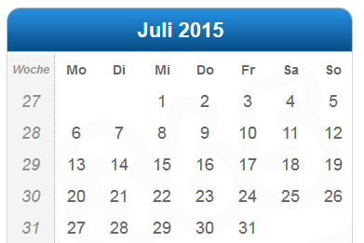
Next Meeting
When? Before summer?
Who might organise it?

Slide 11
Status of Work:
Partner Presentations
If Appropriate: Discussion
Notes:
Partner presentations (10min each)
Institute / company (short)
Contribution to the project, own work effort and timeline (focus)

Slide 12
Open Issues
Next Tel. Conf.

Slide 13
Open Issues
Any important things to discuss?

Slide 14
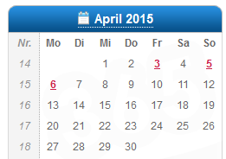
Next Phone Conference
(First) Monday of every month,
4:00 pm (CET)
April 13th, 2015

Slide 15
Bye!

Slide 16
Amendment
Notes:
Partner presentations (10min each)
Institute / company (short)
Contribution to the project, own work effort and timeline (focus)

Slide 17
GA Amendment
- Amendment agreed by Commission!
- Modified Version of DoW at our WEB-Site
(https://www.imt.kit.edu/projects/navolchi/restricted/Administration/Files/NAVOLCHI%20DOW-2%202014-07-25.pdf)
- Modified Deliverables and Milestones
D3.3 m24 → m33
D4.5 m33 → m42
D5.6 m30 → m39
D5.7 m33 → m42
D6.3, D6.4 m36 → m45
D7.5 - D7.7 m36 → m45
MS35, MS36, MS40 m30 → m39
MS41, MS42 m33 → m42
MS43, MS48, MS49 m36 → m45

