Slide 1


NAVOLCHI - Nano Scale Disruptive Silicon-Plasmonic Platform for Chip-to-Chip Interconnection

Slide 2
AGENDA

Slide 3
Agenda
Welcome
Open deliverables and milestones, including new milestones 50 and 51
Preparation of next meeting and final report
Progress of work: Short report from every partner about status of work
Open issues
Next TelCo

Slide 4
  Deliverables & Milestones
  And New Milestones MS50 and MS51

Slide 5
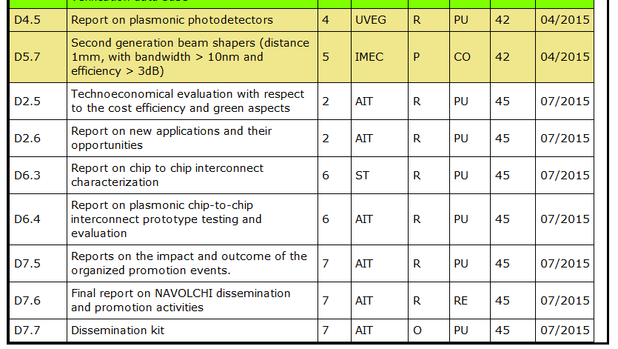
Open Deliverables

Slide 6
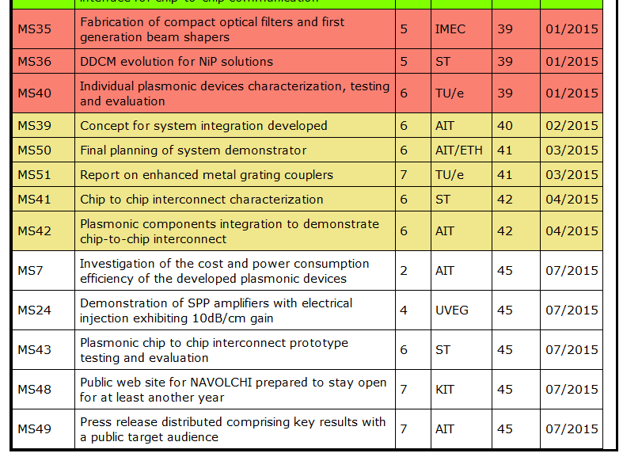
Open Milestones
!
→ ETH
!
→ ETH

Slide 7
Open Milestones
MS 35 should be submitted by IMEC soon as possible (due time: month 39)
MS 39: TU/E will provide updated information on the laser (including pulse shape) to AIT, who will take this information into account in the final version (to be submitted as soon as possible, due time: month 40)
MS 40: TU/E will include the outcome of laser characterization (to be submitted as soon as possible, due time: month 39)
MS 50: Decision on the development of an additional demonstrator besides the contingency plan by AIT and ETH on the basis of the new laser results. No direct modulated laser will be available for the demonstrator (to be submitted in March, due time: month 41)
MS 51: report on the improved metal grating coupler by TU/E (to be submitted in March, due time: month 41)

Slide 8
Planning the Final Report
Notes:
Partner presentations (10min each)
Institute / company (short)
Contribution to the project, own work effort and timeline (focus)

Slide 9
Final Report
End of project: July 2015
Every WP leader is responsible to activate his WP-partners.
KIT will compile the input of all WP-leaders.
Template: Periodic report of month 18.
Keep summer break in mind!
A very draft version form all WP-leaders is expected by
end of June!

Slide 10
Planning the Next Consortium Meeting
Notes:
Partner presentations (10min each)
Institute / company (short)
Contribution to the project, own work effort and timeline (focus)

Slide 11
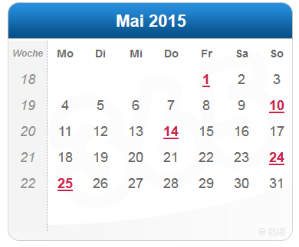
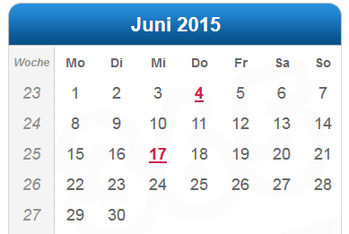
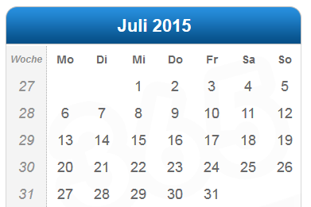
Next Meeting
When? Before summer?
Who might organise it?

Slide 12
Status of Work:
Partner Presentations
  If Appropriate: Discussion
Notes:
Partner presentations (10min each)
Institute / company (short)
Contribution to the project, own work effort and timeline (focus)

Slide 13
  Open Issues
  Next Tel. Conf.

Slide 14
Open Issues
Any important things to discuss?

Slide 15
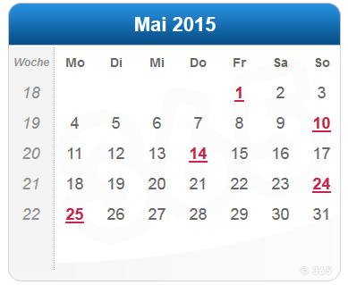
Next Phone Conference
(First) Monday of every month,
4:00 pm (CET)
May 4th, 2015

Slide 16
  Bye!

Slide 17
Amendment
Notes:
Partner presentations (10min each)
Institute / company (short)
Contribution to the project, own work effort and timeline (focus)

Slide 18
GA Amendment
- Amendment agreed by Commission!
- Modified Version of DoW at our WEB-Site
(https://www.imt.kit.edu/projects/navolchi/restricted/Administration/Files/NAVOLCHI%20DOW-2%202014-07-25.pdf)
- Modified Deliverables and Milestones
  D3.3 m24 → m33
  D4.5 m33 → m42
  D5.6 m30 → m39
  D5.7 m33 → m42
  D6.3, D6.4 m36 → m45
  D7.5 - D7.7 m36 → m45
  MS35, MS36, MS40 m30 → m39
  MS41, MS42 m33 → m42
  MS43, MS48, MS49 m36 → m45

